Slide 1
Association Rule Mining
CSC 466: Knowledge Discovery in Data
Instructor: Jonathan Ventura

Slide 2
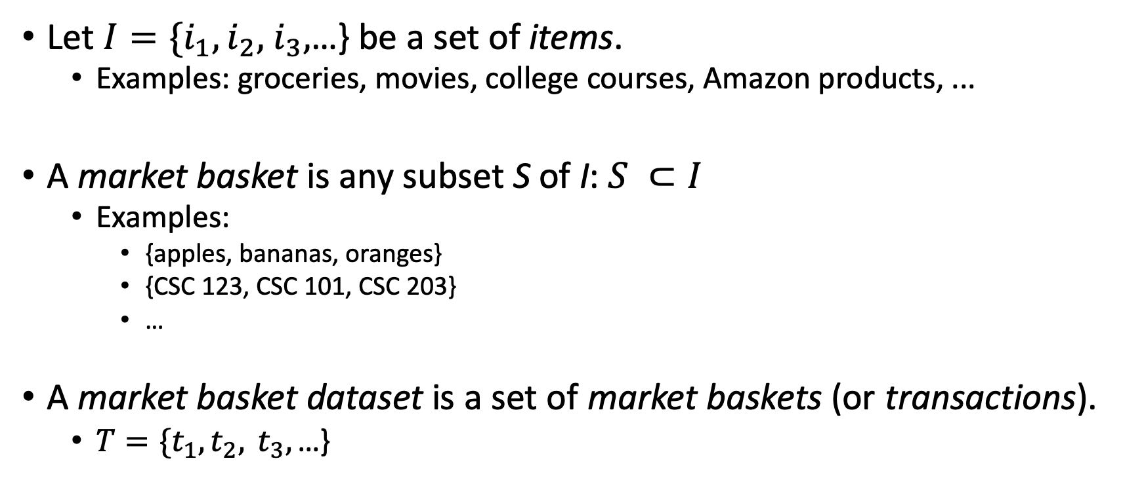
Market Basket Analysis
Let $I=\{i_{1},i_{2},$ $i_{3},$…} be a set of items.
  Examples: groceries, movies, college courses, Amazon products, ...
A market basket is any subset S of I: $S ⊂I$
  Examples:
    {apples, bananas, oranges}
    {CSC 123, CSC 101, CSC 203}
    …
A market basket dataset is a set of market baskets (or transactions).
  $T=\{t_{1},t_{2}, t_{3},\text{…\}}$

Slide 3
Example
Items: {apples, bananas, cheese, diapers}
Market basket dataset:
  {apples, bananas, diapers}
  {apples, cheese, diapers}
  {apples, bananas, cheese, diapers}
  {bananas, cheese, diapers}
  {apples, cheese, diapers}

Slide 4
Example
Items: {A, B, C, D}
Market basket dataset:
  {A, B, D}
  {A, C, D}
  {A, B, C, D}
  {B, C, D}
  {A, C, D}

Slide 5
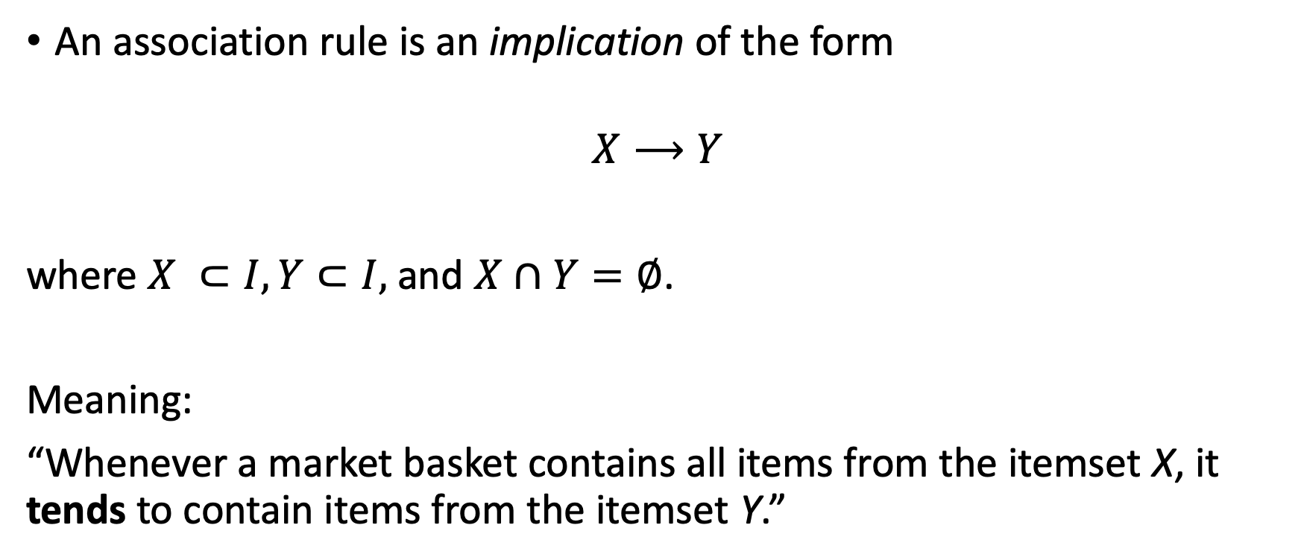
Association Rules
An association rule is an implication of the form
$$X⟶Y$$
where $X ⊂I,Y⊂I,$ and $X∩Y=∅$.
Meaning:
“Whenever a market basket contains all items from the itemset X, it tends to contain items from the itemset Y.”

Slide 6
Example
Items: {A, B, C, D}
Market basket dataset:
  {A, B, D}
  {A, C, D}
  {A, B, C, D}
  {B, C, D}
  {A, C}
Reasonable association rules for this dataset?

Slide 7
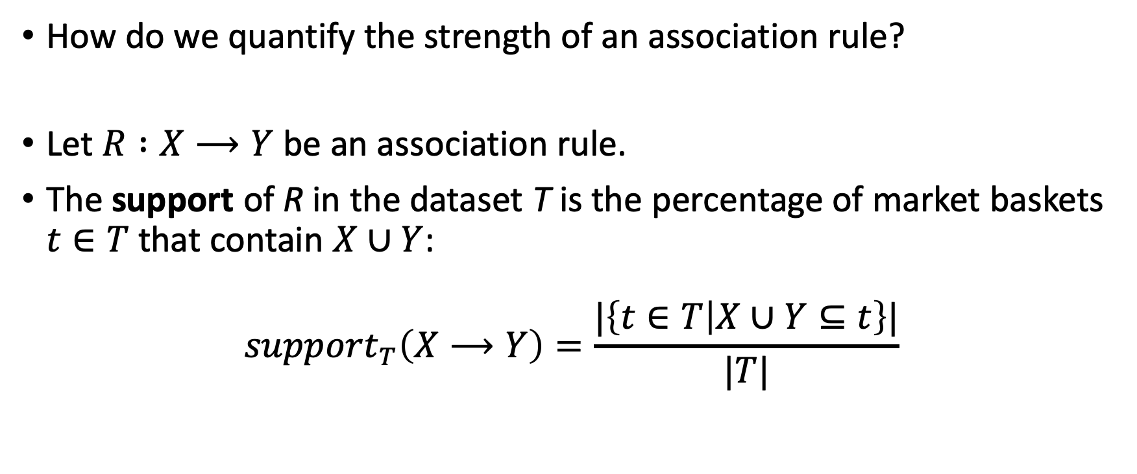
Support
How do we quantify the strength of an association rule?
Let $R :X⟶Y$ be an association rule.
The support of R in the dataset T is the percentage of market baskets $t∈T$ that contain $X∪Y$:
$${support}_{T}\left(X⟶Y\right)=\frac{|\left\{t∈T | X∪Y⊆t\right\}|}{|T|}$$

Slide 8
Example
Market basket dataset:
  {A, B, D}
  {A, C, D}
  {A, B, C, D}
  {B, C, D}
  {A, C}
Calculate support of:
  {A} -> {D}
  {A,C} -> {D}
  {A,B,C} -> {D}

Slide 9
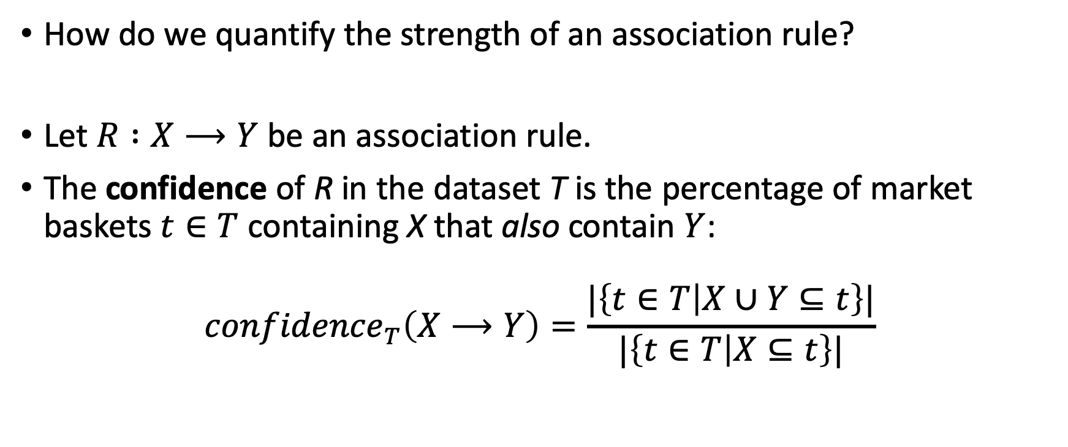
Confidence
How do we quantify the strength of an association rule?
Let $R :X⟶Y$ be an association rule.
The confidence of R in the dataset T is the percentage of market baskets $t∈T$ containing X that also contain $Y$:
$${confidence}_{T}\left(X⟶Y\right)=\frac{|\left\{t∈T | X∪Y⊆t\right\}|}{|\left\{t∈T | X⊆t\right\}|}$$

Slide 10
Example
Market basket dataset:
  {A, B, D}
  {A, C, D}
  {A, B, C, D}
  {B, C, D}
  {A, C}
Calculate confidence of:
  {A} -> {D}
  {A,C} -> {D}
  {A,B,C} -> {D}

Slide 11
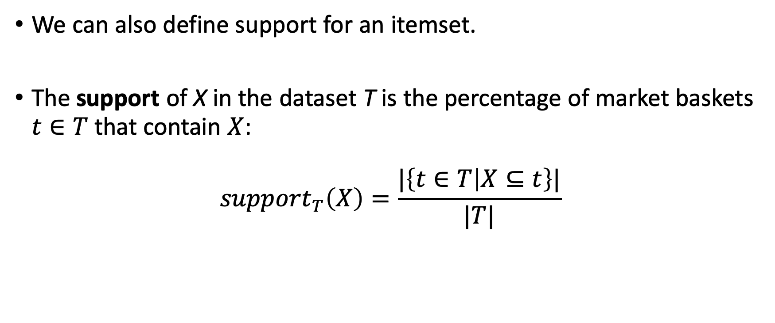
Support
We can also define support for an itemset.
The support of X in the dataset T is the percentage of market baskets $t∈T$ that contain $X$:
$${support}_{T}\left(X\right)=\frac{|\left\{t∈T | X⊆t\right\}|}{|T|}$$

Slide 12
Support and Confidence
Support of an association rule determines its coverage.
  Want to find association rules with high support, because such rules will be about transactions/market baskets that commonly occur.
Confidence of an association rule determines its predictability.
  Want to find association rules with high confidence, because such rules represent strong relationships between items.

Slide 13
Association Rules Mining Problem
Given a set of items I, a market basket dataset T and two numbers: minSup and minConf, find all association rules that occur with the support of at least minSup and confidence of at least minConf in T.

Slide 14
Example
Market basket dataset:
  {A, B, D}
  {A, C, D}
  {A, B, C, D}
  {B, C, D}
  {A, C}
Example association rules:
  {A} -> {D} support: 3/5 = 60% confidence: 3/4 = 75%
  {A,C} -> {D} support: 2/5 = 40% confidence: 2/3 = 67%
  {A,B,C} -> {D} support: 1/5 = 20% confidence: 1/1 = 100%

Slide 15
Example
Market basket dataset:
  {A, B, D}
  {A, C, D}
  {A, B, C, D}
  {B, C, D}
  {A, C}
minSup = 50%, minConf = 50%
  {A} -> {D} support: 3/5 = 60% confidence: 3/4 = 75%
  {A,C} -> {D} support: 2/5 = 40% confidence: 2/3 = 67%
  {A,B,C} -> {D} support: 1/5 = 20% confidence: 1/1 = 100%

Slide 16
Example
Market basket dataset:
  {A, B, D}
  {A, C, D}
  {A, B, C, D}
  {B, C, D}
  {A, C}
minSup = 20%, minConf = 80%:
  {A} -> {D} support: 3/5 = 60% confidence: 3/4 = 75%
  {A,C} -> {D} support: 2/5 = 40% confidence: 2/3 = 67%
  {A,B,C} -> {D} support: 1/5 = 20% confidence: 1/1 = 100%

Slide 17
Brute Force Algorithm
How could we find all association rules by a brute force algorithm?
Enumerate all possible association rules
  i.e., enumerate all possible disjoint X and Y subsets of I
Check support and confidence of each association rule

Slide 18
Brute Force Algorithm
Algorithm ARM_BRUTE_FORCE(T, I, minSup, minConf)
for each X such that X is a subset of I
for each Y such that Y is a subset of I
if X and Y are disjoint then
s := support(T, X->Y)
c := confidence(T, X->Y)
if (s > minSup) and (c > minConf) then output(X->Y)
end if
end for
end for

Slide 19
Example
Market basket dataset:
  {A, B, D}
  {A, C, D}
  {A, B, C, D}
  {B, C, D}
  {A, C}
Brute force with minSup=50%, minConf=50%:
  X = {A}, Y = {B} support: 2/5 = 40% confidence: 2/4=50%
  X = {A}, Y = {C} support: 3/5 = 60% confidence: 2/4=50%
  X = {A}, Y = {D} …
  X = {A}, Y = {B,C} …

Slide 20
Running time of Brute Force Algorithm
Algorithm ARM_BRUTE_FORCE(T, I, minSup, minConf)
for each X such that X is a subset of I
for each Y such that Y is a subset of I
if X and Y are disjoint then
s := support(T, X->Y)
c := confidence(T, X->Y)
if (s > minSup) and (c > minConf) then output(X->Y)
end if
end for
end for

Slide 21
Running time of Brute Force Algorithm
Exponential in number of items
  The algorithm won’t scale with large itemsets
Polynomial in number of transactions
  Need to read entire dataset from disk at each iteration
Not a practical algorithm for real-world datasets.

Slide 22
Pruning the search space
How can we more efficiently search the space of possible association rules?
Apriori Principle

Slide 23

Frequent Itemsets
An itemset $X⊆I$ is a frequent itemset iff ${support}_{T}\left(X\right)>minSup$.

Slide 24
Example
Market basket dataset:
  {A, B, D}
  {A, C, D}
  {A, B, C, D}
  {B, C, D}
  {A, C}
Frequent itemsets with minSup=50%:
  {A} support: 4/5 = 80%
  {B} support: 3/5 = 60%
  {C} support: 4/5 = 80%
  …
  {A,C} support: 3/5 = 60%
  …
  {A,B,C,D} support: 1/5 = 20%

Slide 25
Apriori Principle
The apriori principle states that:
If X is a frequent itemset in T, then every non-empty subset of X is also a frequent itemset in T.

Slide 26
Example
Market basket dataset:
  {A, B, D}
  {A, C, D}
  {A, B, C, D}
  {B, C, D}
  {A, C}
Frequent itemsets with minSup=50%:
  {A} support: 4/5 = 80%
  {B} support: 3/5 = 60%
  {C} support: 4/5 = 80%
  …
  {A,C} support: 3/5 = 60%
  …
  {A,B,C,D} support: 1/5 = 20%

Slide 27
Apriori Principle
The apriori principle states that:
If X is a frequent itemset in T, then every non-empty subset of X is also a frequent itemset in T.
Contrapositive:
If some subset of X is not a frequent itemset in T, then X is not a frequent itemset in T.

Slide 28
Example
A B C D
A,B A,C A,D B,C B,D C,D
A,B,C A,B,D A,C,D B,C,D
A,B,C,D
Market basket dataset:
  {A, B, D}
  {A, C, D}
  {A, B, C, D}
  {B, C, D}
  {A, C}

Slide 29
Example
A B C D
A,B A,C A,D B,C B,D C,D
A,B,C A,B,D A,C,D B,C,D
A,B,C,D
Market basket dataset:
  {A, B, D}
  {A, C, D}
  {A, B, C, D}
  {B, C, D}
  {A, C}

Slide 30
Example
A B C D
A,B A,C A,D B,C B,D C,D
A,B,C A,B,D A,C,D B,C,D
A,B,C,D
Market basket dataset:
  {A, B, D}
  {A, C, D}
  {A, B, C, D}
  {B, C, D}
  {A, C}
minSup = 50%

Slide 31
Apriori Algorithm
How is the apriori principle useful for association rules mining?
  Provides a way to prune the set of possible association rules
  If any subset of X is not a frequent itemset, then we don’t need to check whether X is a frequent itemset – we already know it can’t be by the apriori principle.

Slide 32
Example
A B C D
A,B A,C A,D B,C B,D C,D
A,B,C A,B,D A,C,D B,C,D
A,B,C,D
Market basket dataset:
  {A, B, D}
  {A, C, D}
  {A, B, C, D}
  {B, C, D}
  {A, C}
minSup = 50%

Slide 33
Apriori Algorithm
Finds frequent itemsets with support > minSup
  We will later break these sets into association rules
Level-wise search:
  First find all frequent itemsets of size 1,
  then all frequent itemsets of size 2,
  then all frequent itemsets of size 3,
  and so on.

Slide 34
Example
A B C D
Market basket dataset:
  {A, B, D}
  {A, C, D}
  {A, B, C, D}
  {B, C, D}
  {A, C}
minSup = 50%

Slide 35
Example
80%
60%
80%
80%
A B C D
Market basket dataset:
  {A, B, D}
  {A, C, D}
  {A, B, C, D}
  {B, C, D}
  {A, C}
minSup = 50%

Slide 36
Example
80%
60%
80%
80%
A B C D
A,B A,C A,D B,C B,D C,D
Market basket dataset:
  {A, B, D}
  {A, C, D}
  {A, B, C, D}
  {B, C, D}
  {A, C}
minSup = 50%

Slide 37
Example
A B C D
A,B A,C A,D B,C B,D C,D
Market basket dataset:
  {A, B, D}
  {A, C, D}
  {A, B, C, D}
  {B, C, D}
  {A, C}
minSup = 50%
40%
60%
60%
40%
60%
60%

Slide 38
Example
A B C D
A,B A,C A,D B,C B,D C,D
A,B,C A,B,D A,C,D B,C,D
Market basket dataset:
  {A, B, D}
  {A, C, D}
  {A, B, C, D}
  {B, C, D}
  {A, C}
minSup = 50%

Slide 39
Example
A B C D
A,B A,C A,D B,C B,D C,D
A,B,C A,B,D A,C,D B,C,D
Market basket dataset:
  {A, B, D}
  {A, C, D}
  {A, B, C, D}
  {B, C, D}
  {A, C}
minSup = 50%

Slide 40
Example
A B C D
A,B A,C A,D B,C B,D C,D
A,B,C A,B,D A,C,D B,C,D
Market basket dataset:
  {A, B, D}
  {A, C, D}
  {A, B, C, D}
  {B, C, D}
  {A, C}
minSup = 50%
40%

Slide 41
Example
A B C D
A,B A,C A,D B,C B,D C,D
A,B,C A,B,D A,C,D B,C,D
A,B,C,D
Market basket dataset:
  {A, B, D}
  {A, C, D}
  {A, B, C, D}
  {B, C, D}
  {A, C}
minSup = 50%

Slide 42
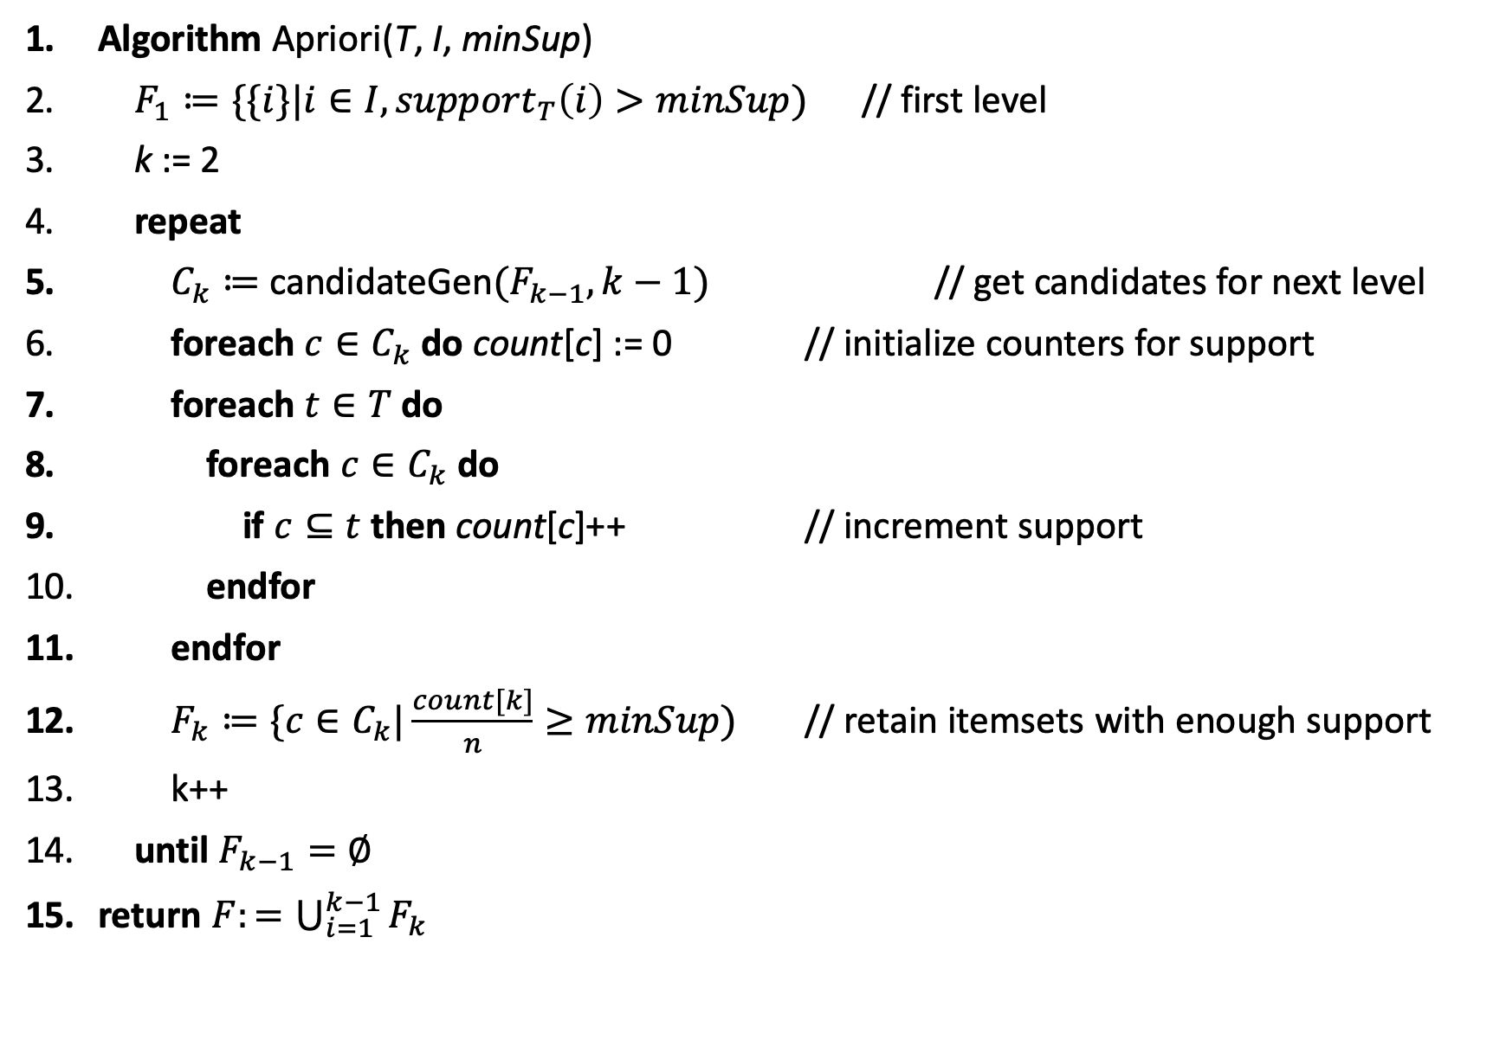
Algorithm Apriori(T, I, minSup)
$F_{1}≔\{\{i\}|i∈I, {support}_{T}\left(i\right)>minSup)$ // first level
k := 2
repeat
$C_{k}≔$ candidateGen${(F}_{k−1},k−1)$ // get candidates for next level
foreach $c∈C_{k}$ do count[c] := 0 // initialize counters for support
foreach $t∈T$ do
foreach $c∈C_{k}$ do
if $c⊆t$ then count[c]++ // increment support
endfor
endfor
$F_{k}≔\{c∈C_{k}|\frac{count[k]}{n}≥minSup)$ // retain itemsets with enough support
k++
until $F_{k−1}=∅$
return $F:=\bigcup_{i=1}^{k−1}{F_{k}}$

Slide 43
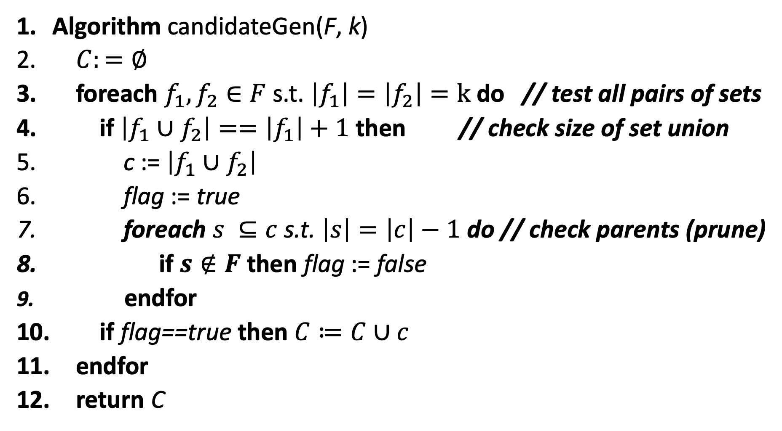
Algorithm candidateGen(F, k)
$C:=∅$
foreach $f_{1},f_{2}∈F$ s.t. $\left|f_{1}\right|=\left|f_{2}\right|=k$ do // test all pairs of sets
if $\left|f_{1}∪f_{2}\right|==\left|f_{1}\right|+1$ then // check size of set union
c := $\left|f_{1}∪f_{2}\right|$
flag := true
foreach $s ⊆c$ s.t. $\left|s\right|=\left|c\right|−1$ do // check parents (prune)
if $s∉F$ then flag := false
endfor
if flag==true then $C≔C∪c$
endfor
return C

Slide 44
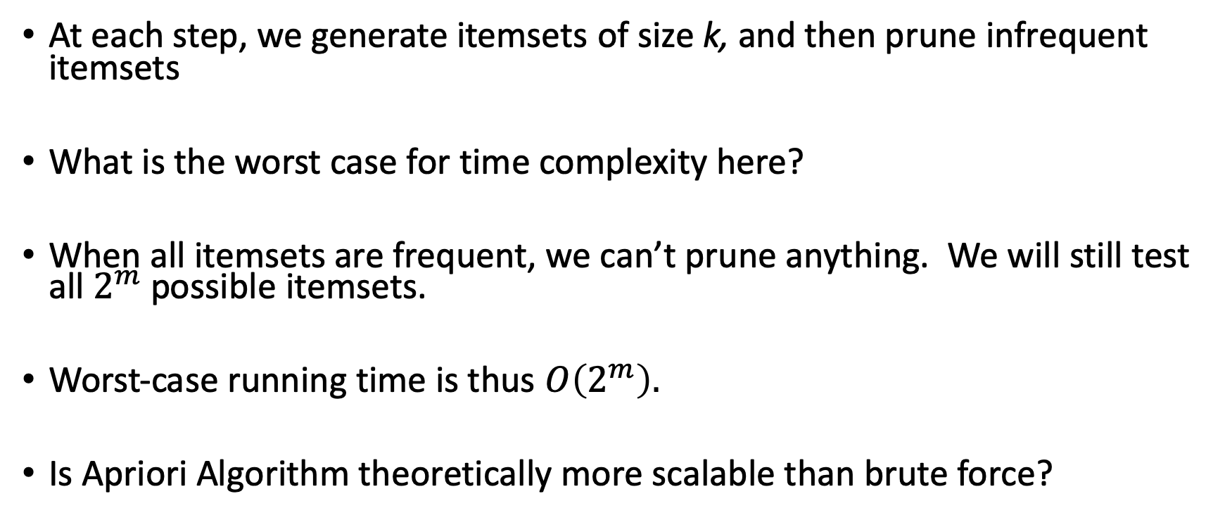
Worst-case complexity of Apriori Algorithm
At each step, we generate itemsets of size k, and then prune infrequent itemsets
What is the worst case for time complexity here?
When all itemsets are frequent, we can’t prune anything. We will still test all $2^{m}$ possible itemsets.
Worst-case running time is thus $O\left(2^{m}\right).$
Is Apriori Algorithm theoretically more scalable than brute force?

Slide 45
Heuristic Efficiency of Apriori Algorithm
The heuristic efficiency of the Apriori algorithm comes from the fact that typically observed market basket data is sparse.
This means that, in practice, relatively few itemsets, especially large itemsets, will be frequent.

Slide 46
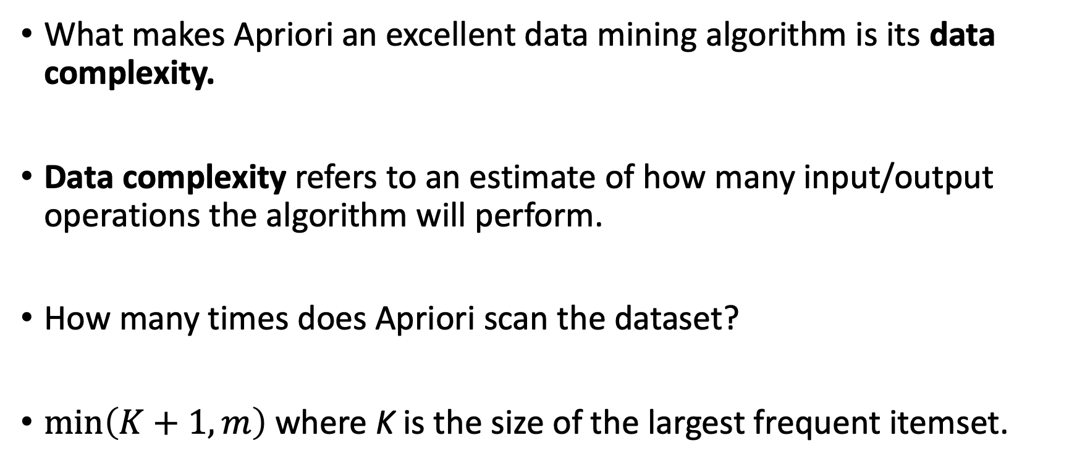
Data Complexity of Apriori Algorithm
What makes Apriori an excellent data mining algorithm is its data complexity.
Data complexity refers to an estimate of how many input/output operations the algorithm will perform.
How many times does Apriori scan the dataset?
$\min\left(K+1,m\right)$ where K is the size of the largest frequent itemset.

Slide 47
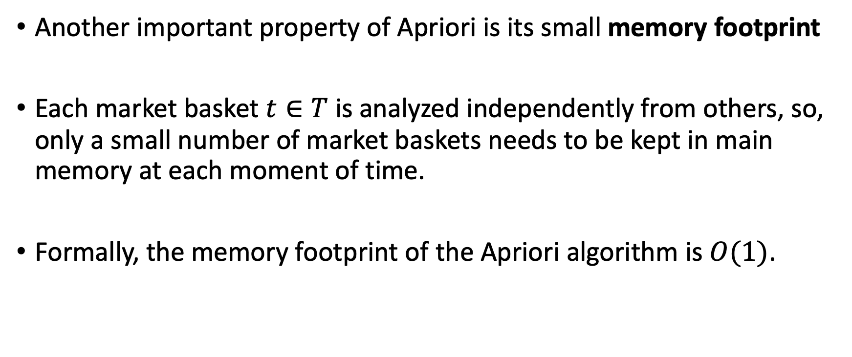
Memory Footprint of Apriori Algorithm
Another important property of Apriori is its small memory footprint
Each market basket $t∈T$ is analyzed independently from others, so, only a small number of market baskets needs to be kept in main memory at each moment of time.
Formally, the memory footprint of the Apriori algorithm is $O(1)$.

Slide 48
Level-wise Search
Each iteration of the Apriori produces frequent itemsets of specific size.
If larger frequent itemsets are not needed, the algorithm can stop after any iteration.

Slide 49
Finding Association Rules
The Apriori algorithm discovers frequent itemsets in the market basket data.
A collection of frequent itemsets can be be extended to a collection of association rules using algorithm genRules.

Slide 50
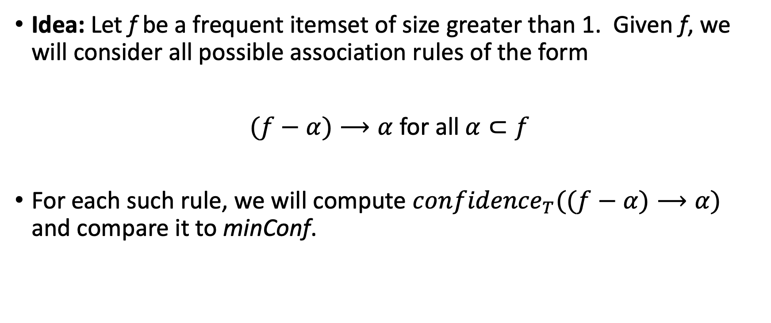
Finding Association Rules
Idea: Let f be a frequent itemset of size greater than 1. Given f, we will consider all possible association rules of the form
$(f−α)⟶α$ for all $α⊂f$
For each such rule, we will compute ${confidence}_{T}((f−α)⟶α)$ and compare it to minConf.

Slide 51
Level-wise Search for Association Rules
First find rules with one item on the right; check confidence
Then use candidateGen to join itemsets on the right; check confidence
Then three, four, …

Slide 52
Example
Market basket dataset:
  {A, B, D}
  {A, C, D}
  {A, B, C, D}
  {B, C, D}
  {A, C, D}
minSup = 50%
minConf = 50%
Frequent itemsets:
{A},{B},{C},{D}
{A,C},{B,D},{C,D}
{A,C,D}

Slide 53
Example
Association rules:
{A,C}
A -> C: confidence = 3/4 = 75%
C -> A: confidence = 3/4 = 75%
{B,D}
B -> D: confidence = 3/3 = 100%
D -> B: confidence = 3/5 = 60%
{C,D}
C -> D: confidence = 4/4 = 100%
D -> C: confidence = 4/5 = 80%
Market basket dataset:
  {A, B, D}
  {A, C, D}
  {A, B, C, D}
  {B, C, D}
  {A, C, D}
minSup = 50%
minConf = 50%

Slide 54
Example
Association rules:
{A,C,D}
A,C -> D: confidence = 3/3 = 100%
A,D -> C: confidence = 3/4 = 75%
C,D -> A: confidence = 3/4 = 75%
Combine right-hand sides to get more rules:
A -> C,D: confidence = 3/4 = 75%
C -> A,D: confidence = 3/4 = 75%
D -> A,C: confidence = 3/5 = 75%
Market basket dataset:
  {A, B, D}
  {A, C, D}
  {A, B, C, D}
  {B, C, D}
  {A, C, D}
minSup = 50%
minConf = 50%

Slide 55
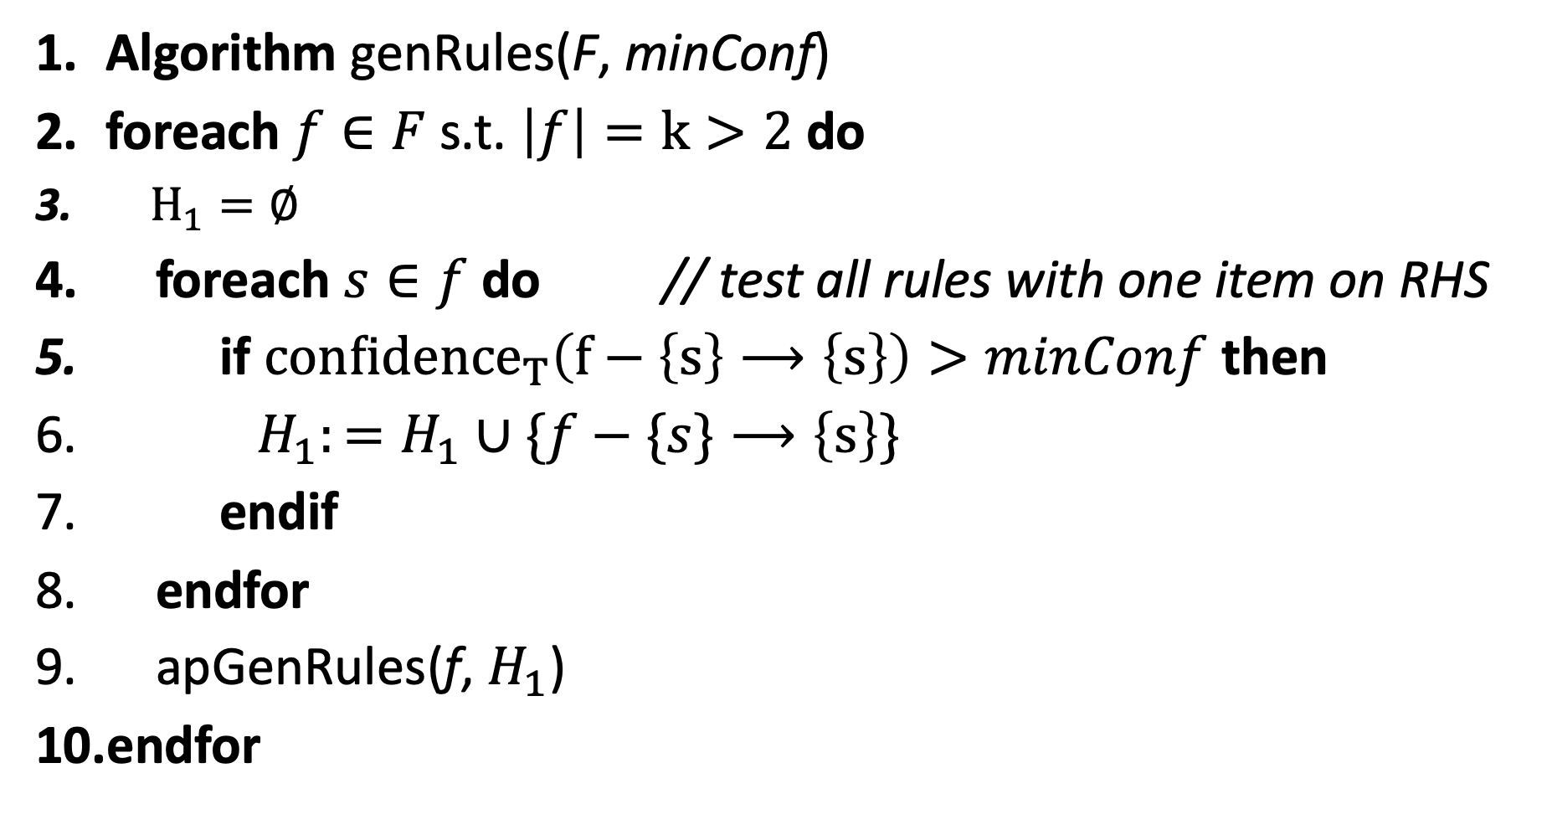
Algorithm genRules(F, minConf)
foreach $f∈F$ s.t. $\left|f\right|=k>2$ do
$H_{1}=∅$
foreach $s∈f$ do // test all rules with one item on RHS
if ${confidence}_{T}\left(f−\left\{s\right\}⟶\left\{s\right\}\right)>minConf$ then
$H_{1}:=H_{1}∪\{f−\{s\}⟶\left\{s\right\}\}$
endif
endfor
apGenRules(f, $H_{1}$)
endfor

Slide 56
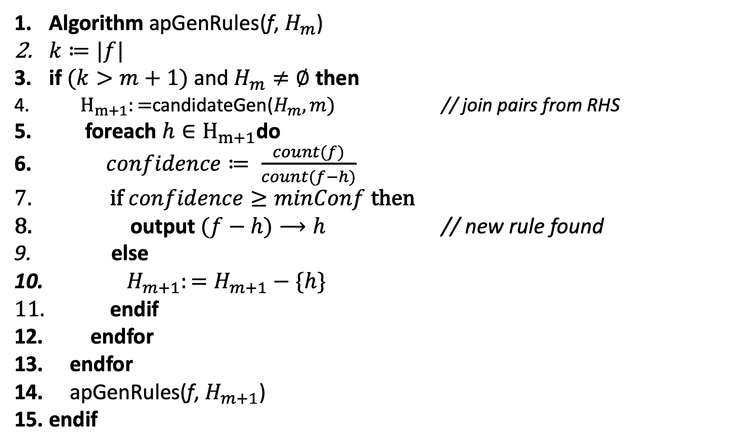
Algorithm apGenRules(f, $H_{m}$)
$k≔|f|$
if $(k>m+1)$ and $H_{m}≠∅$ then
${ H}_{m+1}:=$candidateGen($H_{m},m)$ // join pairs from RHS
foreach $h∈H_{m+1}$do
$confidence≔ \frac{count(f)}{count(f−h)}$
if $confidence≥minConf$then
output $(f−h)⟶h$ // new rule found
else
$H_{m+1}:=H_{m+1}−\{h\}$
endif
endfor
endfor
apGenRules(f, $H_{m+1}$)
endif

Slide 57
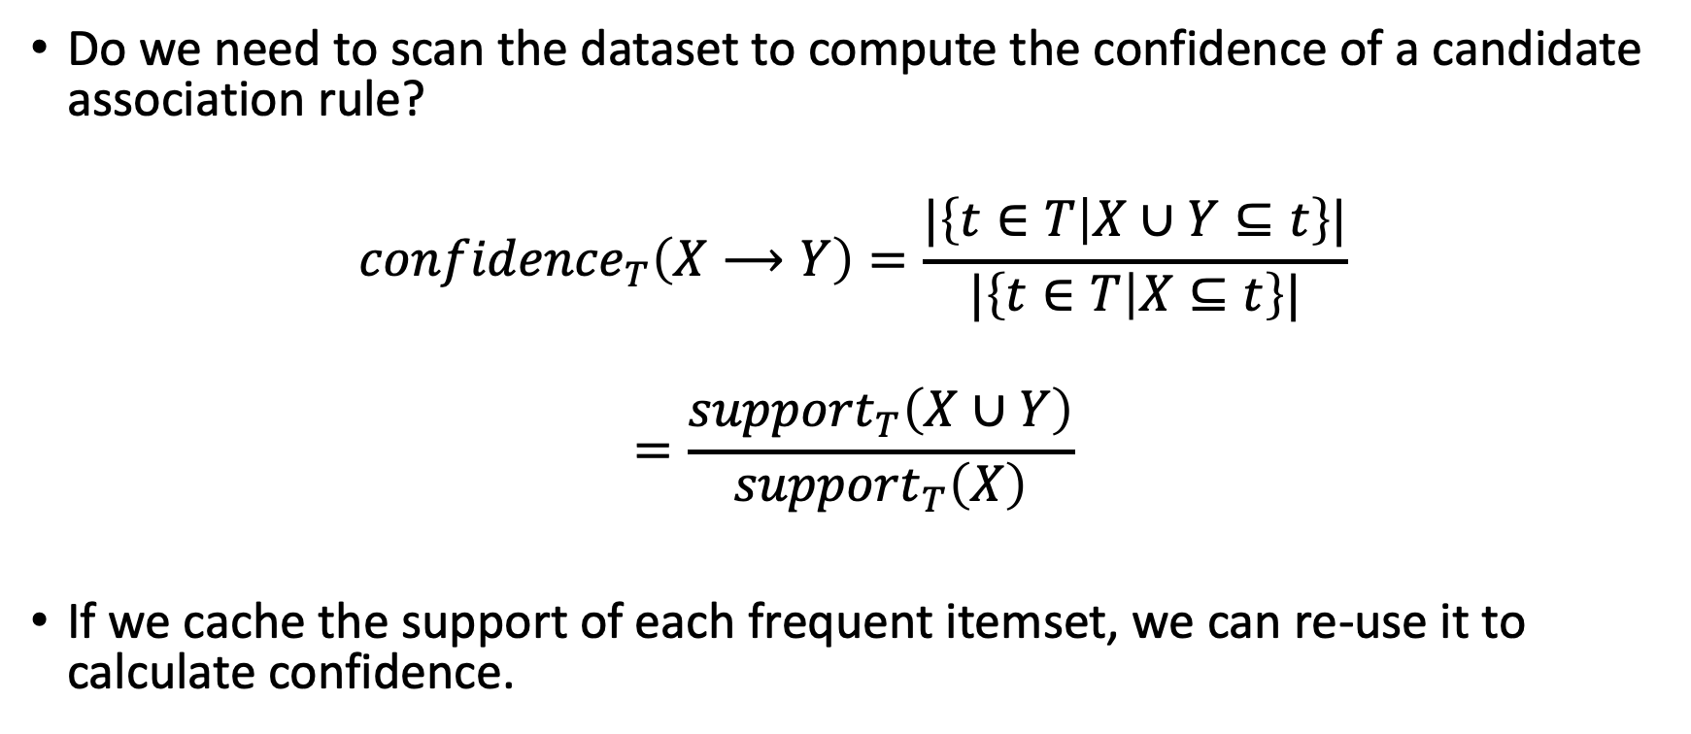
Calculating Confidence
Do we need to scan the dataset to compute the confidence of a candidate association rule?
$${confidence}_{T}\left(X⟶Y\right)=\frac{|\left\{t∈T | X∪Y⊆t\right\}|}{|\left\{t∈T | X⊆t\right\}|}$$
$$=\frac{{support}_{T}\left(X∪Y\right)}{{support}_{T}\left(X\right)}$$
If we cache the support of each frequent itemset, we can re-use it to calculate confidence.

Slide 58
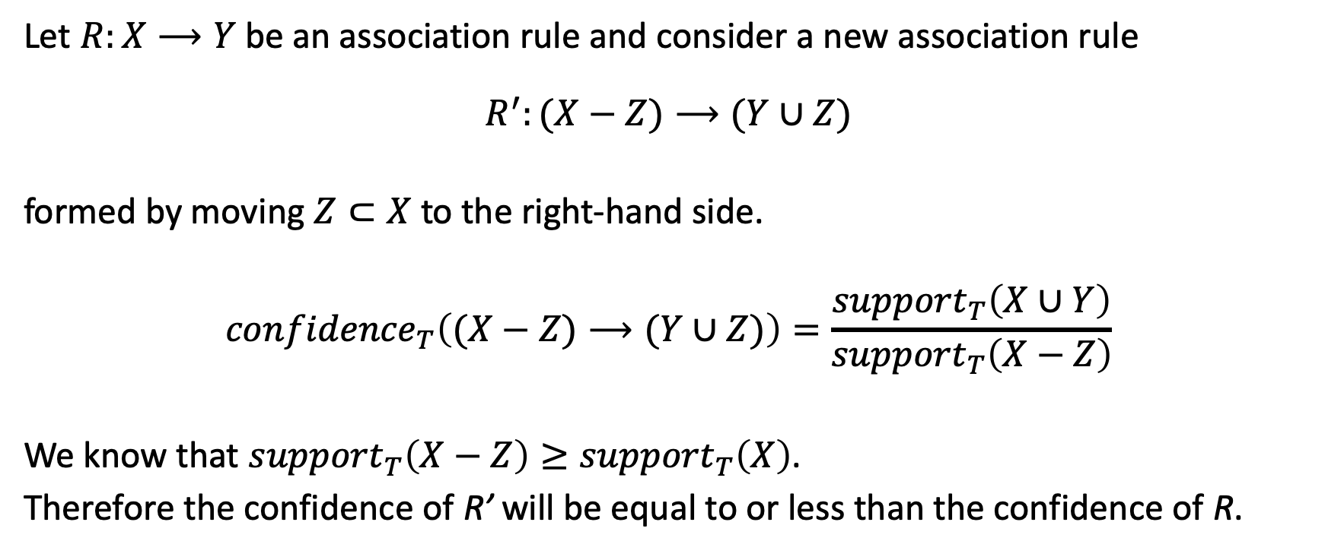
Apriori Principle for Association Rules
Let $R:X⟶Y$ be an association rule and consider a new association rule
$$R^{′}:(X−Z)⟶(Y∪Z)$$
formed by moving $Z⊂X$ to the right-hand side.
$${confidence}_{T}\left((X−Z)⟶(Y∪Z)\right)=\frac{{support}_{T}\left(X∪Y\right)}{{support}_{T}\left(X−Z\right)}$$
We know that ${support}_{T}\left(X−Z\right)≥{support}_{T}\left(X\right)$.
Therefore the confidence of R’ will be equal to or less than the confidence of R.

Slide 59
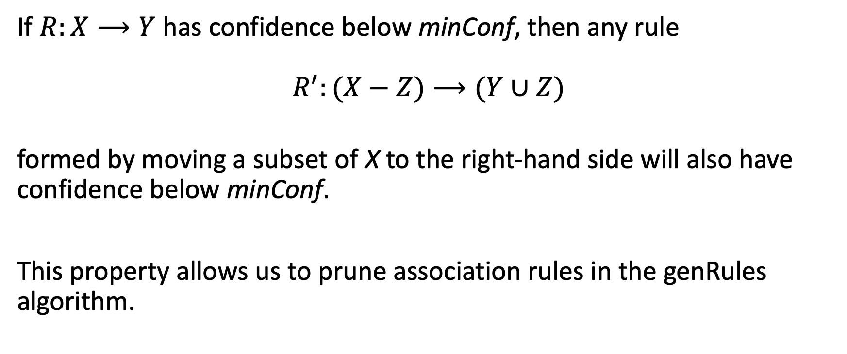
Apriori Principle for Association Rules
If $R:X⟶Y$ has confidence below minConf, then any rule
$$R^{′}:(X−Z)⟶(Y∪Z)$$
formed by moving a subset of X to the right-hand side will also have confidence below minConf.
This property allows us to prune association rules in the genRules algorithm.

Slide 60
Data Formats for Market Basket Analysis
Typically we assume that market baskets are relatively small, compared to the size of the inventory.
Two possible formats for market basket data:
  Dense: store as binary vector: 0,1,0,0,1,1,0
  Sparse: store as list of item indices: 1,4,5

Slide 61
Relational Data as Market Baskets
Student | CSC 365 | CSC 366 | CSC 480 | CSC 437 | CSC 408 | CSC 481
1 | 1 | 1 | 1 | 0 | 0 | 0
2 | 0 | 0 | 0 | 1 | 0 | 1
3 | 1 | 1 | 0 | 0 | 1 | 0
4 | 1 | 0 | 1 | 0 | 1 | 0
5 | 0 | 0 | 1 | 0 | 0 | 0
6 | 1 | 0 | 1 | 0 | 1 | 0

Slide 62
Relational Data as Market Baskets
Student | CSC 365 | CSC 366 | CSC 480 | CSC 437 | CSC 408 | CSC 481
1 | A | B | B
2 |  |  |  | A |  | A
3 | C | C |  |  | B
4 | C |  | B |  | A
5 |  |  | A
6 | C |  | B |  | B
Patterns?
How can we find these kinds of association rules?

Slide 63
Converting Relational Datasets into Market Baskets
Student | CSC 365-A | CSC 365-B | CSC 365-C | CSC 366-A | CSC 366-B | CSC 366-C
1 | 1 |  |  |  | 1
2
3 |  |  | 1 |  |  | 1
4 |  |  | 1
5
6 |  |  | 1

Slide 64
Handling Numerical Data
Employee | Years With Company | Salary (x1,000) | Position | Department
1 | 5 | 70 | Manager | Sales
2 | 23 | 105 | Head | HR
3 | 2 | 37 | Assistant | Production
4 | 3 | 70 | Associate | Analytics
5 | 16 | 85 | Senior Manager | Production

Slide 65
Handling Numerical Data
Employee | Years With Company | Salary (x1,000) | Position | Department
1 | 0-3 | 70 | Manager | Sales
2 | 20-30 | 86-110 | Head | HR
3 | 0-3 | 20-39 | Assistant | Production
4 | 0-3 | 65-85 | Associate | Analytics
5 | 11-20 | 65-85 | Senior Manager | Production
Idea: discretize numerical ranges
Years With Company
0-3
4-10
11-20
21-30
Salary
20-39
40-64
65-85
86-110

