Slide 1
Knowledge Discovery in Data
CSC 466: Knowledge Discovery in Data
Instructor: Jonathan Ventura

Slide 2
What is Knowledge Discovery in Data?
The process of discovering useful patterns or knowledge from (large) data sources.
Umbrella term including:
Pattern Matching and Discovery
Machine Learning
Information Retrieval

Slide 3
Data sources
Databases
Text
Images
World Wide Web
Streaming data (video, audio)
Structures (graphs, networks, etc.)

Slide 4
KDD is a multidisciplinary field
Databases
Statistics
Artificial Intelligence
Visualization
Linguistics

Slide 5
Examples of KDD applications
Google search
Grocery store discount cards
Coupons in the mail
Amazon “People who bought this also bought…”
Netflix movie recommendations
Spam filters
Targeted advertising
all the data you generate on Facebook and other social media platforms…
This course will provide a broad overview of KDD problems and techniques for solving them.

Slide 6
Topics covered
Association Rules Mining
Supervised Learning (Classification)
Unsupervised Learning (Clustering)
Collaborative Filtering and Recommender Systems
Information Retrieval
Link Analysis

Slide 7
Classification

Slide 8
Regression
Location regression
48.8566° N, 2.3522° E

Slide 9
Clustering
airplane
bird
dog

Slide 10
Dimensionality reduction
length
color
dimensionality reduction
car/truck
$$480×640×3$$
reduced space

Slide 11
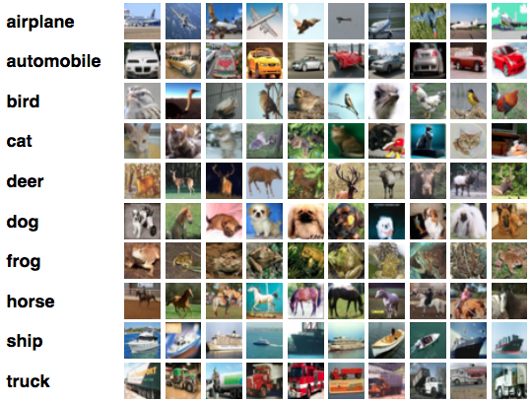
Supervised vs. Unsupervised
Labels = supervised

Slide 13
What is a dataset?
ID Number | Feature 1 | Feature 2 | Feature 3 … | Feature n
x₁ | x₁₁ | x₁₂ | x₁₃ | x₁₄
x₂ | x₂₁ | x₂₂ | x₂₃ | x₂₄
x₃ | x₃₁ | …
x₄ | x₄₁
x₅ | x₅₁
x₆ | x₆₁
x₇ | x₇₁
… | …
Table or matrix of data
Each row is an instance (vector) of data (a data point)
Each column is a different feature of the data -- a dimension of the data

Slide 14
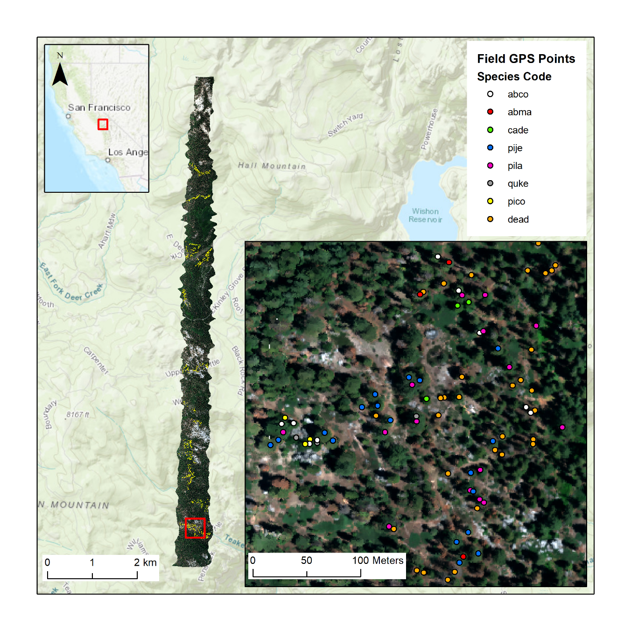

Slide 15
Classification
ID Number | Red channel | Green channel | Blue channel | Label
x₁ | 100 | 121 | 34 | Jeffrey Pine
x₂ | 24 | 35 | 67 | Oak
x₃ | 5 | 7 | 12 | Dead tree
x₄ | x₄₁ |  |  | …
x₅ | x₅₁
x₆ | x₆₁
x₇ | x₇₁
… | …
Last column provides “label” for each row
Goal is to learn how to predict the label column from the feature columns

Slide 16
Transects

Slide 17
Clustering
ID Number | Latitude | Longitude |  | Transect
x₁ | 100 | 121 |  | 1
x₂ | 24 | 124 |  | 2
x₃ | 5 | 120 |  | 4
x₄ | x₄₁ |  |  | …
x₅ | x₅₁
x₆ | x₆₁
x₇ | x₇₁
… | …
“Label” for each row is not in the dataset – it is not available to the ML algorithm
Goal is to group the data points in a meaningful way
Different clusterings of the same data may be useful and valid

Slide 18
What about you?
Why are you interested in KDD & ML?
What applications of KDD have you seen that have inspired or interested you?
What are you hoping to get out of this class?
Other questions / comments?

Slide 19
Next class: Association Rules Mining
ID Number | Diapers | Milk | Bagels | Orange Juice
x₁ | 0 | 1 | 1 | 1
x₂ | 0 | 1 | 0 | 1
x₃ | 1 | 1 | 1 | 1
x₄ | x₄₁ |  |  | …
x₅ | x₅₁
x₆ | x₆₁
x₇ | x₇₁
… | …
“Market basket” analysis
Discover patterns in sets of transactions, like “if you are buying milk and orange juice you are likely to buy bagels too”

Slide 20
Lab 1: Baby names
ID Number | First Name | Last Name | Year | State
x₁ | Jonathan | Ventura | 1983 | CA
x₂ | Olivia | Ventura | 2015 | CO
x₃ | Ethan | Ventura | 2019 | CA
x₄ | x₄₁ |  |  | …
x₅ | x₅₁
x₆ | x₆₁
x₇ | x₇₁
… | …
EDA: Exploratory Data Analysis
Discover, visualize & discuss interesting patterns in a baby names dataset
Work in teams
No need to use fancy KDD algorithms

