Slide 1

Causal-Association Network Extraction
平成弐拾年クリスマス
Brett Bojduj
ボイドイ・ブレツ

Slide 2
Main Contributions
Automatically create Causal-Association Network from unstructured text data
Method for filtering out non-causal sentences
Method for determining polarity of causal relation
Notes:
Pic inside

Slide 3
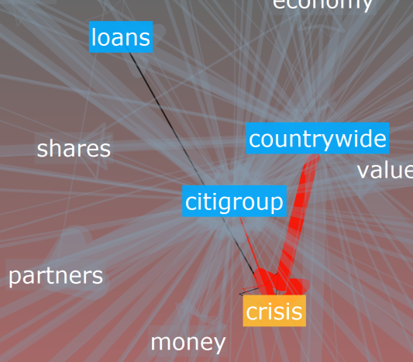
Causal-Association Network
Graph of domain terms
  Directed
  Polarity
    Positive, negative, or neutral
Purpose is to aid decision-making
  Tools such as the “simulation” mode, help to promote creative interaction

Slide 4
Features
Network Simulation
Causal-Association Network
Cause & Effect
Our System
Polarity

Slide 5
Tuple Extraction
Query (Yahoo!)
Extract Tuples
Filter Sentences
Extract Sentences
Score Terms in Tuples
Generate New Queries

Slide 6
Query (Yahoo!)
Query (Yahoo!)
Extract Tuples
Filter Sentences
Extract Sentences
Score Terms in Tuples
Generate New Queries
Term DB
VerbDB
Citigroup
causes

Slide 7
Extract Sentences
Query (Yahoo!)
Extract Tuples
Filter Sentences
Extract Sentences
Score Terms in Tuples
Generate New Queries
Citigroup causes depression.
Citigroup supports causes.
Term DB
VerbDB
Citigroup
causes

Slide 8
Filter Sentences
Query (Yahoo!)
Extract Tuples
Filter Sentences
Extract Sentences
Score Terms in Tuples
Generate New Queries
Citigroup causes depression.
Citigroup supports causes.
Bayesian Filter
Citigroup causes depression.

Slide 9
Extract Tuples
Query (Yahoo!)
Extract Tuples
Filter Sentences
Extract Sentences
Score Terms in Tuples
Generate New Queries
Citigroup causes depression.
Sentence Parser
<citigroup, causes, depression>

Slide 10
Score Terms in Tuples
Query (Yahoo!)
Extract Tuples
Filter Sentences
Extract Sentences
Score Terms in Tuples
Generate New Queries
Term | Frequency | Score
Citigroup | 10 | 101
Depression | 3 | 10
Picture | 1 | 2

Slide 11
Generate New Queries
Query (Yahoo!)
Extract Tuples
Filter Sentences
Extract Sentences
Score Terms in Tuples
Generate New Queries
Term DB
Term | Frequency | Score
Citigroup | 10 | 101
Depression | 3 | 10
Picture | 1 | 2

Slide 12
Query (Yahoo!)
Queries generated from terms and verbs
  Terms: “bankruptcy,” “oil prices,” “recession”
  Causal verbs: troponyms of verb “cause” from WordNet with pluralizations (94 verbs)
Query structure:
  TERM * VERB
  VERB * TERM
  e.g. “oil prices * cause”
Query (Yahoo!)
Extract Tuples
Filter Sentences
Extract Sentences
Score Terms in Tuples
Generate New Queries

Slide 13
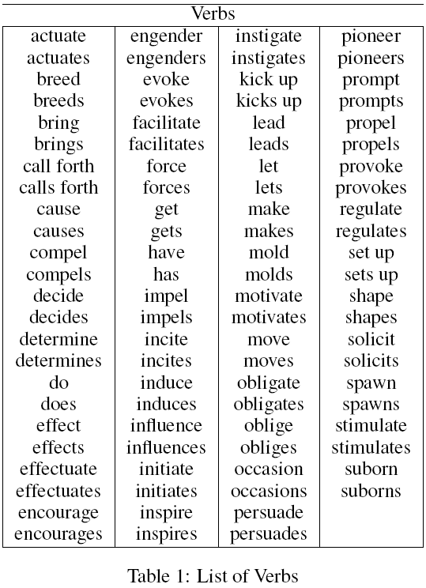
Query (Yahoo!) – Verb List
Query (Yahoo!)
Extract Tuples
Filter Sentences
Extract Sentences
Score Terms in Tuples
Generate New Queries

Slide 14
Extract Sentences
E.g.: “Citigroup causes a global economic crisis.”
Sentence has TERM + VERB
Save Sentence to DB
Query (Yahoo!)
Extract Tuples
Filter Sentences
Extract Sentences
Score Terms in Tuples
Generate New Queries

Slide 15
Filter Sentences
Many errors in cause and effect extraction are caused by trying to extract from sentences that do not contain a causal relation.
  E.g. “Scientists predict that effects of global warming will take many decades.”
Our remedy to this:
Bayesian Classifier
Binary Classify as Causal or Not
Only Process Causal Sentences
Query (Yahoo!)
Extract Tuples
Filter Sentences
Extract Sentences
Score Terms in Tuples
Generate New Queries
Notes:
Simple plz

Slide 16
Bayesian Causal Classifier
Features:
Bag of words without common words
Decreasing words marked with “_dec” tag and original word is also kept
Causal verbs are marked with “_verb” tag and original word is also kept
Verb patterns plus phrase “verbPatt”
Word Patterns plus the phrase “wordPatt”
Query (Yahoo!)
Extract Tuples
Filter Sentences
Extract Sentences
Score Terms in Tuples
Generate New Queries

Slide 17
Bayesian Causal Classifier Results
Precision: 71.7%
Recall: 94.3%
F-Score: 81.5%
Results from 15-fold cross-validation on 1,500 annotated sentences
Possible features: CIDVSPW
 | PrecisionYes | RecallYes | F-ScoreYes | PrecisionNo | RecallNo | F-ScoreNo
Baseline | 65.38461538 | 59.13043478 | 62.10045662 | 82.65682657 | 86.15384615 | 84.36911488
C | 62.58064516 | 63.26086957 | 62.91891892 | 83.67149758 | 83.26923077 | 83.46987952
CD | 62.42038217 | 63.91304348 | 63.15789474 | 83.86783285 | 82.98076923 | 83.42194297
CDP | 69.17808219 | 87.82608696 | 77.39463602 | 93.88646288 | 82.69230769 | 87.93456033
CDPW | 70.40650407 | 94.13043478 | 80.55813953 | 96.94915254 | 82.5 | 89.14285714
CDS | 61.61616162 | 66.30434783 | 63.87434555 | 84.57711443 | 81.73076923 | 83.12958435
CDSP | 67.71523179 | 88.91304348 | 76.87969925 | 94.30803571 | 81.25 | 87.29338843
CDSPW | 68.77971474 | 94.34782609 | 79.56003666 | 97.00805524 | 81.05769231 | 88.31849136
CDSW | 68.24104235 | 91.08695652 | 78.02607076 | 95.3724605 | 81.25 | 87.74662513
CDV | 63.55748373 | 63.69565217 | 63.62649294 | 83.92685274 | 83.84615385 | 83.88648389
CDVP | 70.38327526 | 87.82608696 | 78.14313346 | 93.9524838 | 83.65384615 | 88.50457782
CDVPW | 71.73553719 | 94.34782609 | 81.50234742 | 97.09497207 | 83.55769231 | 89.81912145
CDVS | 62.44813278 | 65.43478261 | 63.90658174 | 84.38113949 | 82.59615385 | 83.47910593
CDVSP | 68.76061121 | 88.04347826 | 77.21639657 | 93.96267838 | 82.30769231 | 87.74987186
CDVSPW | 70.01620746 | 93.91304348 | 80.22284123 | 96.82899207 | 82.21153846 | 88.92355694
CDVSW | 69.23076923 | 90 | 78.26086957 | 94.90022173 | 82.30769231 | 88.15653965
CDVW | 70.89041096 | 90 | 79.31034483 | 94.97816594 | 83.65384615 | 88.95705521
CDW | 69.84924623 | 90.65217391 | 78.9025544 | 95.23809524 | 82.69230769 | 88.52290273
CI | 62.55230126 | 65 | 63.75266525 | 84.24657534 | 82.78846154 | 83.51115422
CID | 62.31884058 | 65.43478261 | 63.8388123 | 84.36578171 | 82.5 | 83.42245989
CIDP | 68.6440678 | 88.04347826 | 77.14285714 | 93.95604396 | 82.21153846 | 87.69230769
CIDPW | 69.88727858 | 94.34782609 | 80.2960222 | 97.04209329 | 82.01923077 | 88.90046899
CIDS | 61.30952381 | 67.17391304 | 64.10788382 | 84.83935743 | 81.25 | 83.00589391
CIDSP | 67.21311475 | 89.13043478 | 76.63551402 | 94.38202247 | 80.76923077 | 87.04663212
CIDSPW | 68.23899371 | 94.34782609 | 79.19708029 | 96.99074074 | 80.57692308 | 88.02521008
CIDSW | 67.74193548 | 91.30434783 | 77.77777778 | 95.45454545 | 80.76923077 | 87.5
CIDV | 63.48195329 | 65 | 64.23200859 | 84.3537415 | 83.46153846 | 83.90526825
CIDVP | 69.94818653 | 88.04347826 | 77.95957652 | 94.02823018 | 83.26923077 | 88.32228455
CIDVPW | 71.31147541 | 94.56521739 | 81.30841121 | 97.19101124 | 83.17307692 | 89.6373057
CIDVS | 62.44897959 | 66.52173913 | 64.42105263 | 84.75247525 | 82.30769231 | 83.51219512
CIDVSP | 68.51851852 | 88.47826087 | 77.22960152 | 94.15011038 | 82.01923077 | 87.66700925
CIDVSPW | 69.72624799 | 94.13043478 | 80.11100833 | 96.92832765 | 81.92307692 | 88.79624805
CIDVSW | 68.98839138 | 90.43478261 | 78.26904986 | 95.09476031 | 82.01923077 | 88.07434177
CIDVW | 70.50847458 | 90.43478261 | 79.23809524 | 95.16483516 | 83.26923077 | 88.82051282
CIDW | 69.37086093 | 91.08695652 | 78.7593985 | 95.42410714 | 82.21153846 | 88.32644628
CIP | 68.76061121 | 88.04347826 | 77.21639657 | 93.96267838 | 82.30769231 | 87.74987186
CIPW | 70.11308562 | 94.34782609 | 80.44485635 | 97.04880817 | 82.21153846 | 89.01613743
CIS | 61.47704591 | 66.95652174 | 64.09989594 | 84.78478478 | 81.44230769 | 83.07994115
CISP | 67.32348112 | 89.13043478 | 76.70720299 | 94.38832772 | 80.86538462 | 87.10512688
CISPW | 68.34645669 | 94.34782609 | 79.26940639 | 96.99421965 | 80.67307692 | 88.0839895
CISW | 67.85714286 | 90.86956522 | 77.69516729 | 95.24886878 | 80.96153846 | 87.52598753
CIV | 63.22580645 | 63.91304348 | 63.56756757 | 83.96135266 | 83.55769231 | 83.75903614
CIVP | 70.01733102 | 87.82608696 | 77.91706847 | 93.93282774 | 83.36538462 | 88.33418237
CIVPW | 71.26436782 | 94.34782609 | 81.19738073 | 97.08193042 | 83.17307692 | 89.59088555
CIVS | 62.52587992 | 65.65217391 | 64.05090138 | 84.46411013 | 82.59615385 | 83.51968887
CIVSP | 68.76061121 | 88.04347826 | 77.21639657 | 93.96267838 | 82.30769231 | 87.74987186
CIVSPW | 70.01620746 | 93.91304348 | 80.22284123 | 96.82899207 | 82.21153846 | 88.92355694
CIVSW | 69.23076923 | 90 | 78.26086957 | 94.90022173 | 82.30769231 | 88.15653965
CIVW | 70.4778157 | 89.7826087 | 78.96749522 | 94.85776805 | 83.36538462 | 88.74104401
CIW | 69.4490818 | 90.43478261 | 78.56468366 | 95.11653718 | 82.40384615 | 88.30499742
CP | 69.24398625 | 87.60869565 | 77.3512476 | 93.79084967 | 82.78846154 | 87.94688458
CPW | 70.63621533 | 94.13043478 | 80.7082945 | 96.95603157 | 82.69230769 | 89.25791386
CS | 61.58536585 | 65.86956522 | 63.65546218 | 84.42460317 | 81.82692308 | 83.10546875
CSP | 67.66169154 | 88.69565217 | 76.76387582 | 94.20289855 | 81.25 | 87.24832215
CSPW | 68.73015873 | 94.13043478 | 79.44954128 | 96.89655172 | 81.05769231 | 88.27225131
CSW | 68.19672131 | 90.43478261 | 77.75700935 | 95.05617978 | 81.34615385 | 87.66839378
CV | 63.45733042 | 63.04347826 | 63.24972737 | 83.7008629 | 83.94230769 | 83.82141143
CVP | 70.45454545 | 87.60869565 | 78.10077519 | 93.85775862 | 83.75 | 88.51626016
CVPW | 71.73553719 | 94.34782609 | 81.50234742 | 97.09497207 | 83.55769231 | 89.81912145
CVS | 62.89308176 | 65.2173913 | 64.03415155 | 84.3597263 | 82.98076923 | 83.66456617
CVSP | 69.17808219 | 87.82608696 | 77.39463602 | 93.88646288 | 82.69230769 | 87.93456033
CVSPW | 70.4730832 | 93.91304348 | 80.52190121 | 96.843292 | 82.59615385 | 89.15412558
CVSW | 69.6969697 | 90 | 78.55787476 | 94.92273731 | 82.69230769 | 88.38643371
CVW | 70.96219931 | 89.7826087 | 79.2706334 | 94.88017429 | 83.75 | 88.96833504
CW | 69.93243243 | 90 | 78.70722433 | 94.9339207 | 82.88461538 | 88.50102669
D | 65.09433962 | 60 | 62.44343891 | 82.89962825 | 85.76923077 | 84.3100189
DP | 71.70172084 | 81.52173913 | 76.29704985 | 91.29989765 | 85.76923077 | 88.44819038
DPW | 73.09090909 | 87.39130435 | 79.6039604 | 93.89473684 | 85.76923077 | 89.64824121
DS | 64.50892857 | 62.82608696 | 63.65638767 | 83.74524715 | 84.71153846 | 84.22562141
DSP | 70.44609665 | 82.39130435 | 75.95190381 | 91.58004158 | 84.71153846 | 88.01198801
DSPW | 71.60714286 | 87.17391304 | 78.62745098 | 93.72340426 | 84.71153846 | 88.98989899
DSW | 70.66420664 | 83.26086957 | 76.44710579 | 91.96242171 | 84.71153846 | 88.18818819
DV | 65.96244131 | 61.08695652 | 63.43115124 | 83.33333333 | 86.05769231 | 84.67360454
DVP | 72.11538462 | 81.52173913 | 76.53061224 | 91.32653061 | 86.05769231 | 88.61386139
DVPW | 73.34558824 | 86.73913043 | 79.48207171 | 93.61924686 | 86.05769231 | 89.67935872
DVS | 64.41441441 | 62.17391304 | 63.27433628 | 83.52272727 | 84.80769231 | 84.16030534
DVSP | 70.24482109 | 81.08695652 | 75.27749748 | 91.02167183 | 84.80769231 | 87.80487805
DVSPW | 71.4801444 | 86.08695652 | 78.10650888 | 93.2346723 | 84.80769231 | 88.82175227
DVSW | 70.46728972 | 81.95652174 | 75.77889447 | 91.39896373 | 84.80769231 | 87.98004988
DVW | 72.32824427 | 82.39130435 | 77.03252033 | 91.70081967 | 86.05769231 | 88.78968254
DW | 72.02268431 | 82.82608696 | 77.04752275 | 91.86405767 | 85.76923077 | 88.71208354
I | 65.20737327 | 61.52173913 | 63.31096197 | 83.39587242 | 85.48076923 | 84.42545109
ID | 64.77272727 | 61.95652174 | 63.33333333 | 83.49056604 | 85.09615385 | 84.28571429
IDP | 70.86466165 | 81.95652174 | 76.00806452 | 91.42561983 | 85.09615385 | 88.14741036
IDPW | 72.22222222 | 87.60869565 | 79.17485265 | 93.94904459 | 85.09615385 | 89.3037336
IDS | 64.33260394 | 63.91304348 | 64.1221374 | 84.084372 | 84.32692308 | 84.20547288
IDSP | 69.98158379 | 82.60869565 | 75.77268195 | 91.64054336 | 84.32692308 | 87.83174762
IDSPW | 71.09929078 | 87.17391304 | 78.3203125 | 93.6965812 | 84.32692308 | 88.76518219
IDSW | 70.30965392 | 83.91304348 | 76.51139742 | 92.21871714 | 84.32692308 | 88.09643395
IDV | 66.20689655 | 62.60869565 | 64.3575419 | 83.84976526 | 85.86538462 | 84.8456057
IDVP | 71.89292543 | 81.73913043 | 76.50050865 | 91.40225179 | 85.86538462 | 88.54734755
IDVPW | 73.07692308 | 86.73913043 | 79.32405567 | 93.60587002 | 85.86538462 | 89.56870612
IDVS | 64.31718062 | 63.47826087 | 63.89496718 | 83.93881453 | 84.42307692 | 84.18024928
IDVSP | 69.88847584 | 81.73913043 | 75.3507014 | 91.26819127 | 84.42307692 | 87.71228771
IDVSPW | 70.96774194 | 86.08695652 | 77.79960707 | 93.2059448 | 84.42307692 | 88.59737639
IDVSW | 70.05545287 | 82.39130435 | 75.72427572 | 91.55370177 | 84.42307692 | 87.84392196
IDVW | 72.15909091 | 82.82608696 | 77.12550607 | 91.87242798 | 85.86538462 | 88.76739563
IDW | 71.2962963 | 83.69565217 | 77 | 92.1875 | 85.09615385 | 88.5
IP | 71.40151515 | 81.95652174 | 76.31578947 | 91.46090535 | 85.48076923 | 88.36978131
IPW | 72.59528131 | 86.95652174 | 79.12957468 | 93.67755532 | 85.48076923 | 89.3916541
IS | 64.60176991 | 63.47826087 | 64.03508772 | 83.96946565 | 84.61538462 | 84.29118774
ISP | 70.37037037 | 82.60869565 | 76 | 91.66666667 | 84.61538462 | 88
ISPW | 71.37745975 | 86.73913043 | 78.31207066 | 93.51753454 | 84.61538462 | 88.84401817
ISW | 70.4797048 | 83.04347826 | 76.24750499 | 91.85803758 | 84.61538462 | 88.08808809
IV | 66.43356643 | 61.95652174 | 64.11698538 | 83.66013072 | 86.15384615 | 84.88867835
IVP | 72.2007722 | 81.30434783 | 76.48261759 | 91.24236253 | 86.15384615 | 88.62512364
IVPW | 73.33333333 | 86.08695652 | 79.2 | 93.33333333 | 86.15384615 | 89.6
IVS | 64.65324385 | 62.82608696 | 63.72657111 | 83.76068376 | 84.80769231 | 84.28093645
IVSP | 70.3564728 | 81.52173913 | 75.52870091 | 91.20992761 | 84.80769231 | 87.89237668
IVSPW | 71.42857143 | 85.86956522 | 77.98617966 | 93.13621964 | 84.80769231 | 88.77705083
IVSW | 70.41198502 | 81.73913043 | 75.65392354 | 91.30434783 | 84.80769231 | 87.93619143
IVW | 72.30769231 | 81.73913043 | 76.73469388 | 91.42857143 | 86.15384615 | 88.71287129
IW | 71.56308851 | 82.60869565 | 76.69021191 | 91.74406605 | 85.48076923 | 88.50174216
P | 72.2007722 | 81.30434783 | 76.48261759 | 91.24236253 | 86.15384615 | 88.62512364
PW | 73.48066298 | 86.73913043 | 79.56131605 | 93.62591432 | 86.15384615 | 89.7346019
S | 64.70588235 | 62.17391304 | 63.41463415 | 83.55387524 | 85 | 84.27073403
SP | 70.78651685 | 82.17391304 | 76.05633803 | 91.51138716 | 85 | 88.13559322
SPW | 71.84115523 | 86.52173913 | 78.50098619 | 93.44608879 | 85 | 89.02316213
SW | 70.8411215 | 82.39130435 | 76.18090452 | 91.60621762 | 85 | 88.17955112
V | 65.94724221 | 59.7826087 | 62.71379704 | 82.91782087 | 86.34615385 | 84.59726802
VP | 72.21135029 | 80.2173913 | 76.00411946 | 90.79878665 | 86.34615385 | 88.5165106
VPW | 73.55679702 | 85.86956522 | 79.23771314 | 93.25025961 | 86.34615385 | 89.66550175
VS | 64.67889908 | 61.30434783 | 62.94642857 | 83.27067669 | 85.19230769 | 84.22053232
VSP | 70.61068702 | 80.43478261 | 75.20325203 | 90.77868852 | 85.19230769 | 87.8968254
VSPW | 71.89781022 | 85.65217391 | 78.17460317 | 93.06722689 | 85.19230769 | 88.95582329
VSW | 70.83333333 | 81.30434783 | 75.70850202 | 91.15226337 | 85.19230769 | 88.07157058
VW | 72.48062016 | 81.30434783 | 76.63934426 | 91.2601626 | 86.34615385 | 88.73517787
W | 72.36084453 | 81.95652174 | 76.86034659 | 91.52196118 | 86.15384615 | 88.7568103
 | PrecisionYes | RecallYes | F-ScoreYes
CDVPW | 71.735 | 94.347 | 81.502
CVPW | 71.735 | 94.347 | 81.502
CIDVPW | 71.311 | 94.565 | 81.308
CIVPW | 71.264 | 94.347 | 81.197
CPW | 70.636 | 94.130 | 80.708
Query (Yahoo!)
Extract Tuples
Filter Sentences
Extract Sentences
Score Terms in Tuples
Generate New Queries

Slide 18
Extract Tuples
Stanford Parser
Search Parse Tree
Extract
Input = Sentence
Parse Tree:
ROOT
VP
NP
ADJ
NP
Query (Yahoo!)
Extract Tuples
Filter Sentences
Extract Sentences
Score Terms in Tuples
Generate New Queries

Slide 19
Tuple Format
Tuple
Cause
Verb
Effect
Query (Yahoo!)
Extract Tuples
Filter Sentences
Extract Sentences
Score Terms in Tuples
Generate New Queries

Slide 20
Extraction Strategy
Strategy
Find Terms in Cause or Effect
Build n-grams where no Term
Query (Yahoo!)
Extract Tuples
Filter Sentences
Extract Sentences
Score Terms in Tuples
Generate New Queries

Slide 21
Extraction Strategy
Sentence: “Citigroup Corp. determines common stock price.”
Cause:
  citigroup
Effects:
  common
  common stock
  common stock price
  stock
  stock price
  price
Term DB
Query (Yahoo!)
Extract Tuples
Filter Sentences
Extract Sentences
Score Terms in Tuples
Generate New Queries

Slide 22
Extraction Strategy Cont…
Sentence: “Citigroup Corp. determines common stock price.”
Cause:
  citigroup
Effect:
  stock price
Term DB
Query (Yahoo!)
Extract Tuples
Filter Sentences
Extract Sentences
Score Terms in Tuples
Generate New Queries

Slide 23
Score Terms in Tuples
Storing n-grams stores lots of bad tuples in addition to the correct tuples
Our remedy to this: Score each record
  Frequency² + NumWords
    This works fairly well.
    For future work could consider TF/IDF and/or term clustering
Example of scores:
  Inflation = 21,825
  War = 18,734
  Central banks = 120
  Framing = 3
Query (Yahoo!)
Extract Tuples
Filter Sentences
Extract Sentences
Score Terms in Tuples
Generate New Queries

Slide 24
Cause and Effect Extraction Results
Accuracy: 86%
  Random Sample: 50
  Correct: 43
Larger sample size is in progress

Slide 25
Network Generation
Polarity Classification
Causal Network VIZUAliZATION
Compute co-occurrence of Tuples

Slide 26
Polarity Classification
Bayesian classifier determines polarity
  Classifiy polarity as increasing or decreasing
    “Any fuel price hike leads to consumer inflation.”
    “Rising food prices makes inflation control difficult.”
Neutral Polarity:
  “Earthquakes affect the earth”
    Only 12/500 sentences were neutral
Polarity Classification
Causal Network VIZUALIZATION
Compute co-occurrence of Tuples

Slide 27
Bayesian Polarity Classifier
Features:
Bag of words
Decreasing words marked with “_dec” tag and original word is also kept
Causal verbs are marked with “_verb” tag and original word is also kept
Words plus stems of words are added
  Porter stemming algorithm
Polarity Classification
Causal Network vizualization
Compute co-occurrence of Tuples

Slide 28
Bayesian Polarity Classifier Results
Precision: 72.1%
Recall: 80.2%
F-Score: 75.97%
Results from 5-fold cross-validation on 500 annotated sentences
Possible features: CIDVSPW
 | PrecisionP | RecallP | F-ScoreP
IDVS | 72.131 | 80.243 | 75.971
IDVSP | 72.252 | 79.939 | 75.901
IDVSPW | 72.252 | 79.939 | 75.901
Polarity Classification
Causal Network VIZUALIZATION
Compute co-occurrence of Tuples

Slide 29
Compute Co-Occurrence of Tuples
Determine net effect of a term on another term based on frequency
  Strength of connection is based on net co-occurrence frequency
Polarity Classification
Causal Network vIZUALIZATION
Compute co-occurrence of Tuples

Slide 30
Compute Co-Occurrence of Tuples
Example:
  <fuel prices, causes, inflation> Polarity = p
  <fuel prices, makes, inflation> Polarity = p
  <fuel prices, determines, inflation> Polarity = n
  <inflation, has, fuel prices> Polarity = n
Net strength = 3 – 1 = +2 for fuel prices causing inflation
Net polarity = 2 – 1 = +1 positive
Polarity Classification
Causal Network vIZUALIZATION
Compute co-occurrence of Tuples

Slide 31

Visualization Demo
Polarity Classification
Causal Network vIZUALIZATION
Compute co-occurrence of Tuples

Slide 32
Conclusions
Our method:
  Automated extraction of causal-association networks
    Directed graph of causal relations with polarity
New contributions
  Filter out non-causal sentences
  Extraction of new terms based on tuple co-occurrence
  Polarity information

Slide 33
Future Work
Make the system run in real-time by converting it to a multi-agent system where different agents perform different tasks
Improve classification and extraction results
Use causal-association network to create a computational model of a complex-adaptive system
Combine theoretical work on causality to extract implicit relations

Slide 34
Special Thanks
島田さん
河合さん
山田博士
皆さん
鈴木さん

Slide 35
?
?
?
因果関係
?
?
?
?
?
?
?
?
?

Slide 36
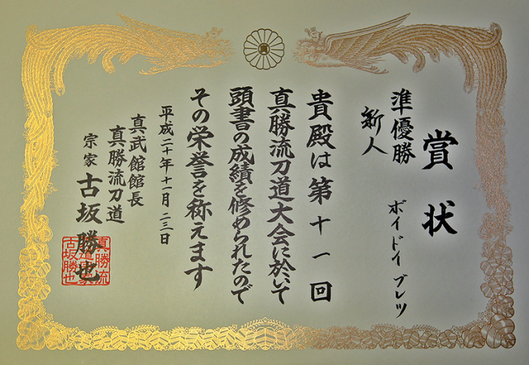
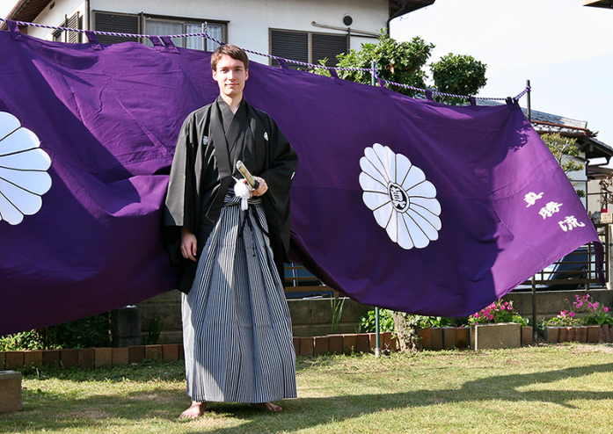
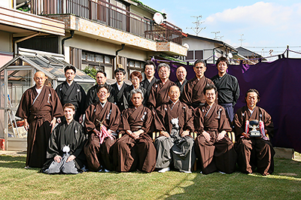
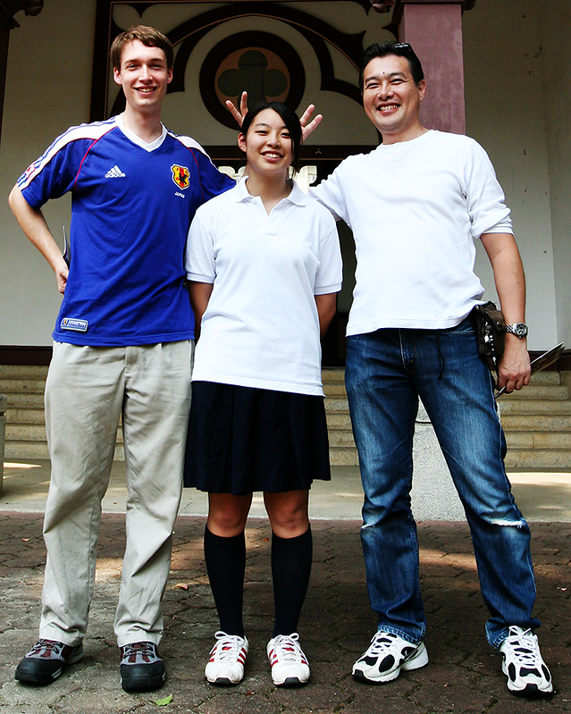
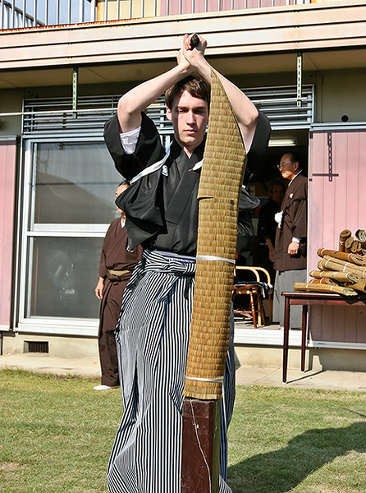
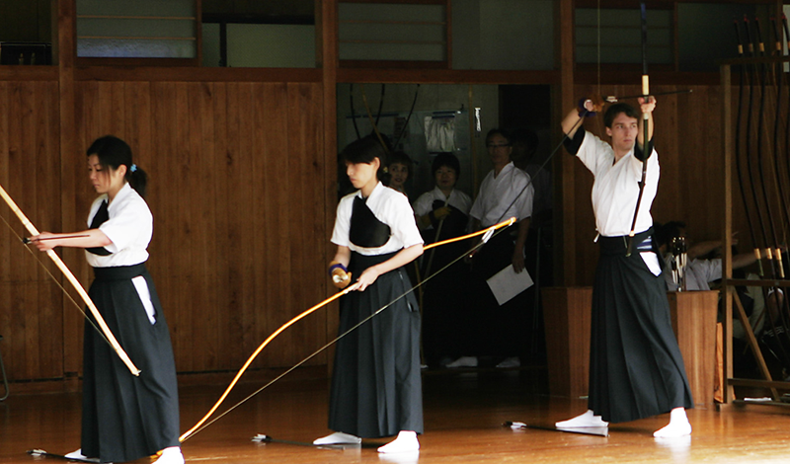
Extracurricular Activities

Slide 37




Extracurricular Activities

