Slide 1
SEASR Overview
Loretta Auvil and Bernie Acs
National Center for Supercomputing Applications
University of Illinois at Urbana-Champaign
[lauvil or acs1]@illinois.edu
www.seasr.org

Slide 2
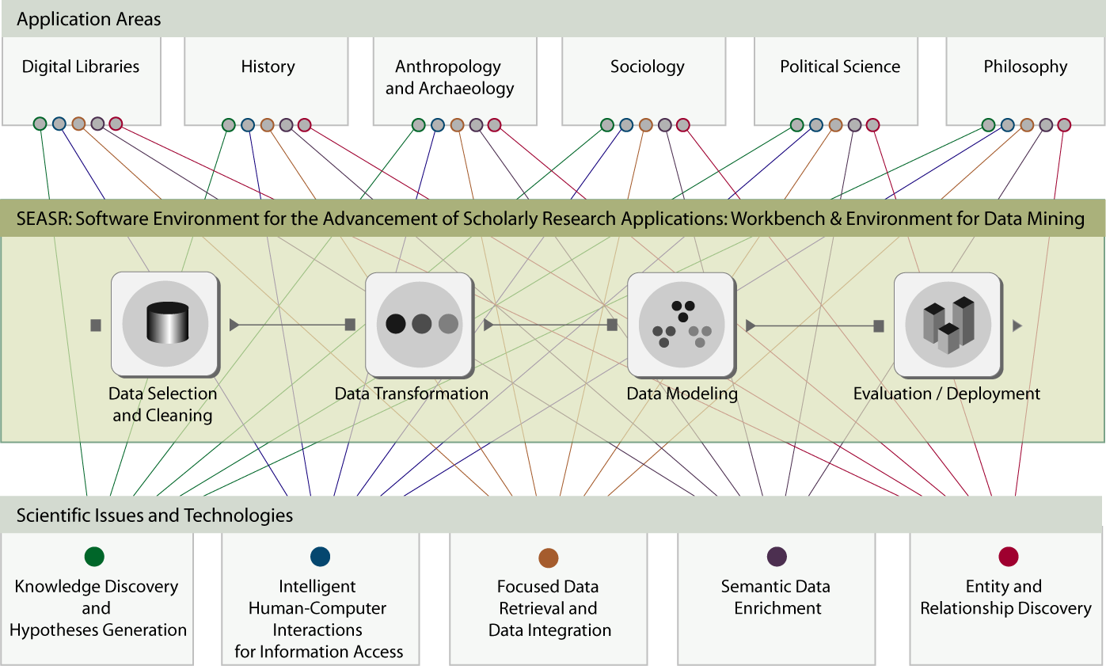
SEASR Overview

Slide 3
SEASR Focus
The Project’s focus:
  Supporting framework
  Developing
  Integrating
  Deploying
  Sustaining a set of
    Reusable and
    Expandable software components and
SEASR can provide benefit a broad set of data mining applications for scholars in humanities

Slide 4
SEASR Goals
The key goals are:
  Support the development of a state-of-the-art software environment for unstructured data management and analysis of digital libraries, repositories and archives
  Develop user interfaces, a data-flow engine and the data-flows that data management, analysis and visualization
  Support education and training through workshops to promote its usage among scholars

Slide 5
Workshop Objective
The objective of the workshop is to:
Introduction of SEASR
Learn what analytics SEASR can do

Slide 6
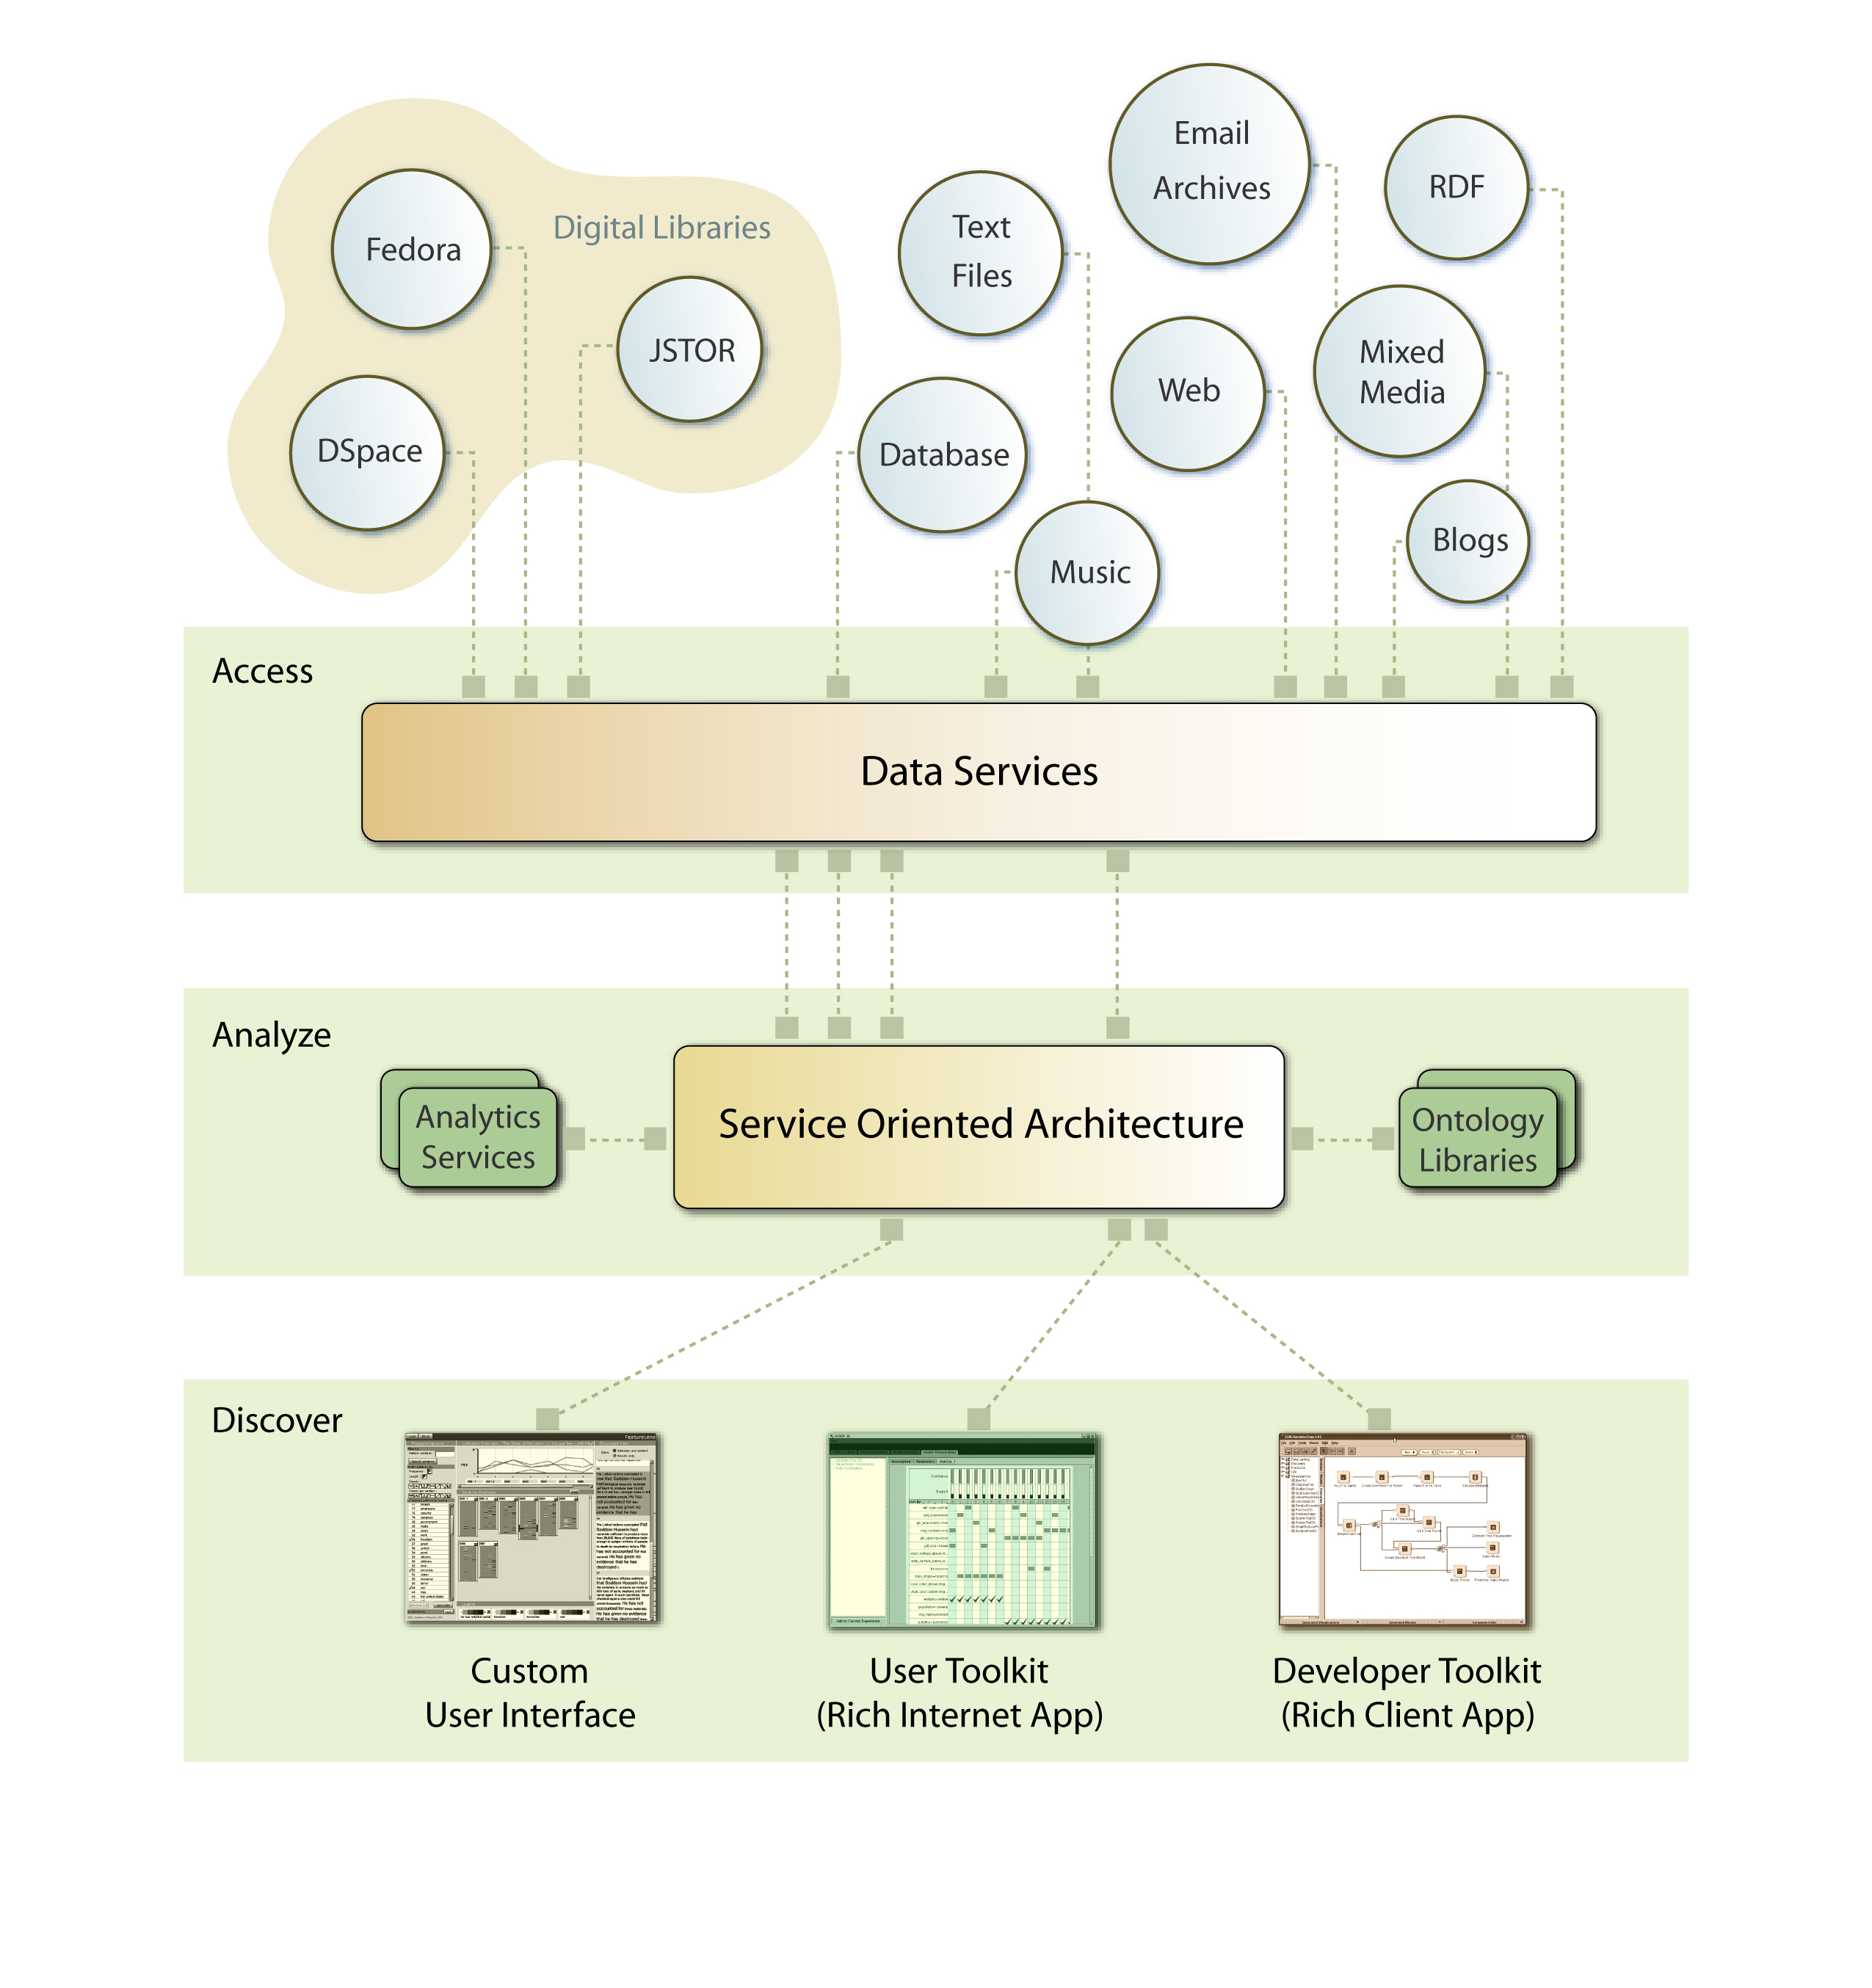
The SEASR Picture

Slide 7
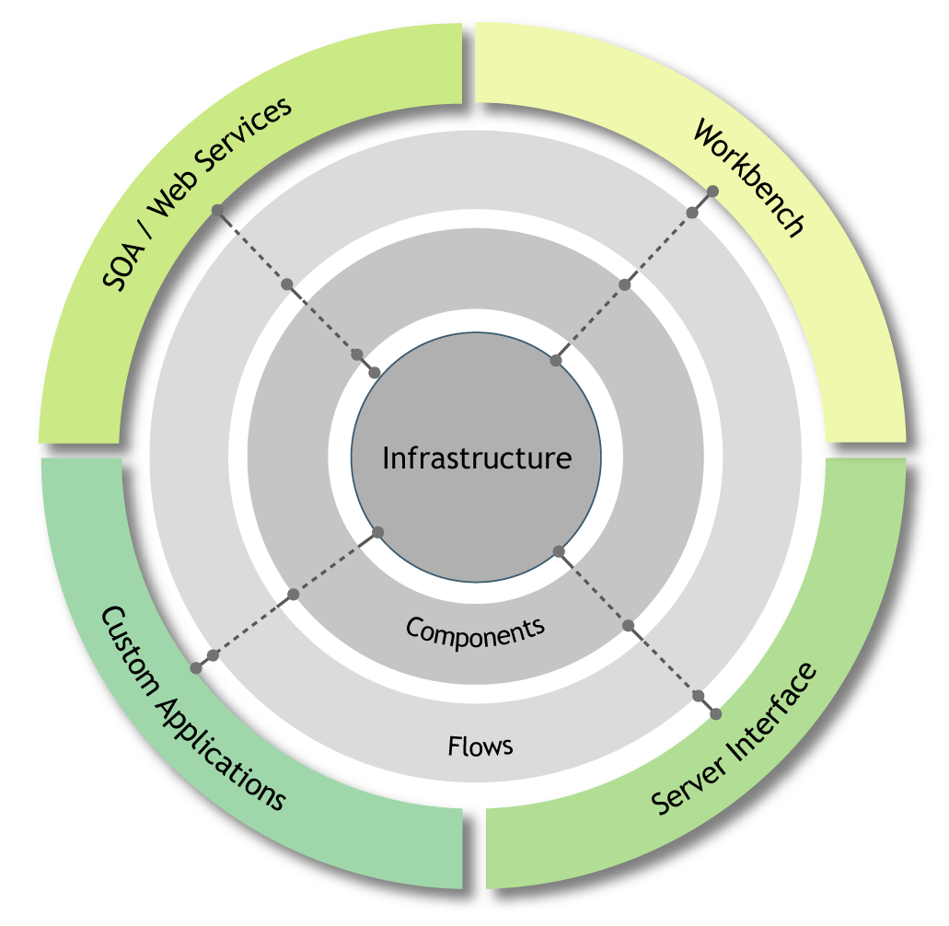
SEASR Architecture

Slide 8
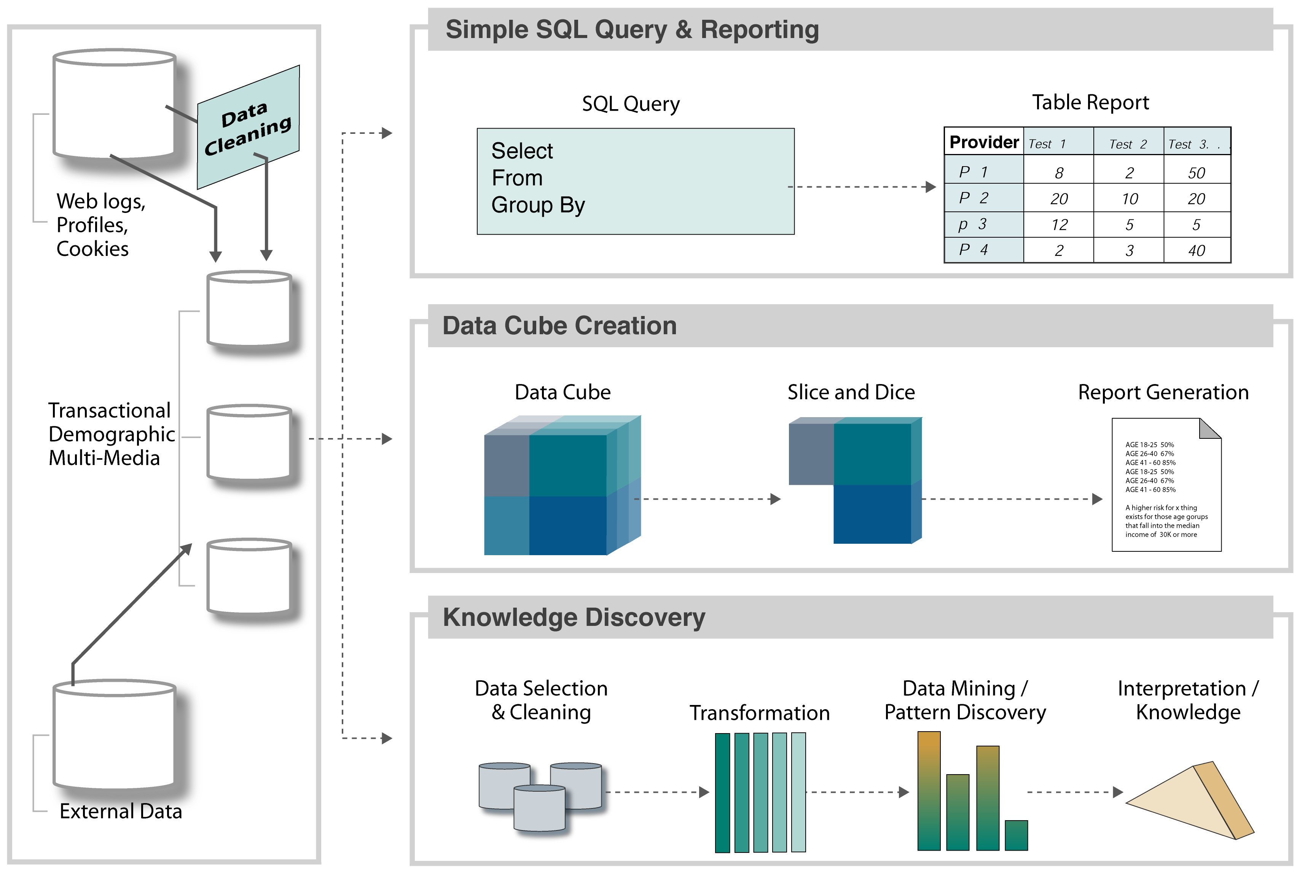
Data Driven Models

Slide 9
SEASR Enables Scholarly Research
Discovery
  What hypothesis or rules can be generated by the “features” of the corpus?
  What “features” or language of the corpus best describes the corpus?
  What are the “similarities” between elements, documents, or corpuses to each other?
  What patterns can be identified?

Slide 10
Enables Humanist to Ask…
Pattern identification using automated learning
  Which patterns are characteristic of the English language?
  Which patterns are characteristic of a particular author, work, topic, or time?
  Which patterns based on words, phrases, sentences, etc. can be extracted from literary bodies?
  Which patterns are identified based on grammar or plot constructs?
  When are correlated patterns meaningful?
  Can they be categorized based on specific criteria?
  Can an author’s intent be identified given an extracted pattern?

Slide 11
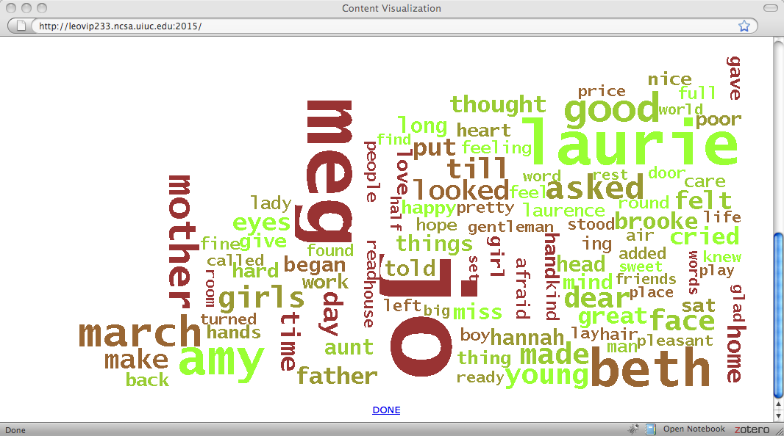
SEASR @ Work – Tag Cloud
Counts tokens
Several different filtering options supported

Slide 12
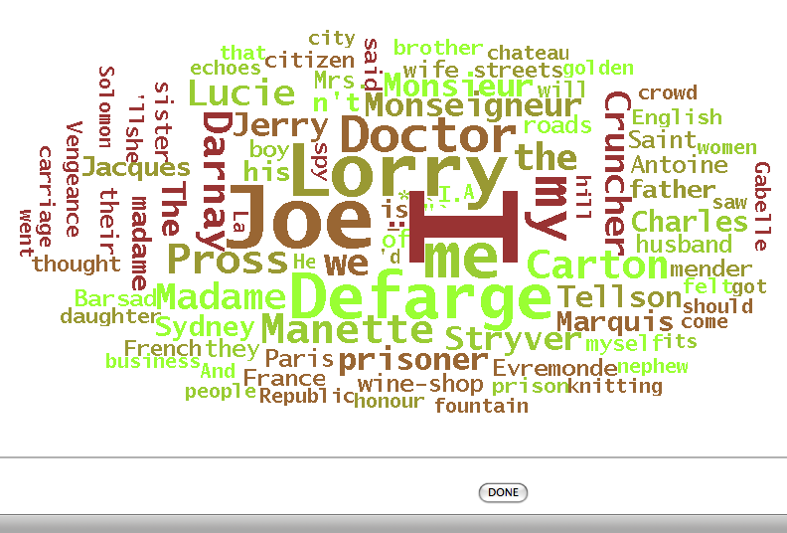
SEASR @ Work – Dunning Loglikelihood
Feature Comparison of Tokens
Specify an analysis document/collection
Specify a reference document/collection
Perform Statistics comparison using Dunning Loglikelihood
Example showing over-represented
Analysis Set: The Project Gutenberg EBook of A Tale of Two Cities, by Charles Dickens
Reference Set: The Project Gutenberg EBook of Great Expectations, by Charles Dickens

Slide 13
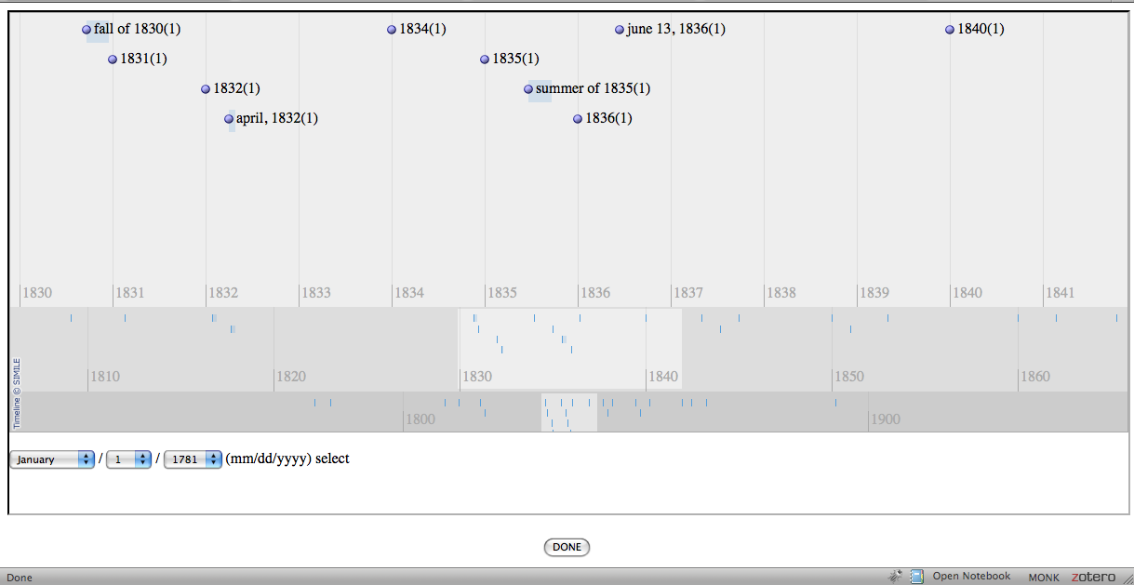
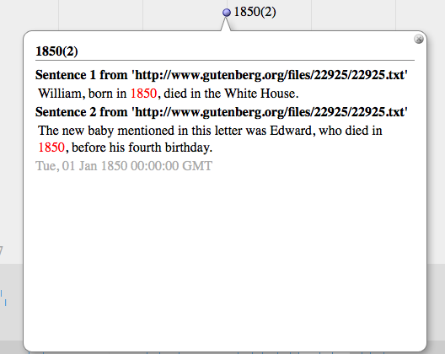
SEASR @ Work – Date Entities to Simile Timeline
Entity Extraction with OpenNLP
Dates viewed on Simile Timeline
Locations viewed on Google Map

Slide 14
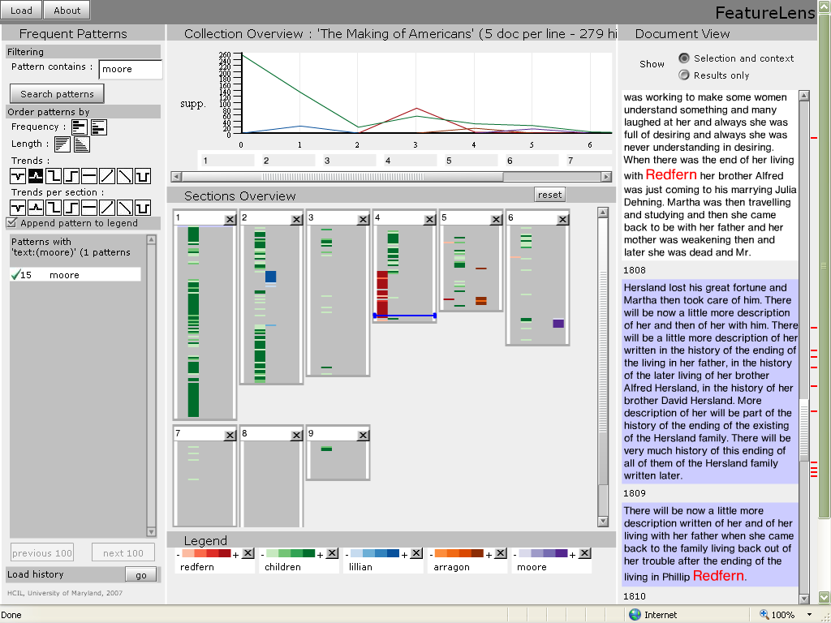
Text Analytics: Frequent Patterns
Given: Set of documents
Find Frequent Patterns such that
  Common words patterns used in the collection
Evaluation: What Is Good Patterns?
Results:
1060 patterns discovered.
322: Lincoln
147: Abe
117: man
100: Mr.
100: time
98: Lincoln Abe
91: father
85: Lincoln Mr.
85: Lincoln man
75: day
70: Abraham
70: President
68: boy
67: Lincoln time
65: Lincoln Abraham
65: life
63: Lincoln father
57: men
57: work
52: Lincoln day
…

Slide 15
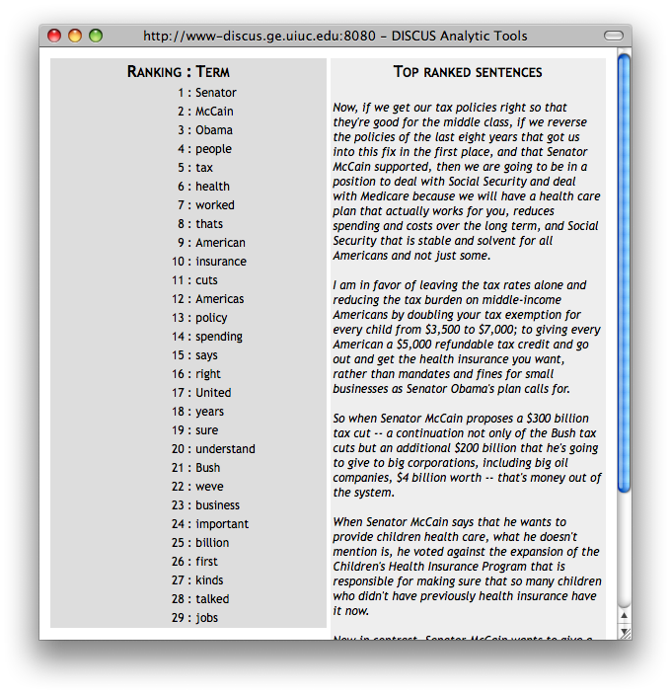
Text Analytics: Summarizer
Given: Set of documents
Find Top
  Sentences
    contain top tokens
  Tokens
    exist in top sentences
Results:

Slide 16
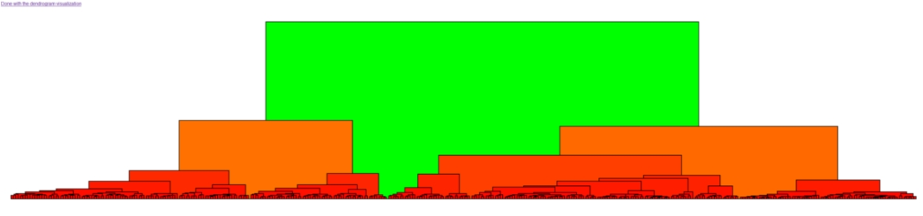
SEASR @ Work – Text Clustering
Clustering of Text by token counts
Filtering options for stop words, Part of Speech
Dendogram Visualization

Slide 17
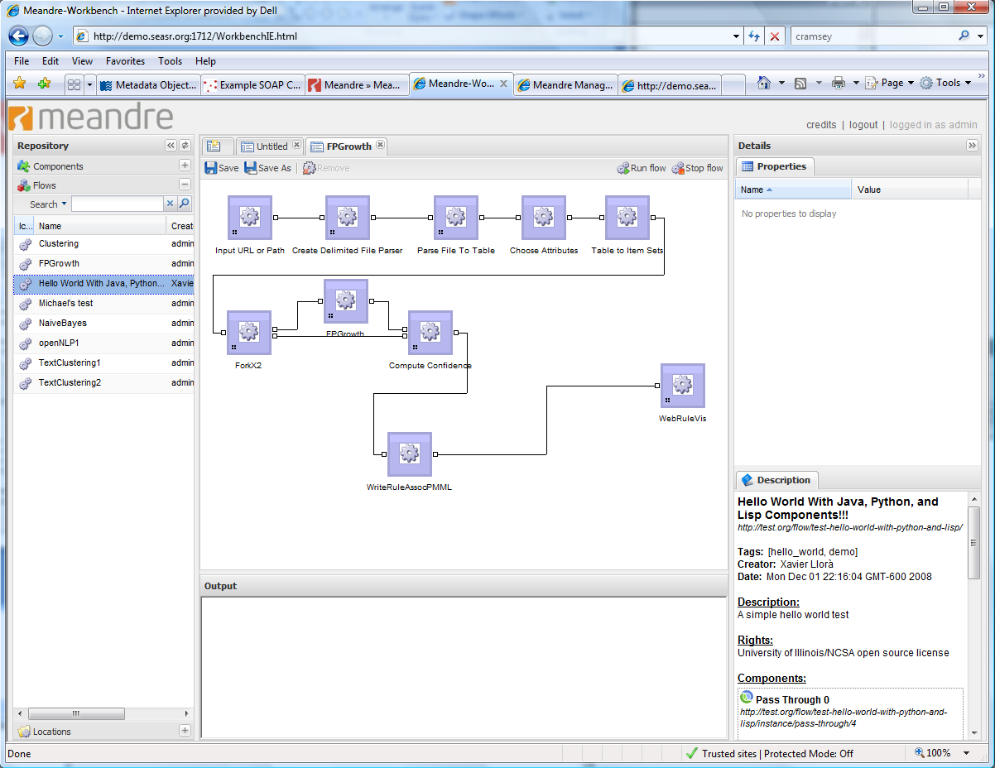
Meandre: Workbench Existing Flow
Web-based UI
Components and flows are retrieved from server
Additional locations of components and flows can be added to server
Create flow using a graphical drag and drop interface
Change property values
Execute the flow
Components
Flows
Locations
The SEASR project and its Meandre infrastructure
are sponsored by The Andrew W. Mellon Foundation

Slide 18
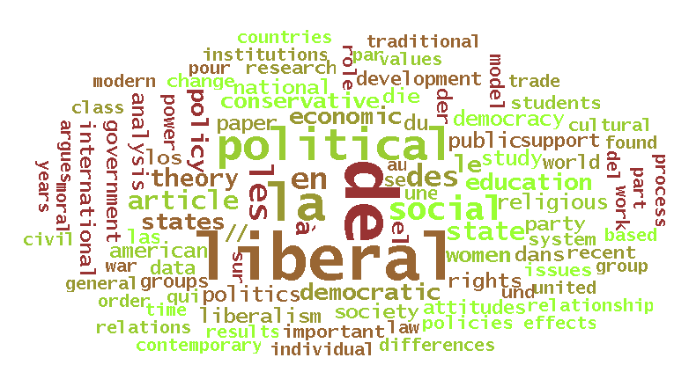
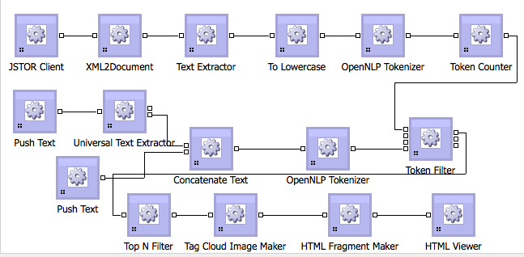
SEASR Accesses Existing API’s
Created components to
  Access TAPoRware web services as SEASR components
  Access JSTOR API in SEASR components
Use the output of these components with existing SEASR components

Slide 19
VUE Component
Goal: Transform the functionality of VUE to SEASR Components
Implementations:
  Generate VUE Map from a dataset
  Transform VUE Map to HTML, JPEG, PNG, etc.
Slide courtesy of Anoop Kumar of the VUE Team at Tufts University

Slide 20
VUE Component: Implementation
Make a component from VUE
  Inputs
  Outputs
  Properties
  Tags
Applications:
  Use the VUE components in SEASR flows (abstraction)
  Work with concept mapping beyond VUE application
Slide courtesy of Anoop Kumar of the VUE Team at Tufts University
Notes:
Philosophical thing, but I would like to mention it. Once we start building the applications and worlds, we add features and give power to creatures in the world. But then you want to think what are these accomplishing and this is the focus we tried to accomplish here. We morphed VUE into a SEASR component; We made components that can perform specific functions. We identified the inputs, … for these functions. I think this is powerful.

Slide 21
SEASR Support in VUE
Goal: Provide functionality in VUE to use SEASR flows
Implementations:
  Add content to map
  Get metadata for content
  Get information about content
  SEASR Datasource
Slide courtesy of Anoop Kumar of the VUE Team at Tufts University

Slide 22
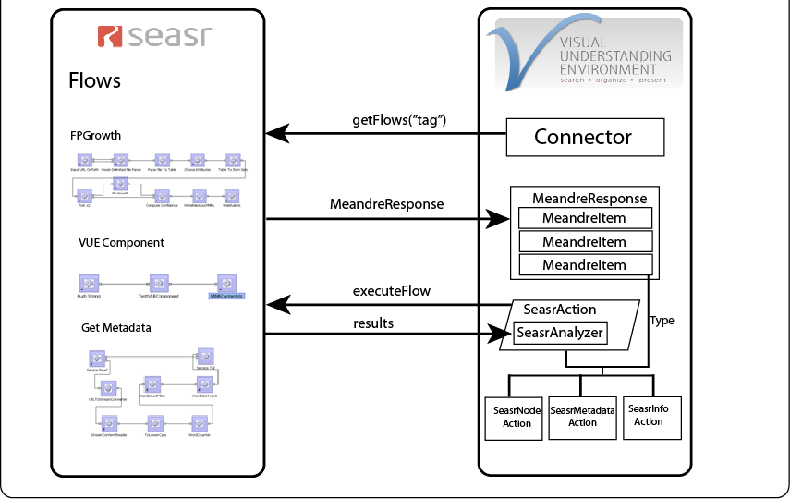
VUE and SEASR Interaction Architecture
Slide courtesy of Anoop Kumar of the VUE Team at Tufts University

Slide 23
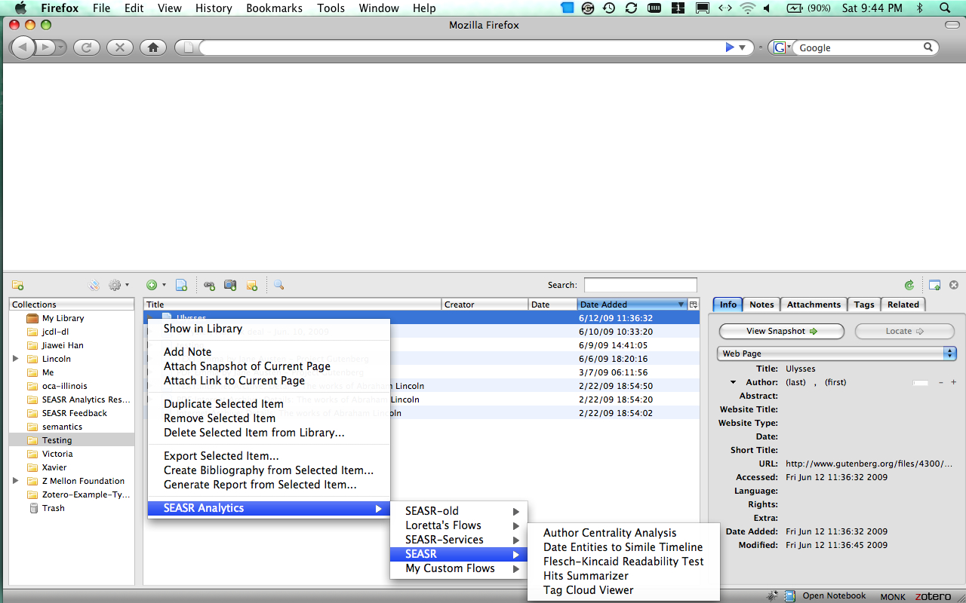
SEASR @ Work – Zotero
Plugin to Firefox
Zotero manages the collection
Launch SEASR Analytics on a server

Slide 24
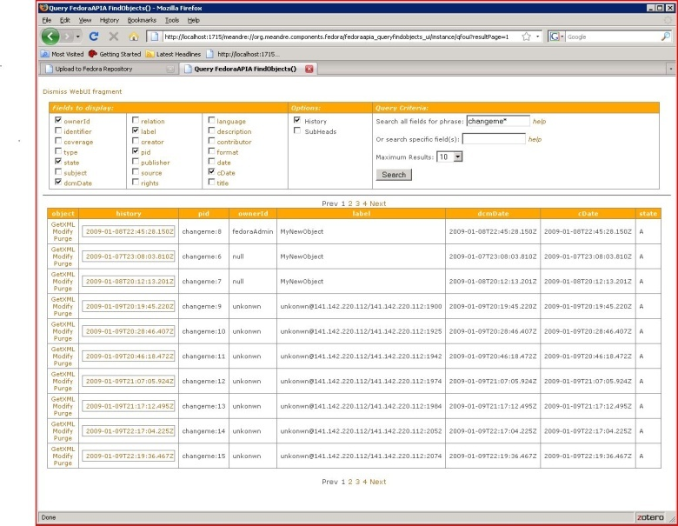
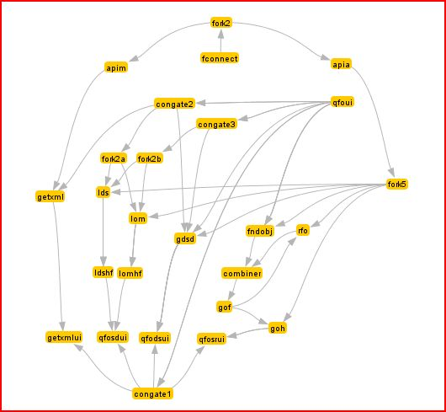
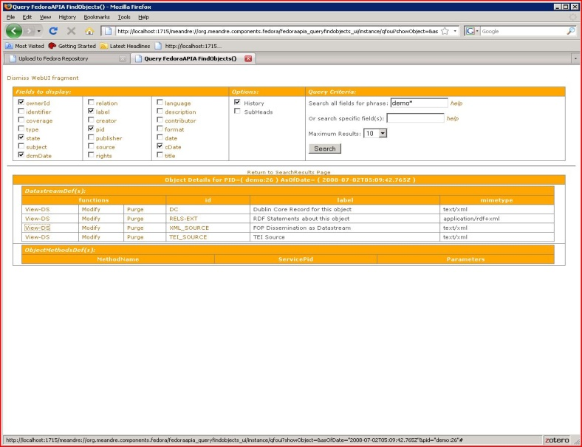
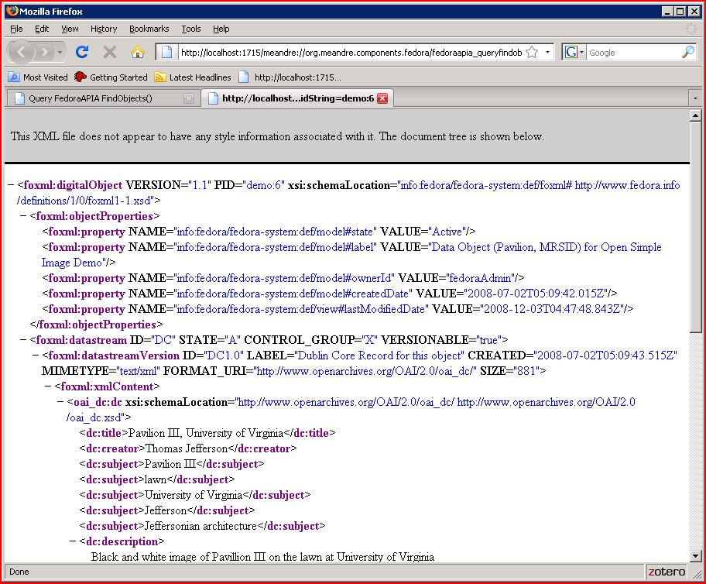
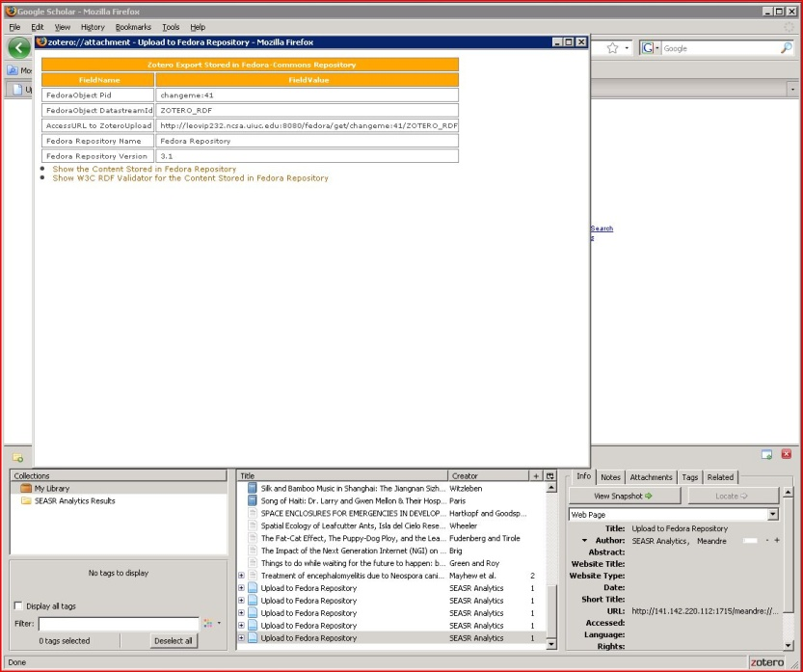
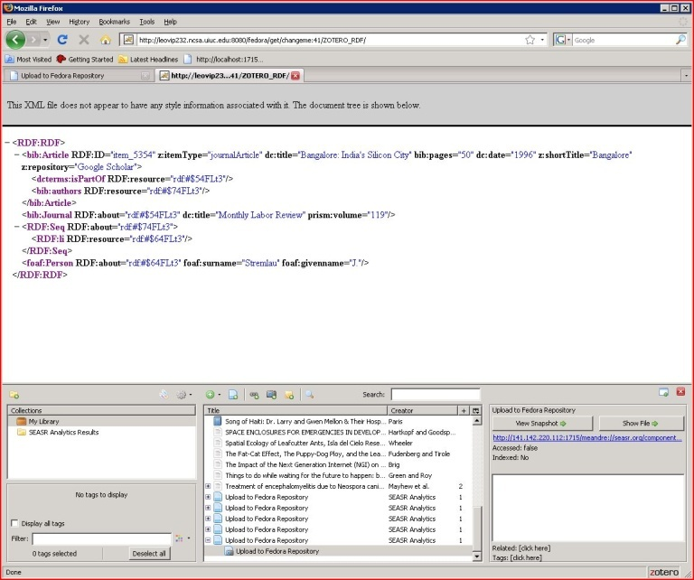
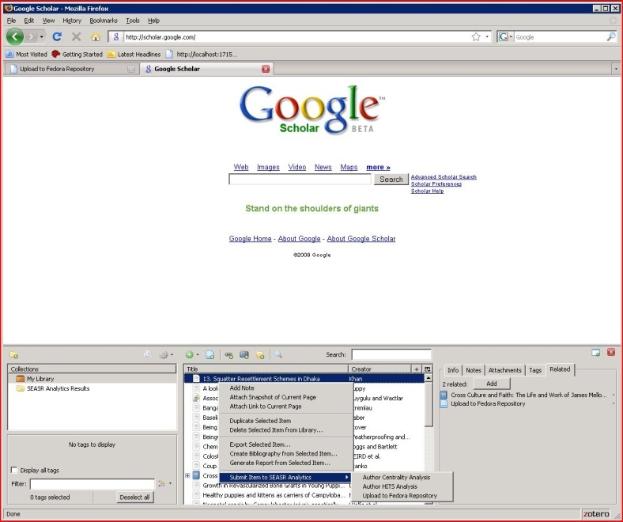
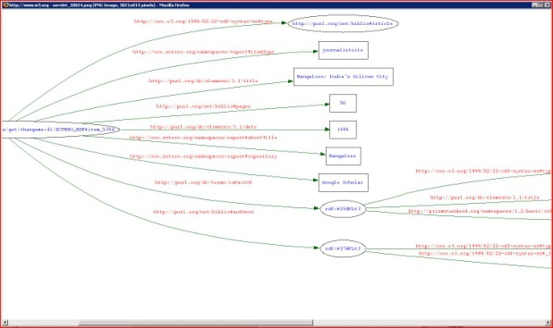
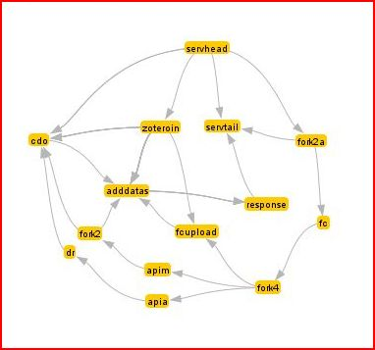
SEASR @ Work – Fedora
Repository Search & Browse
Interactive Web
Application
Web Service
Zotero Upload to Repository

Slide 25
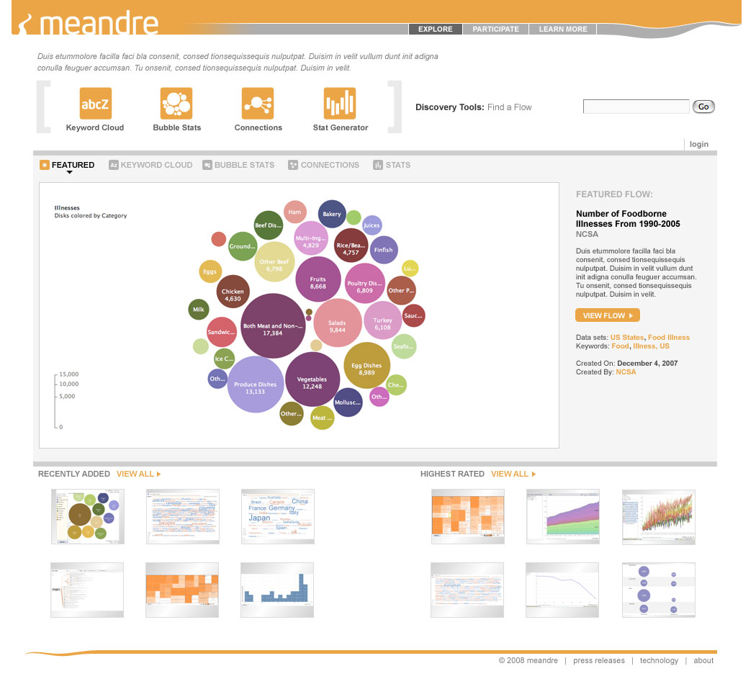
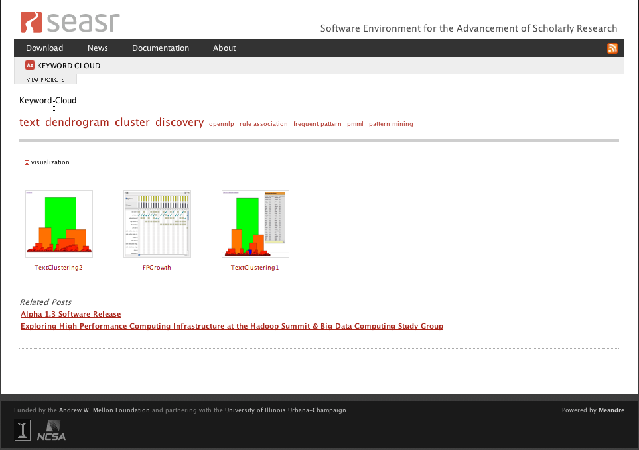
Community Hub
Explore existing flows to find others of interest
  Keyword Cloud
  Connections
Find related flows
Execute flow
Comments

Slide 26
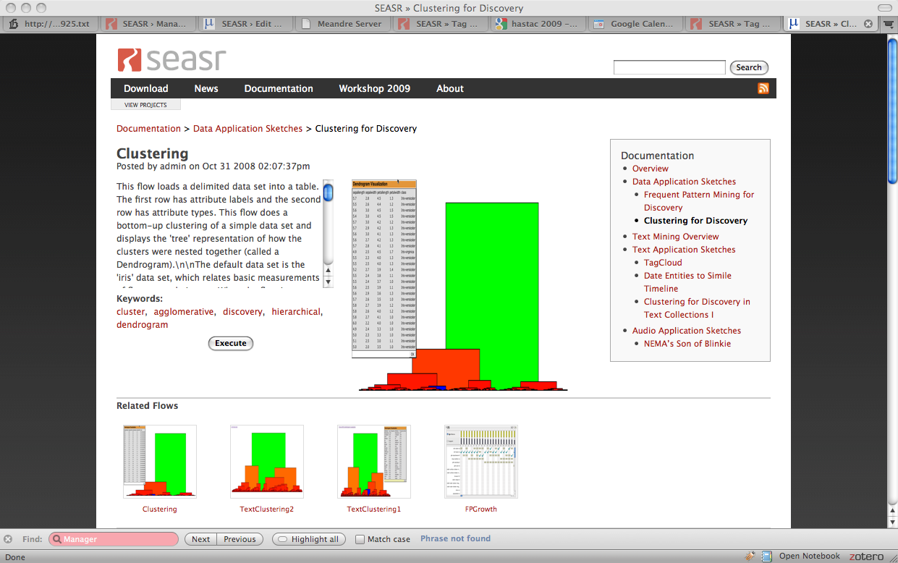
Detail View of Application
Detail View with Related Flows

Slide 27
SEASR Overview
Loretta Auvil and Bernie Acs
National Center for Supercomputing Applications
University of Illinois at Urbana-Champaign
[lauvil or acs1]@illinois.edu
www.seasr.org

