Slide 1
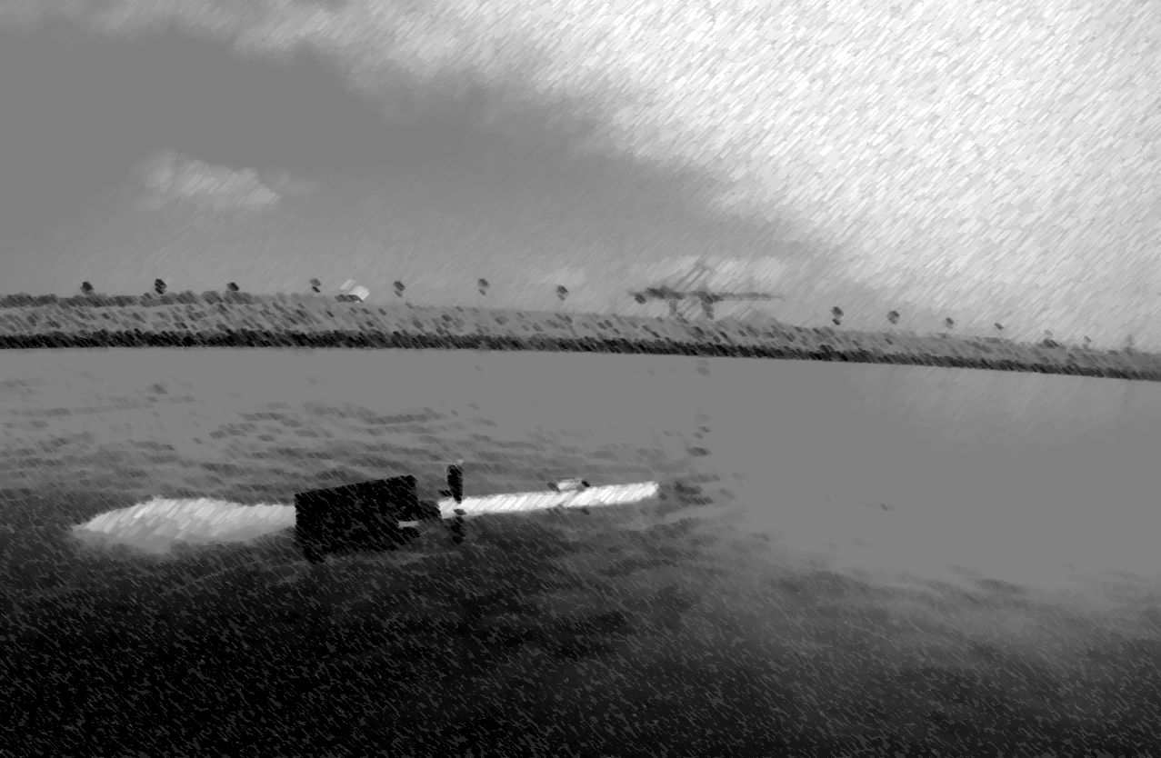
A SYSTEM FOR AUTONOMOUS TRACKING AND FOLLOWING OF SHARKS WITH AN AUTONOMOUS UNDERWATER VEHICLE
Esfandiar Manii
Advisor: Dr. Christopher M. Clark
A Presentation for CSC 590

Slide 2
Introduction
Tracking Objects underwater?
Why do we want to track those objects?
What to track?
Why Sharks?

Slide 3
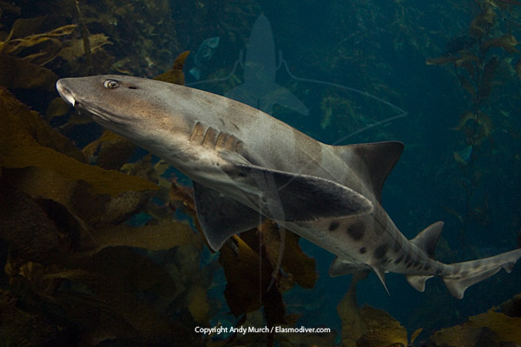
What type of Shark has been chosen?
Sharks

Slide 4
What do we need to track a shark?
An autonomous underwater vehicle (AUV)
At least a tracking device (Acoustic Systems e.g. Sonars, Hydrophones; GPS Systems, visual tracking Systems)
A Shark
Requirements

Slide 5
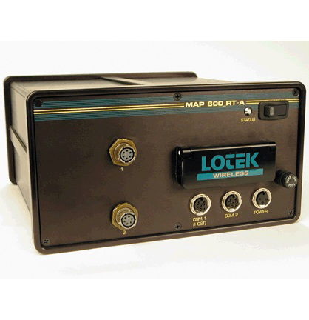
The Tracking device
Acoustic System tracking device.
Tracking Device

Slide 6
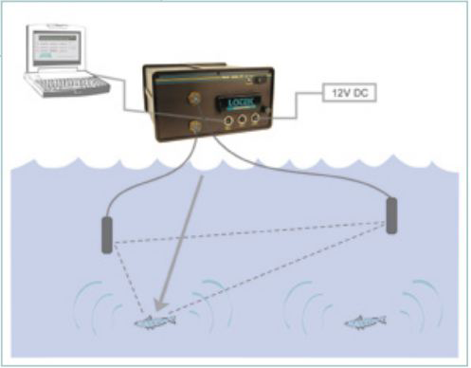
Consists of two hydrophones.
One or more acoustic transmitter.
Tracking Device

Slide 7
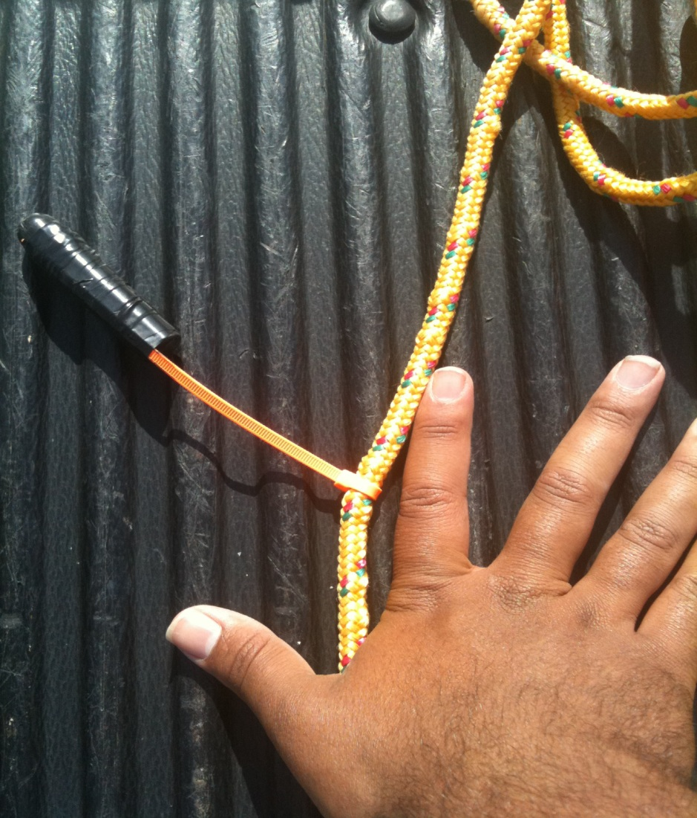
Acoustic transmitter
Transmitter

Slide 8
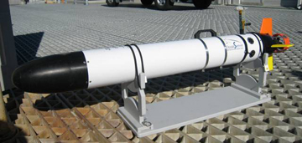
The AUV
AUV

Slide 9
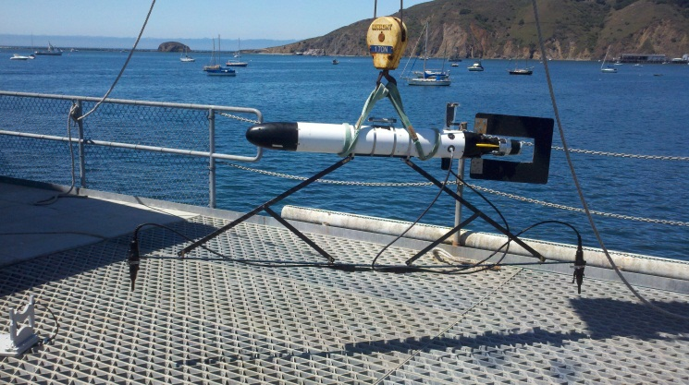
AUV

Slide 10
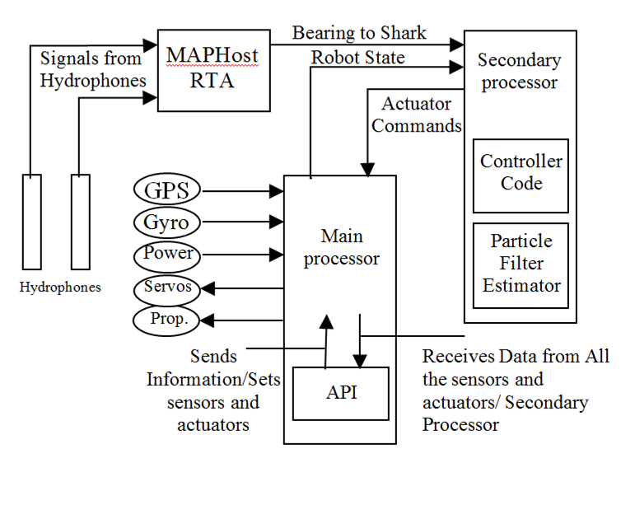
System Diagram
System Diagram

Slide 11
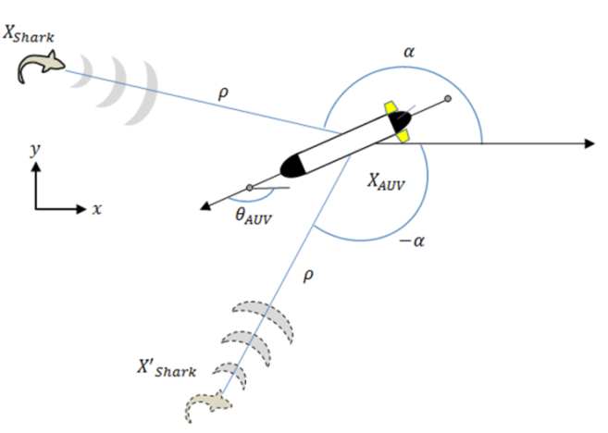
AUV and Shark

Slide 12
AUV and Shark

Slide 13
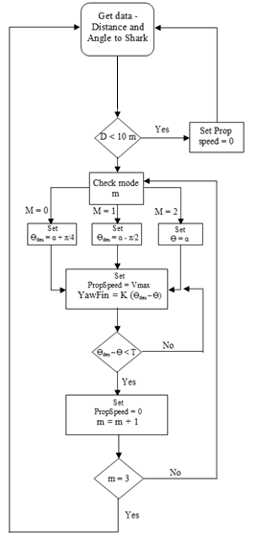
Control System

Slide 14
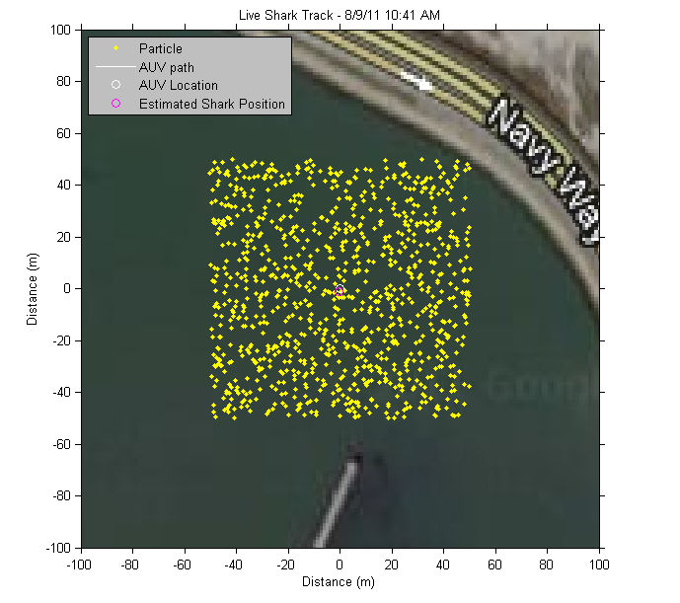
Localization
Particle Filter.
Algorithm

Slide 15
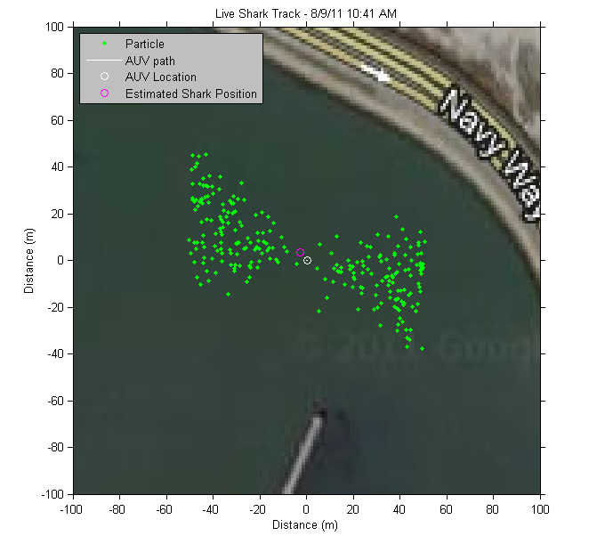
Algorithm

Slide 16
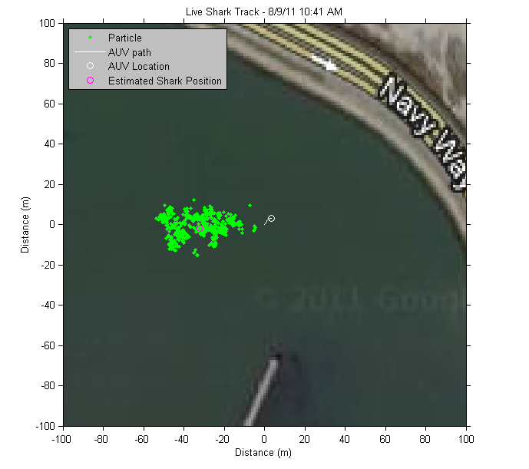
Algorithm

Slide 17
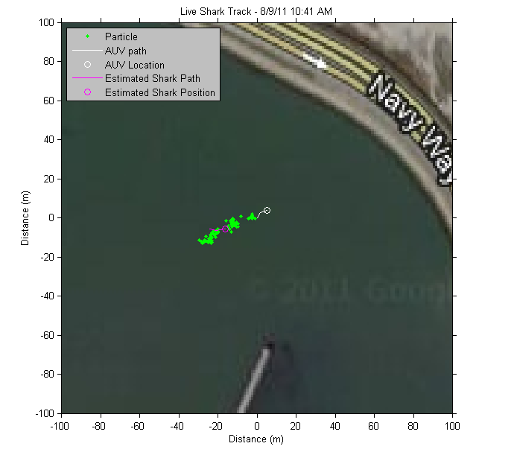
Algorithm

Slide 18
Algorithm

Slide 19
Is it really intelligent?
By getting more signals from the tracking device, robot learns more.
Motion planner tries to find an optimal
path to the shark, to decrease the travelled
distance.
Depend on the situation, robot
stop when the shark is so close and it sets
its speed in comparison with the distance.
If the AUV loses the shark, depend on
the situation, it stops or seek for the shark.

Slide 20
Improved Controller
Improved Controller

Slide 21
Improved Controller

Slide 22
Improved Controller

Slide 23
Comparison
Improved Controller

Slide 24
How can we trust the algorithm?
Experiments at Cal Poly pier, Avila Beach.
Stationary transmitter.
Non-Stationary transmitter.
Validation

Slide 25
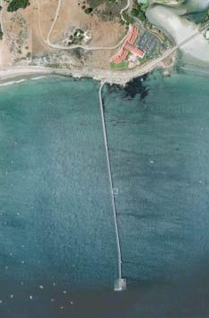
Stationary Tag Tracking
Cal Poly pier, Avila Beach.
Validation

Slide 26
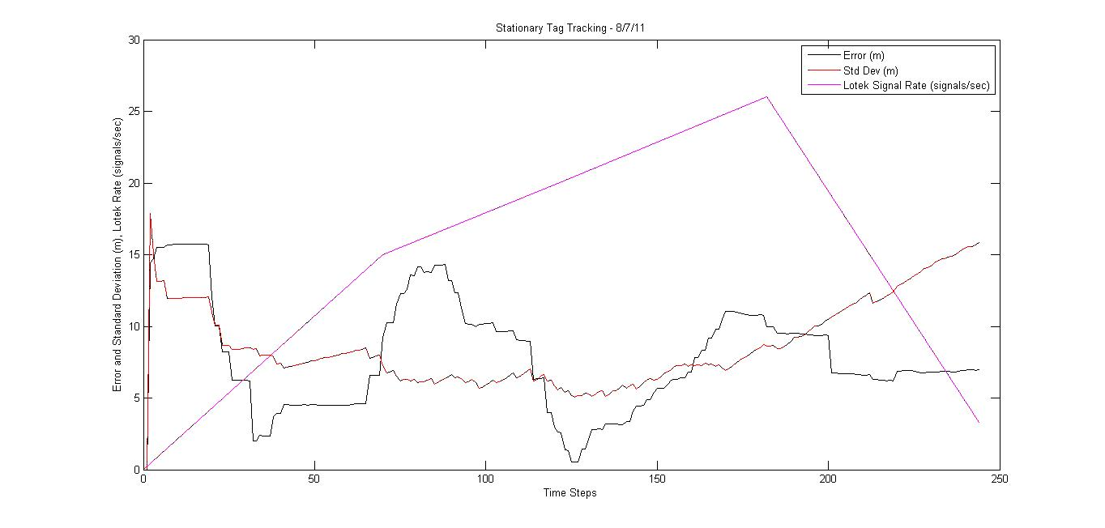
Validation

Slide 27
Tagged AUV Tracking
SeaPlane Lagoon, LA
Validation

Slide 28
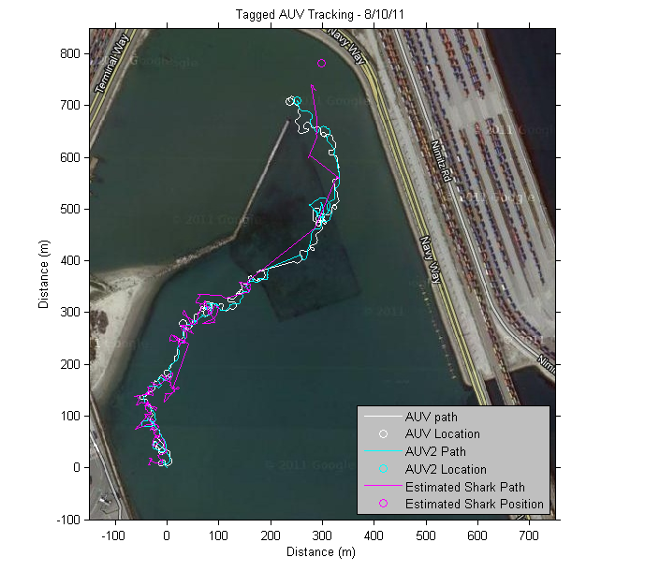
Validation

Slide 29
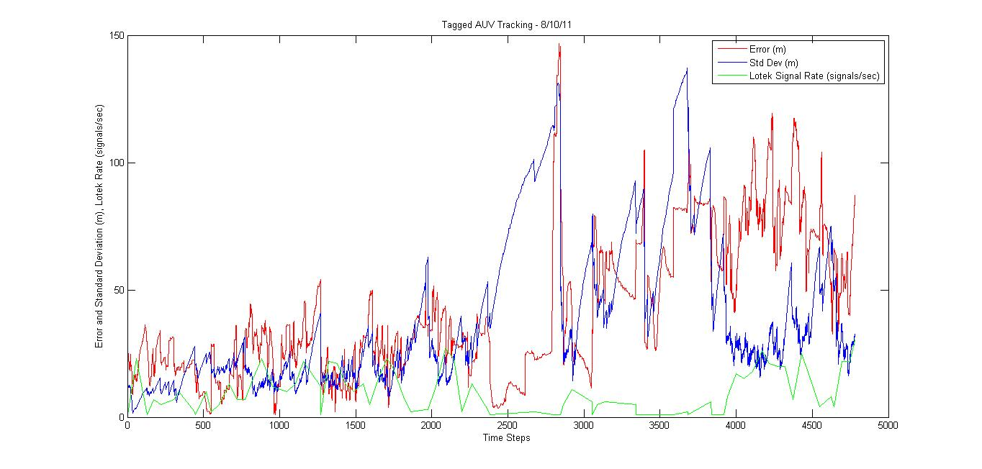
Validation

Slide 30
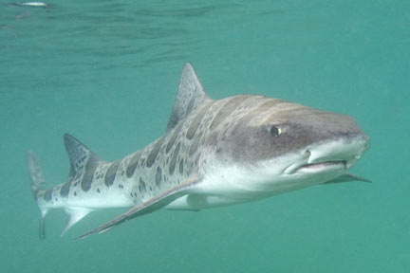
Shark Tracking
Validation

Slide 31
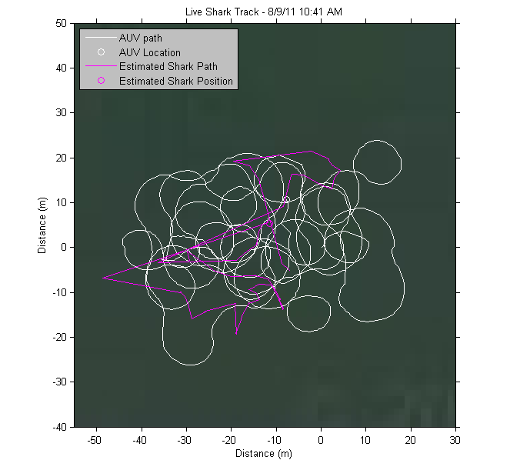
Validation

Slide 32
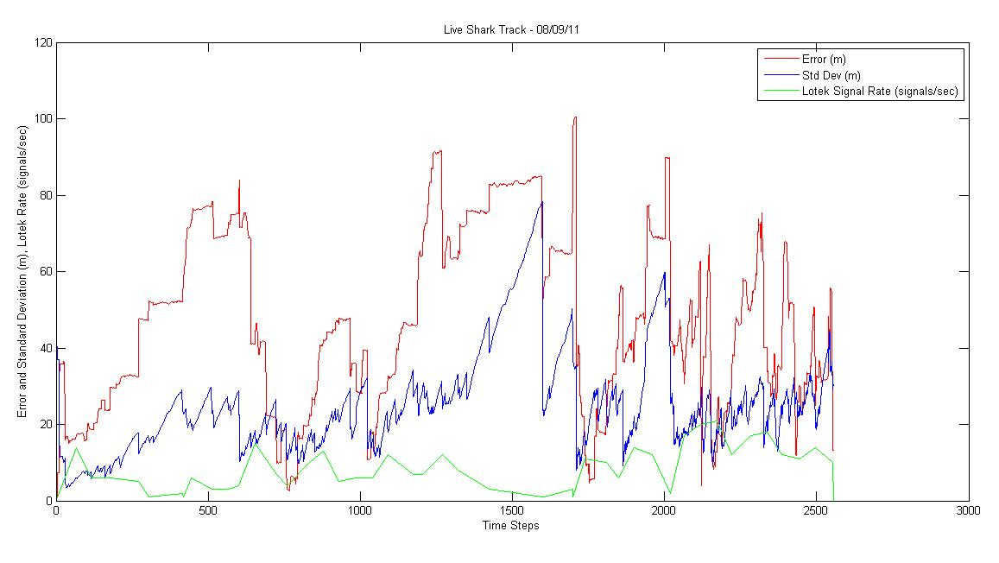
Validation

Slide 33
Luring a Shark

Slide 34
Field Experiment

Slide 35
Thank you all for your attention.

