Slide 1
Headset Control with Assistive AI for Limited Mobility Users
Frankie Pike Adviser: Dr. Franz Kurfess

Slide 2
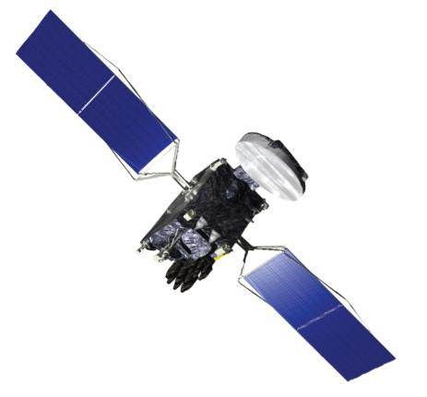
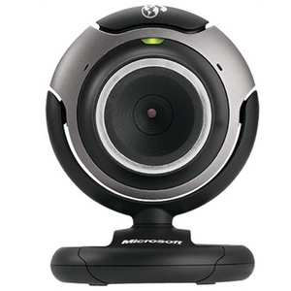
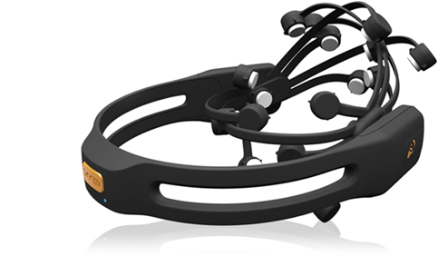
Why I’m interested

Slide 3
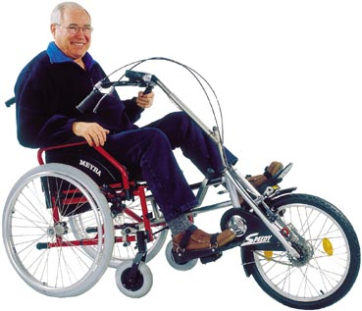
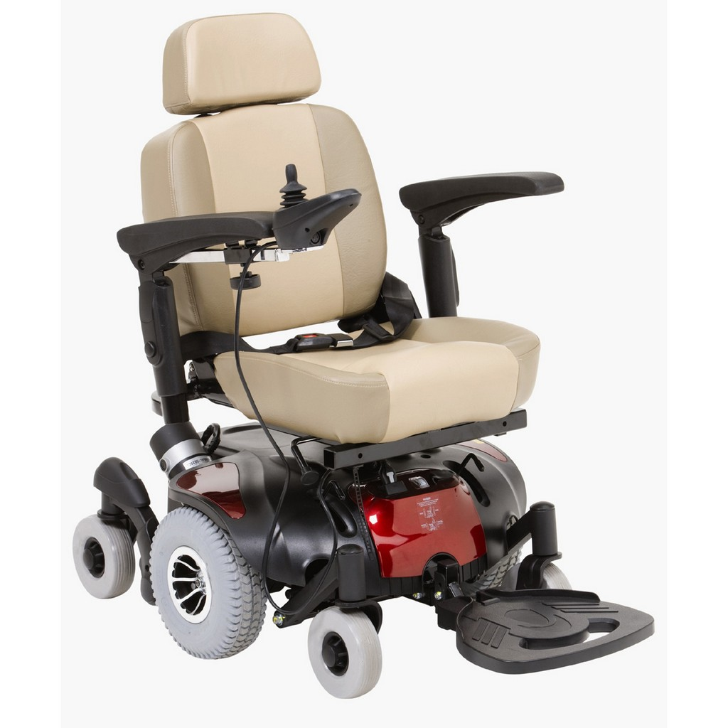
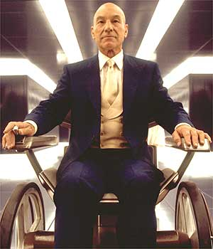
Why I’m interested

Slide 4
But that’s EASY!
GPS = where we are
Cameras = what we don’t want to hit
Mind control = magic

Slide 5
Architecture
Consensus
Obstacle Detection
User Commands
(EEG)
GPS Path Plotting

Slide 6
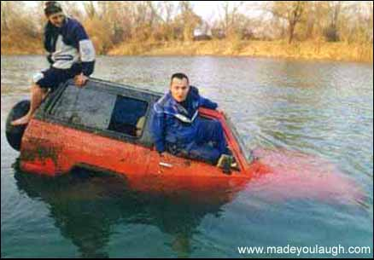
But that’s EASY!

Slide 7
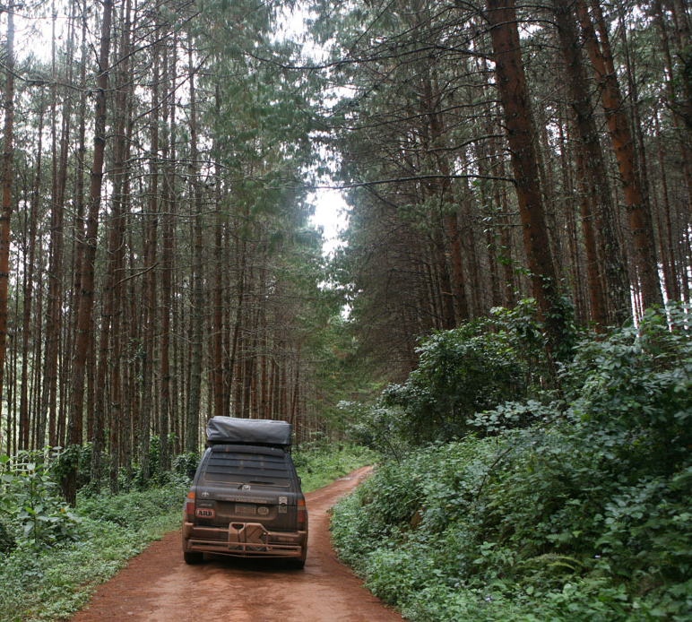
But that’s EASY!

Slide 8
But that’s EASY!

Slide 9
Architecture
Consensus
Obstacle Detection
User Commands
GPS Path Plotting

Slide 10
eBay!
Multi-Agent Decision Engine
Agents
Auctioneer
Auction
NavClasses
Message Feed
Timer
OAS
Long Range Planner
3D Cameras
GPS
Compass
User
EEG Filter
Override
Bidders

Slide 11
Agent Lifecycles
Start Auction
Receive Bids
Issue Directive
Compute Decay
Store Last Directive
Call NavClass
Evaluate Solution
Submit Best Bid
Bidder
Monitor

Slide 12
Architecture
Consensus
Obstacle Detection
User Commands
GPS Path Plotting

Slide 13
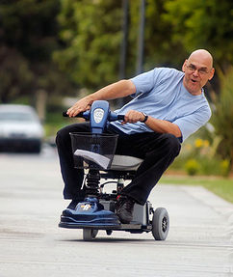
Architecture
Consensus
Obstacle Detection
User Commands
GPS Path Plotting

Slide 14
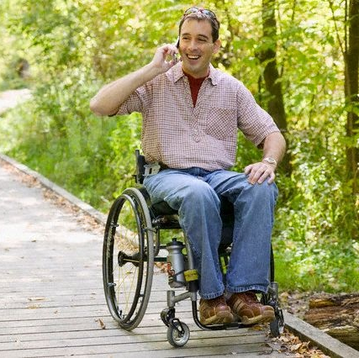
Architecture
Consensus
Obstacle Detection
User Commands
GPS Path Plotting

Slide 15
Architecture
Consensus
Obstacle Detection
User Commands
GPS Path Plotting
Partially Observable Environment

Slide 16
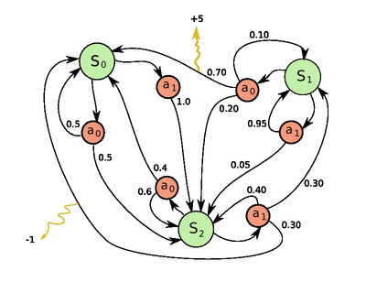
POMDPs
Partially Observable Markov Decision Processes
Allow modeling with uncertainty
Uncertainty in state
Uncertainty in transition
PSPACE-Hard (Go)

Slide 17
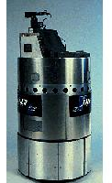
Xavier (Carnegie Mellon)
One of the first POMDP based
3000 states
Periodic re-evaluation
60km of testing in offices
Compartmentalized Nav
Landmark: 80%
POMDP: 93%
Resilient to failure

Slide 18
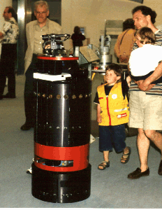
RHINO
Tested in a museum
Builds model of environment
Decentralized processing
Markov models for localization
V1: Glass is invisible to lasers
What else is?

Slide 19
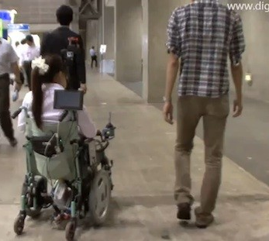
Collaborative Wheelchair Control
Guided
Follow, not push
Side by side
Pass through door
Follow behind
Heuristics for dense environments

Slide 20
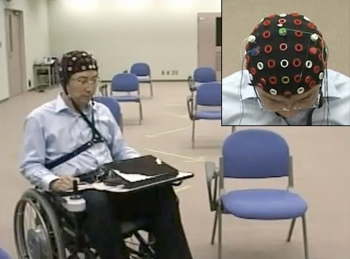
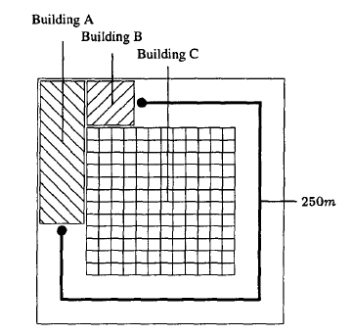
HaWCoS (Hands-free Wheelchair Control System)
Non-autonomous
Modest hardware (P3)
Timed Tasks
EEG = 48% longer
Better with AI?

Slide 21
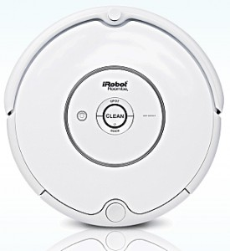
Doable and worthwhile

