Slide 1
Encouraging Secure Programming Practice in Academia
Scott Kuroda
Advisor: Dr. Franz Kurfess

Slide 2
Goals
Develop a system that exposes students to:
Secure programming practice
Attack scenarios
Vulnerable code
Develop system in a service oriented manner.
Accessible via Internet

Slide 3
Current Tools
Static Code Analysis
Sandbox Environments
Courses

Slide 4
Static Code Analysis
Lint
PC-Lint
JS-Lint
Pylint
Pychecker

Slide 5
Sandbox Environment
Provide a controlled space for experiments.
Penetration test
Allow “safe” environment for safe competitions
Defcon
International Capture the Flag Hacking Competition (UCSB)
Traditional CTF
“Treasure Hunt”
“Botnet” Scenario
Simulated attack against a rogue nation

Slide 6
Academics
Courses
Theory and concepts of security
Encryption
Program Security
Network Security
Implementation of attacks
Buffer Overflow
Breaking encryption
Graceful failure
SQL Injection
Clubs
White Hat

Slide 7
Current Research
Teaching computer security
Course design
Automated tools in academics
Checking for plagiarism
In industry
Penetration testing
Automated software testing

Slide 8
Research in Academics
Course design
Not practical to create an additional required course for many universities.
Code analysis
Utilized by many institutions to reduce plagiarism.
Textual analysis
Structural analysis
Variable analysis

Slide 9
Research in Industry
Threat Model Driven Approach for Security Testing
Automated Software Testing as a Service

Slide 10
Threat Model Driven Approach for Security Testing
Threats modeled as an UML
Scenarios developed as sequence diagrams at design phase
Determine security policy, then define model behavior that would violate said policy.

Slide 11
Automated Software Testing as a Service
Leverage cloud services to test code.
Reduce the load on a given system.
Provide continuous testing of code to developers.
Developers can define both high level specifications and lower level test predicates.
Predicates broken into two categories, universal and application specific.

Slide 12
So what?
Goals reiterated:
To expose students to computer security issues.
Close the knowledge gap for student developers
Students will be exposed to security issues, at a minimum, through submitting and receiving feedback on their code.
Students may choose to extend their knowledge by becoming “experts” in the system.

Slide 13
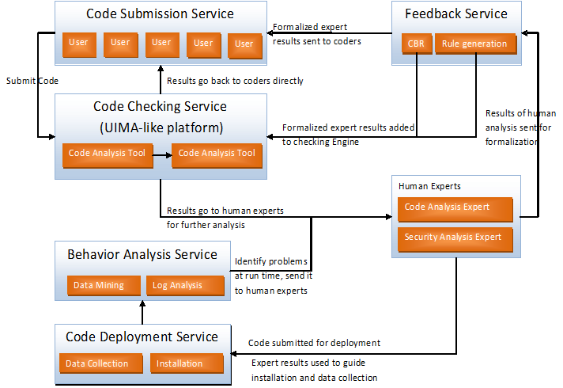
Proposed Architecture
From proposal by Dr. Seng, Dr. Kurfess, Dr. Nico, and Dr. Assal

Slide 14
Code Checking
Perform static code analysis
Generate annotated report for both user and experts
Intermediate agent to potentially combine reports
Shorten final report
Reduce redundancy of a given error
Several challenges
Reports from each tool may appear differently.
Text parsing and language processing to accurately create final report

Slide 15
Human Expert
Second level of analysis.
Use levels to define how much of an “expert” in the field of computer/network security.
E.g. Students providing feedback vs. Industry Expert

Slide 16
Code Deployment
Actual running of submitted code.
Collect various metrics about deployed code.
Potentially utilize non-static code analysis methods
Requires building a safe closed environment to run code.
Must be isolated from external influences.
Must be restricted if malicious code is submitted.

Slide 17
Behavior Analysis
Analysis of code behavior
Various analysis methods performed on data generated from code deployment.

Slide 18
Questions?

Slide 19
Proposed Architecture
From proposal by Dr. Seng, Dr. Kurfess, Dr. Nico, and Dr. Assal

