Slide 1
Computer Hardware and Software
Chapter 1

Slide 2
Overview
Brief History of Computers
Hardware of a Computer
Binary and Hexadecimal Numbers
Compiling vs. Interpreting Computer Programs
Executing Java programs
Application Software vs. Operating System Software
Different Generations of Programming Languages
Brief History of Computer Games

Slide 3
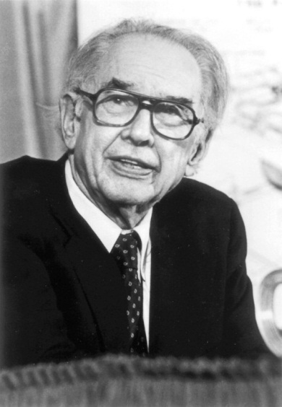
History of Computers
Computers are electronic devices that can perform calculations.
The first electronic digital computer was built by physics professor John Atanasoff and his graduate student Clifford Berry in 1937. The computer could not be programmed and could be used only to solve linear equations.
Picture of John Atanasoff

Slide 4
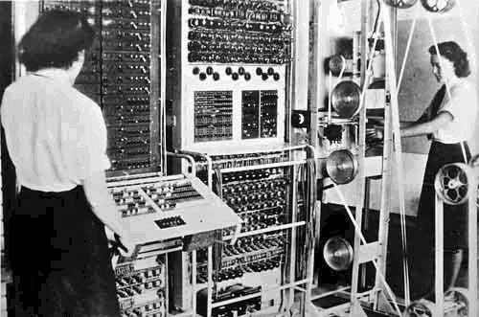
History of Computer (cont’d)
Six year later, in 1943, the first programmable electronic computer was built by Tommy Flowers.

Slide 5
History of Computers (cont’d)
The first computers took a lot of space.
Different components, such as secondary storage and main memory were in separate racks.
Early computers could easily fill a present-day classroom.
The term bug, which is commonly used to describe a software error, derives from the days when actual rodents were roaming around the different components of a computer.
As time progressed, computers became smaller and cheaper.
The personal computer was introduced in the late 1970s and early 1980s by the likes of Hewlett Packard, Apple, and IBM.

Slide 6
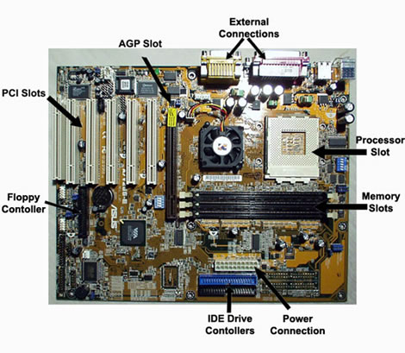
Hardware of a Computer

Slide 7
Hardware of Computer (cont’d)
CPU
Main Memory
Monitor
Hard Disc
Keyboard

Slide 8
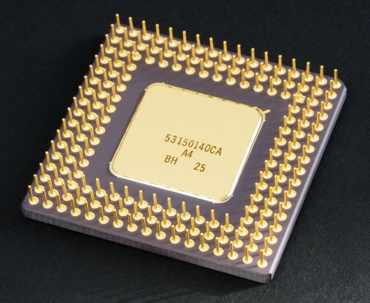
Central Processing Unit (CPU)
It is the brain of a computer.
It is a device that can perform simple calculations. These includes addition, deletion, subtraction, and multiplication.
The speed of a CPU is measured in herz, which is a measure of frequency in cycles per second.
In one cycle, the CPU can perform one instruction.
Typical CPU speeds of modern computers are around 2GHz, which corresponds to 2 gigahertz, or 2 billion instructions per second.

Slide 9
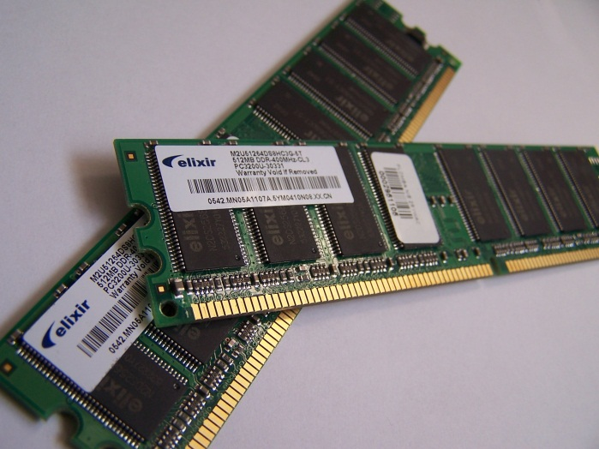
Main Memory
The CPU communicates with the main memory.
The program that is executed and data that is used must be stored here.
Main memory is typically RAM (random access memory).
It takes the same time to read or write every cell of the data.
Volatile (deleted when power goes off).

Slide 10
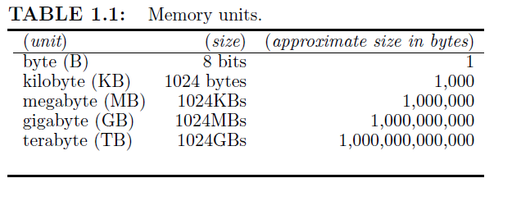
Main Memory (cont’d)
The main memory of a computer consists of a sequence of cells, where every cell can take one of two states: 0 or 1. The different values are usually represented by different voltage. For example, 0.8 volts or below may denote 0, while 2.2 volts or above can denote the number 1. In computer science, this single cell is referred to as a bit.

Slide 11
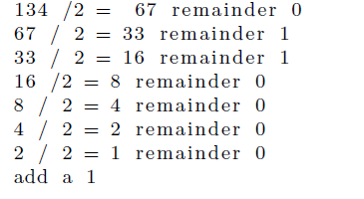
Binary Numbers
Base 10: 342 = 3*10²+4*10¹+2*10⁰
Base 2: 1010 = 1*2³+0*2²+1*2¹+0*2⁰
Decimal to Binary: 134 to binary
Binary Number is: 10000110 (the result backwards).

Slide 12
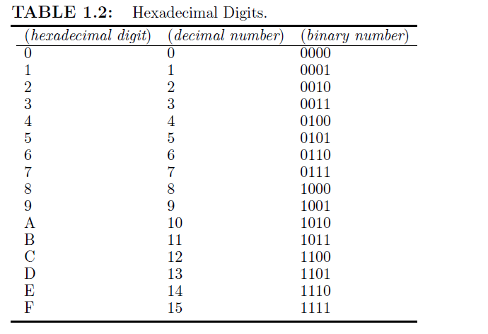
Hexadecimal Numbers

Slide 13
Binary to Hexadecimal
1101 0010₂= 12 2 = C2₁₆
Given 8 bits, split in two half-bytes. Convert each half-byte to hexadecimal using table.
Decimal to Hexadecimal: Convert to Binary and then to hexadecimal.
Hexadecimal to decimal:
FC03 = F*16³+C*16²+0*16¹+3*16⁰= 15*16³+12*16²+0*16¹+3*16⁰=64515

Slide 14
The Process of Program Creation
Software is written using text files that are saved on the hard disk (called a program). An Integrated Development Environment (IDE) can be used to create the files.
If a compiler is used, then the code is translated into executable binary code that is loaded in the main memory.
The CPU executes the binary code from the main memory.
If an interpreter is used, then the translation to binary code and the execution of the code happens at the same time. Since the program needs to be translated to binary code during program execution, an interpreter is slower than a compiler.

Slide 15
What About Java?
Java uses both an interpreter and a compiler.
A compiler translates a .java text file into a .class binary file. The .class contains Java binary code.
The Java binary code can be later executed using an interpreter (called Java Virtual Machine (JVM)).
Since an interpreter is used, executing Java code can be slow.
The advantage is that Java binary code can run under different operating systems as long as the JVM software is installed.

Slide 16
Type of Software
Application Software
Games, office software, web browsers, etc.
Operating System Software
Supports Graphical User Interface (GUI).
Allows access to I/O devices: e.g. keyboard, hard disc, monitor, mouse, etc.
Allows concurrent program execution.

Slide 17
Types of Programming Languages
1st generation: Machine Language (use 0 and 1s or hexadecimal code).
2nd generation: Assembly language (use memory locations and registers (CPU memory)). Example, add a b c.
3rd generation: Higher level language with variables. Does not translate directly into machine code. Examples: C, C++, Java.
4th generation: Descriptive languages. Tell the computer what you want, but not how to get it. Example: SQL.

Slide 18
Brief History of Computer Games
Tennis for Two
Knob for trajectory and a button for hitting the ball.
Part of Brookhaven National Laboratory.
Developed in 1969.

Slide 19
Cathode Ray Tube
Spacewar!
Year: 1971
coin-operated
1,500 games manufactured

Slide 20
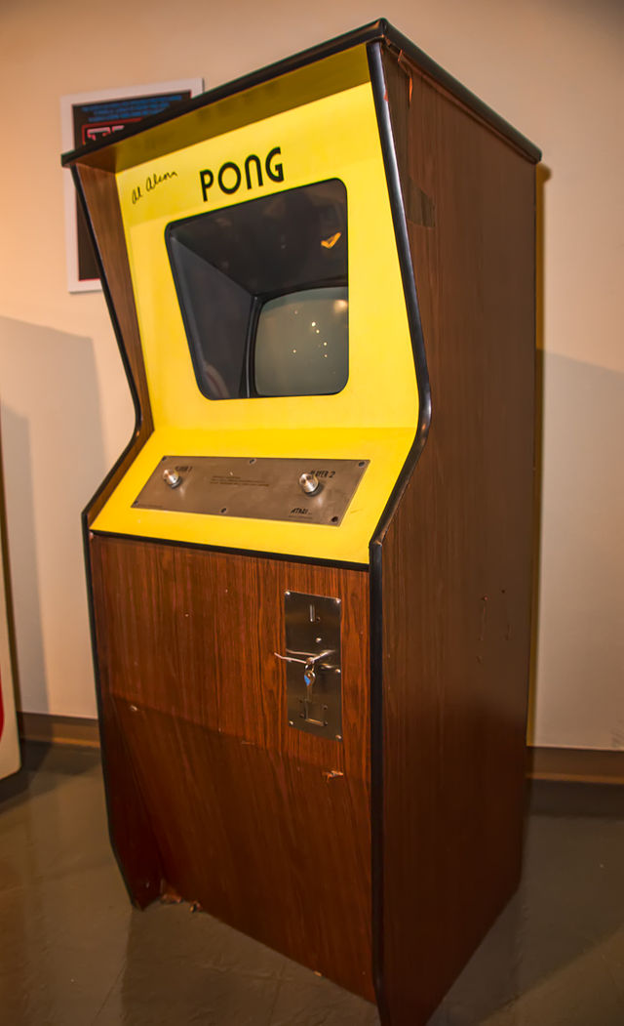
First Mass Video Game
Pong
1972
19,000 machines sold
(similar to game console).

Slide 21
Color Games
Space Invaders
1978
Produced by Atari

Slide 22
1979
Asteroids
Produced by Atari

Slide 23
1980
Pac-Man

Slide 24
Conclusion
Computers understand only binary code (0s and 1s).
Computers can execute only simple operations: read/write memory, arithmetic operations, interact with I/O devices (through the main memory of the I/O devices).
A computer program is written using text. Then a compiler or an interpreter is used to create the binary code that computers can understand.
Permanent data is saved on the hard disk. It needs to be moved to the main memory before it can be accessed by the CPU. The size of the main memory is much smaller than the size of hard disk. However, reading from / (writing to) main memory is much faster.

