Slide 1
Layout Management and GUI Components
Chapter 12

Slide 2
Overview
Creating Graphical User Interface (GUI) components: Buttons, Labels, Text Fields, Text Areas, Scroll Bars, Check Boxes, Radio Buttons, and so on.
Layouts: Flow Layout, Grid Layout, Border Layout.

Slide 3
Creating Buttons
We use the class JButton to create buttons. It starts with J because it is part of the Swing library.
The constructor can take as input the text that is to be displayed in the button.
An object that belongs to a class that implements the ActionListener interface can be registered with a button.
Use the method addActionListner to register the event listener with the button.
When the button is pressed, the actionPerformed method of the action listener is called.
The getText/setText methods can be used to get/set the text of a button.
The pack method is used to automatically set the window size.

Slide 4
import java.awt.event.*;
import javax.swing.*;
public class ButtonGame {
public static void main(String[] args) {
MyFrame f = new MyFrame();
f.setVisible(true);
}
}
class MyFrame extends JFrame {
public MyFrame() {
final JButton button = new JButton("Press me please");
button.addActionListener(new ActionListener() {
public void actionPerformed(ActionEvent e) {
button.setText("Thank You!");
}
});
add(button);
pack();
}
}

Slide 5
Flow Layout
Default layout for JPanel.
Components are ordered left to right and top to bottom.
When the first line of components is filled, a second line is started and so on.
The setLayout method changes the layout (for JPanel and JFrame).
setLayout(new FlowLayout(FlowLayout.LEFT,2,10)) changes the layout to flow layout, left justified (default is center), 2 pixels horizontal gap and 5 pixels vertical gap.

Slide 6
import java.awt.*;
import javax.swing.*;
public class Test{
public static void main(String[] args){
MyFrame f = new MyFrame();
f.setVisible(true);
}
}
class MyFrame extends JFrame {
public MyFrame() {
JButton button1 = new JButton("First Button");
JButton button2 = new JButton("Second Button");
JButton button3 = new JButton("Third Button");
setLayout(new FlowLayout());
add(button1);
add(button2);
add(button3);
pack();
}
}

Slide 7
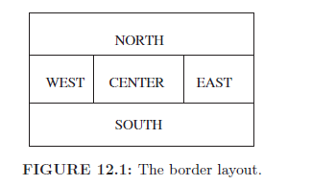
Border Layout
Default layout for JFrame.
Allows us to add a component (including a panel) in one of five areas.
When a window is resized, only the size of the center area changes.

Slide 8
...
class MyFrame extends JFrame {
public MyFrame() {
JPanel p1 = new JPanel();
p1.setBackground(Color.RED);
JPanel p2 = new JPanel();
p2.setBackground(Color.GREEN);
JPanel p3 = new JPanel();
p3.setBackground(Color.ORANGE);
JPanel p4 = new JPanel();
p4.setBackground(Color.WHITE);
JPanel p5 = new JPanel();
p5.setBackground(Color.BLACK);
add(p1,BorderLayout.NORTH);
add(p2,BorderLayout.WEST);
add(p3,BorderLayout.CENTER);
add(p4,BorderLayout.EAST);
add(p5,BorderLayout.SOUTH);
pack();
}
}

Slide 9
More on Border Layout
p.setLayout(new BorderLayout()) will change the layout of the panel p.
add(p, BorderLayout.SOUTH) will add the panel p to the south.
Note that we cannot add more than one component in any area.
If multiple components are added in the same area, then only the last component is visible.
If we do not specify the location in the add method, then the component is inserted in the center.
This is why we cannot add multiple components to a frame if we do not specify the location (e.g., SOUTH).

Slide 10
Text Fields and Labels
JTextField creates a text field. This is a field where the user can enter text. The getText/setText method can get/set the text of the field.
The trim method should be called after calling the getText method. It will remove leading/trailing spaces.
The constructor of JTextField can take as input the approximate size of the filed in characters.
JLabel creates a label. It is similar to a text filed, but it cannot be edited.
Next slides show a program that converts between degree Celsius and degree Fahrenheit.

Slide 11
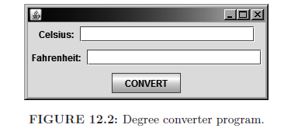

Slide 12
import java.awt.*;
import java.awt.event.*;
import javax.swing.*;
public class DegreeConverter{
public static void main(String[] args){
ConverterFrame f = new ConverterFrame();
f.setVisible(true);
}
}
class ConverterFrame extends JFrame {
public ConverterFrame() {
setDefaultCloseOperation(JFrame.DISPOSE_ON_CLOSE);
setLayout(new BorderLayout()); //not required
JPanel cPanel = new JPanel();
JPanel fPanel = new JPanel();
JPanel buttonPanel = new JPanel();
final JTextField cField = new JTextField(20);
final JTextField fField = new JTextField(20);
cPanel.add(new JLabel("Celsius: "));
cPanel.add(cField);

Slide 13
fPanel.add(new JLabel("Fahrenheit: "));
fPanel.add(fField);
JButton convertButton = new JButton("CONVERT");
buttonPanel.add(convertButton);
add(cPanel, BorderLayout.NORTH);
add(fPanel, BorderLayout.CENTER);
add(buttonPanel, BorderLayout.SOUTH);
convertButton.addActionListener(new ActionListener() {
public void actionPerformed(ActionEvent e) {
if (cField.getText().trim().equals("") &&
fField.getText().trim().equals("")) {
return; //both empty
}
if (cField.getText().trim().equals("")) {
// From Fahrenheit to Celsius
String result = fField.getText().trim();
double number = Double.parseDouble(result);
number = (number-32)*(5/9.0);
cField.setText("" + number);
}

Slide 14
if (fField.getText().trim().equals("")) {
// From Celsius to Fahrenheit
String result = cField.getText().trim();
double number = Double.parseDouble(result);
number = number * (9 / 5.0) + 32;
fField.setText("" + number);
}
}
});
pack();
}
}
Note, parseDouble method of class Double convers a string to a
double. There is a similar parseInt method in the class Integer.

Slide 15
Grid Layout
The components are placed in a rectangular grid.
Use GridLayout to create the grid.
Example: new GridLayout(2,4,3,6) will create 2 rows, 4 columns, 3 pixels horizontal gap and 6 pixels vertical gap. Last two parameters are optional.
We will show a calculator application, where we will use a grid layout to create the buttons.
String s = (new ScriptEngineManager(). getEngineByName("JavaScript").eval(expression).toString(); will evaluate the expression. It also throws an exception.

Slide 16
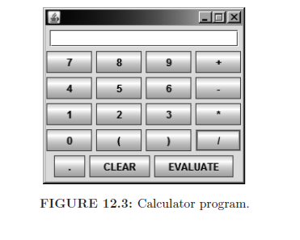

Slide 17
import java.awt.*;
import java.awt.event.*;
import javax.swing.*;
import javax.script.*;
public class Calculator{
public static void main(String[] args) throws Exception{
CalculatorFrame f = new CalculatorFrame();
f.setVisible(true);
}
}
class CalculatorFrame extends JFrame {
JTextField text = new JTextField(20);
public CalculatorFrame() throws Exception {
setDefaultCloseOperation(JFrame.DISPOSE_ON_CLOSE);
JPanel displayPanel = new JPanel();
JPanel buttonPanel = new JPanel();
JPanel bottomPanel = new JPanel();

Slide 18
displayPanel.add(text);
String[] buttonNames = {"7", "8", "9", "+", "4", "5",
"6", "-", "1", "2", "3", "*", "0", "(", ")", "/"};
buttonPanel.setLayout(new GridLayout(4, 4, 5, 5));
for (String el : buttonNames) {
buttonPanel.add(new CalculatorButton(el));
}
JButton evaluateButton = new JButton("EVALUATE");
JButton clearButton = new JButton("CLEAR");
clearButton.addActionListener(new ActionListener() {
public void actionPerformed(ActionEvent e) {
text.setText("");
}
});
evaluateButton.addActionListener(new ActionListener() {
public void actionPerformed(ActionEvent e) {
try {
String s = (new ScriptEngineManager().
getEngineByName("JavaScript").eval(text.getText().
trim())).toString();
text.setText(s);
} catch (Exception exc) {

Slide 19
text.setText("");
}
}
});
bottomPanel.add(new CalculatorButton("."));
bottomPanel.add(clearButton);
bottomPanel.add(evaluateButton);
add(displayPanel, BorderLayout.NORTH);
add(buttonPanel, BorderLayout.CENTER);
add(bottomPanel, BorderLayout.SOUTH);
setResizable(false);
pack();
}

Slide 20
private class CalculatorButton extends JButton {
public CalculatorButton(String name) {
super(name);
addActionListener(new ActionListener() {
public void actionPerformed(ActionEvent e) {
text.setText(text.getText().trim() +
CalculatorButton.super.getText());
}
});
}
}
}
Note the syntax: CalculatorButton.super from an inner class.
This refers to the super object of the outer class. Alternatively,
CalculatorButton.this will refer to the outer object.

Slide 21
Text Areas
A text area is similar to a text field, but it contains multiple lines.
It is created using the JTextArea class.
new JTextArea(20,30) will create a text area of 30 lines, where every line has approximately 20 characters.
getText/setText method can be used to get/set the text of the text area.
The append method can be used to append text.
If we want scrollbars, then we can create an object of type JScrollPane, which constructor takes as input an object of type JTextArea.
Next slide shows first version of a poor-man's notepad application.

Slide 22
import java.awt.*;
import javax.swing.*;
public class Notepad{
public static void main(String[] args) {
NotepadFrame f = new NotepadFrame();
f.setVisible(true);
}
}
class NotepadFrame extends JFrame{
private static int WIDTH = 600;
private static int HEIGHT = 600;
public NotepadFrame(){
setSize(WIDTH,HEIGHT);
setDefaultCloseOperation(JFrame.DISPOSE_ON_CLOSE);
JTextArea textArea = new JTextArea();
add(new JScrollPane(textArea),BorderLayout.CENTER);
}
}

Slide 23
Combo Boxes
A combo box allows us to select from a number of options
Created using the JComboBox class. Constructor can be empty or take as input an array of strings.
getSelectedItem/setSelectedItem get/set selected item. Result is of type object and it must be casted to appropriate type (e.g., String).
setEditable(false) makes the combo box not editable.
addItem method adds a new item to the menu.
Adding available fonts:
JComboBox fontComboBox = new JComboBox(fontNames);
or
JComboBox sizeComboBox = new JComboBox();
for(int i = 8; i<=72; i++ ){
sizeComboBox.addItem(i);
}

Slide 24
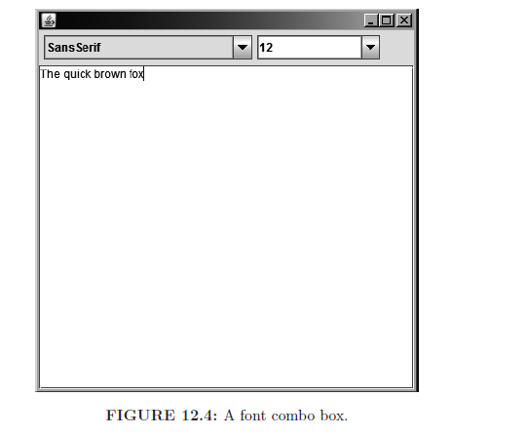

Slide 25
import java.awt.*;
import java.awt.event.*;
import javax.swing.*;
public class Notepad{
public static void main(String[] args) {
NotepadFrame f = new NotepadFrame();
f.setVisible(true);
}
}
class NotepadFrame extends JFrame{
private static int WIDTH = 600;
private static int HEIGHT = 600;
public NotepadFrame(){
setDefaultCloseOperation(JFrame.DISPOSE_ON_CLOSE);
setSize(WIDTH,HEIGHT);
final JTextArea textArea = new JTextArea();
add(new JScrollPane(textArea),BorderLayout.CENTER);
JPanel controlPanel = new JPanel();

Slide 26
controlPanel.setLayout(new FlowLayout(FlowLayout.LEFT));
String[] fontNames = GraphicsEnvironment.
getLocalGraphicsEnvironment().
getAvailableFontFamilyNames();
final JComboBox fontComboBox = new JComboBox(fontNames);
fontComboBox.setSelectedItem("SansSerif");
final JComboBox sizeComboBox = new JComboBox();
for(int i = 8; i <= 72; i++){
sizeComboBox.addItem(i);
}
sizeComboBox.setSelectedItem(12);
sizeComboBox.setEditable(true);
ActionListener changeListener = new ActionListener(){
public void actionPerformed(ActionEvent e){
textArea.setFont(new Font((String)fontComboBox.
getSelectedItem(),Font.PLAIN,
(Integer)sizeComboBox.getSelectedItem()));
}
};
fontComboBox.addActionListener(changeListener);
sizeComboBox.addActionListener(changeListener);
controlPanel.add(fontComboBox);

Slide 27
controlPanel.add(sizeComboBox);
add(controlPanel,BorderLayout.NORTH);
}
}
The setFont method changes the font of a JTextArea.
An ActionListener can be registered with a JComboBox object.
It is activated when the current value of the combo box is changed.
Inside any listener, we can write e.getSource() to refer to the
source of the event e.
Note that a single action listener can handle both combo boxes.
Inside the action listener, we change both the font and the point size
of the text.

Slide 28
Check Boxes
A small square where the user can place a check box.
Uses the JCheckBox class.
The isSelected method tells us if the checkbox is selected.
We will expand our Notepad application and add checkboxes for bold and italic.
import java.awt.*;
import java.awt.event.*;
import javax.swing.*;
public class Test{
public static void main(String[] args) {
NotepadFrame f = new NotepadFrame();
f.setVisible(true);
}
}

Slide 29
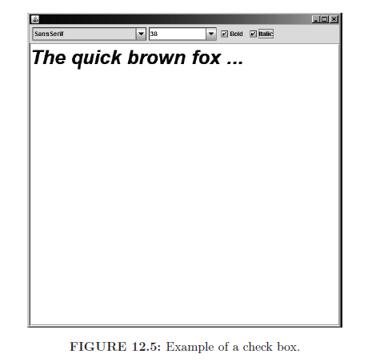

Slide 30
class NotepadFrame extends JFrame {
private static int WIDTH = 600;
private static int HEIGHT = 600;
public NotepadFrame() {
setDefaultCloseOperation(JFrame.DISPOSE_ON_CLOSE);
setSize(WIDTH, HEIGHT);
final JTextArea textArea = new JTextArea();
add(new JScrollPane(textArea), BorderLayout.CENTER);
JPanel controlPanel = new JPanel();
controlPanel.setLayout(new FlowLayout(FlowLayout.LEFT));
String[] fontNames = GraphicsEnvironment.
getLocalGraphicsEnvironment().
getAvailableFontFamilyNames();
final JComboBox fontComboBox = new JComboBox(fontNames);
fontComboBox.setSelectedItem("SansSerif");
final JComboBox sizeComboBox = new JComboBox();
final JCheckBox boldCheckBox = new JCheckBox("Bold");
final JCheckBox italicCheckBox = new JCheckBox("Italic");
for (int i = 8; i <= 72; i++) {
sizeComboBox.addItem(i);
}

Slide 31
sizeComboBox.setSelectedItem(12);
sizeComboBox.setEditable(true);
ActionListener changeListener = new ActionListener() {
public void actionPerformed(ActionEvent e) {
int mask = Font.PLAIN;
if (boldCheckBox.isSelected()) {
mask += Font.BOLD;
}
if (italicCheckBox.isSelected()) {
mask += Font.ITALIC;
}
textArea.setFont(new Font((String)
fontComboBox.getSelectedItem(), mask,
(Integer) sizeComboBox.getSelectedItem()));
}
};
fontComboBox.addActionListener(changeListener);
sizeComboBox.addActionListener(changeListener);
boldCheckBox.addActionListener(changeListener);
italicCheckBox.addActionListener(changeListener);

Slide 32
controlPanel.add(fontComboBox);
controlPanel.add(sizeComboBox);
controlPanel.add(boldCheckBox);
controlPanel.add(italicCheckBox);
add(controlPanel, BorderLayout.NORTH);
}
}
Note that there is a single event listener.
It is registered with the two combo boxes and two check boxes.
When an event occurs, the value of all combo boxes and
checkboxes is examined and the font is set appropriately.

Slide 33
Radio Buttons
Radio buttons are similar to checkboxes. However, they are round and several of them can be put in the same button group. A button group has the property that only one radio button in the group can be selected at any time.
The JRadioButton class can be used to crate a radio button.
The constructor of JRadioButton can take as input the name of the radio button and a Boolean value that specify whether the radio button is initially selected.
It has the isSelected method that lets us know whether the radio button is selected.

Slide 34
Button Groups
A button group is created using the ButtonGroup class (part of
AWT and no J).
A button group is formed by adding radio buttons to it using the
add method.
Java makes sure that only one radio button in a button group
can be selected at any given time.

Slide 35
import java.awt.*;
import javax.swing.*;
public class Test{
public static void main(String[] args) {
NumbersFrame f = new NumbersFrame();
f.setVisible(true);
}
}
class NumbersFrame extends JFrame{
public NumbersFrame(){
setSize(400,100);
JPanel p = new JPanel();
add(p,BorderLayout.NORTH);
JRadioButton upButton = new JRadioButton("Increment",
true);
JRadioButton downButton = new JRadioButton("Decrement",
false);
p.add(upButton);
p.add(downButton);
ButtonGroup group = new ButtonGroup();
group.add(upButton);
group.add(downButton);}}

Slide 36
Document Listeners
We can associate a document listener with a document. The getDocument method can be called on a text field or text area to get the associated document.
The document listener needs to inherit from the DocumentListner interface, which has the insertUpdate, removeUpdate, and changeUpdate methods. If the document listener object inherits from the DocumentAdapter class, than we can chose which methods to override.
Use the addDocumentListener method to register the listener.
Next slides show a simple program that has the same radio buttons as before. The text in the text field can be automatically or manually changed.

Slide 37
import java.awt.*;
import java.awt.event.*;
import javax.swing.*;
import javax.swing.event.*;
public class Test{
public static void main(String[] args) {
NumbersFrame f = new NumbersFrame();
f.setVisible(true);
}
}
class NumbersFrame extends JFrame {
JRadioButton upButton;
JRadioButton downButton;
public NumbersFrame() {
setSize(400,100);
JPanel p = new JPanel();
add(p, BorderLayout.NORTH);
upButton = new JRadioButton("Increment", true);
downButton = new JRadioButton("Decrement", true);
p.add(upButton);

Slide 38
p.add(downButton);
ButtonGroup group = new ButtonGroup();
group.add(upButton);
group.add(downButton);
CenterPanel centerPanel = new CenterPanel();
add(centerPanel, BorderLayout.CENTER);
}
class CenterPanel extends JPanel {
JTextField textField = new JTextField("0", 20);
int x = 0;
public CenterPanel() {
add(textField);
Timer t = new Timer(1000, new ActionListener() {
public void actionPerformed(ActionEvent e) {
if (upButton.isSelected()) x++;
if(downButton.isSelected()) x--;
textField.setText("" + x);
}
});
t.start();

Slide 39
textField.getDocument().addDocumentListener(
new DocumentListener() {
public void insertUpdate(DocumentEvent e) {
try {
x = Integer.parseInt(textField.getText().
trim());
} catch (Exception es) {
}
}
public void removeUpdate(DocumentEvent e) {
try {
x = Integer.parseInt(textField.getText().
trim());
} catch (Exception es) {
}
}
public void changedUpdate(DocumentEvent e) {
}
});
}
}
}

Slide 40
Notes
The parseInt method will raise an exception when the input does not contain an integer.
This is the reason we have a try/catch block that handles this exception.
When the user enters something that is not an integer in the text field, the program simply ignores it. When the second expires, the program adds/deletes one to/from the old number.

Slide 41
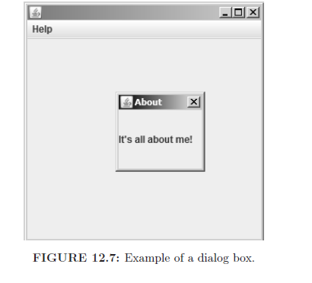
Dialog Boxes
Similar to a regular window, but it cannot be minimized or restored.
Example:

Slide 42
Dialog Boxes (cont'd)
A modal dialog box prevents interaction with all other windows of the application until the dialog is closed (e.g., we are asking for login/password).
A modeless dialog box allows us to interact with it and other windows of the application at the same time.
A dialog box is created using the JDialog class. The constructor takes as input a reference to the parent window, the title of the dialog box, and a Boolean value that tells us whether the dialog is modal.

Slide 43
import java.awt.event.*;
import javax.swing.*;
public class AboutProgram{
public static void main(String[] args) {
AboutFrame f = new AboutFrame();
f.setVisible(true);
}
}
class AboutFrame extends JFrame {
public AboutFrame() {
setSize(300, 300);
JMenuBar menuBar = new JMenuBar();
setJMenuBar(menuBar);
JMenu helpMenu = new JMenu("Help");
menuBar.add(helpMenu);
JMenuItem aboutMI = new JMenuItem("About");
helpMenu.add(aboutMI);
aboutMI.addActionListener(new ActionListener() {
public void actionPerformed(ActionEvent e) {

Slide 44
AboutDialog dialog = new
AboutDialog(AboutFrame.this);
dialog.setSize(100, 100);
dialog.setVisible(true);
}
});
}
}
class AboutDialog extends JDialog {
public AboutDialog(JFrame owner) {
super(owner, "About", true);
JLabel label = new JLabel("It's all about me!");
add(label);
}
}
Note the reference AboutFrame.this. This refers to the outer object,
which happens to be the parent window.

Slide 45
Password Fields
In a password field, stars are shown instead of characters.
There is some extra security added in processing the result.
The JPasswordField class is similar to a JTextField. However, it is used to enter password information.
It supports the getPassword method, which returns the password as an array of characters.
Next, we show a program that displays a login/password in a modal dialog.
The program only continues when the correct login/password is entered.
The dispose method is used to destroy the dialog when the correct information is entered.

Slide 46
import javax.swing.*;
import java.awt.*;
import java.awt.event.*;
import java.util.Arrays;
public class PasswordGame {
public static void main(String[] args){
LoginFrame frame = new LoginFrame();
}
}
class LoginFrame extends JFrame {
public LoginFrame() {
setVisible(true);//we need to make the frame visible
setSize(300, 300);//before we display the dialog
LoginDialog dialog = new LoginDialog(this);
dialog.setSize(200, 100);//this is parent window
dialog.setVisible(true);
}

Slide 47
class LoginDialog extends JDialog {
public LoginDialog(JFrame owner) {
super(owner, "Authentication", true);
setResizable(false);
setDefaultCloseOperation(JDialog.DO_NOTHING_ON_CLOSE);
JPanel centerPanel = new JPanel();
centerPanel.setLayout(new GridLayout(2, 2));
JLabel label1 = new JLabel("login: ");
centerPanel.add(label1);
final JTextField loginField = new JTextField("", 10);
centerPanel.add(loginField);
JLabel label2 = new JLabel("passowrd: ");
centerPanel.add(label2);
final JPasswordField passwordField =
new JPasswordField("", 10);
centerPanel.add(passwordField);
add(centerPanel, BorderLayout.CENTER);
JPanel southPanel = new JPanel();
add(southPanel, BorderLayout.SOUTH);
JButton okButton = new JButton("OK");
southPanel.add(okButton);

Slide 48
okButton.addActionListener(new ActionListener() {
public void actionPerformed(ActionEvent e) {
char[] correctPassword = {'f','u','n'};
if (loginField.getText().trim().equals("java")){
char[] password = passwordField.getPassword();
if(Arrays.equals(password,correctPassword)){
LoginDialog.this.dispose();
}
}
Arrays.fill(correctPassword, '0');
}
});
}
}
}

Slide 49
Notes
We used setDefaultCloseOperation(JDialog.DO_NOTHING_ON_CLOSE); to prevent the user from closing the dialog.
Arrays.equals is used to compare the password with the correct password.
We erase the correct password from main memory using Arrays.fill(correctPassword, '0') when we are done.
LoginDialog.this refers to the outer object.
A better implementation will be to store a function of the correct password. Then we can apply the function of the input password and compare the result. One should not be able to easily deduce the inverse of the function in order for this to work.

Slide 50
Summary
We described three layouts: Flow, Border, and Grid. There are more layouts and we can even define our own layout (not covered here).
We described different GUI components, including buttons, text fields, text areas, sliders, combo boxes, check boxes, radio boxes, and password fields.
We described how to create dialogs. Dialogs are windows that cannot be minimized. A modal dialog prevents the user from interacting with other windows until the dialog is closed.

