Slide 1
Recursion
Chapter 14

Slide 2
Overview
Base case and general case of recursion.
A recursion is a method that calls itself. That simplifies the problem. The simpler method is solved the same way. At some point, the problem becomes very simple, and a direct solution (a.k.a., a base case) is applied.
We will examine problems that can be solved using recursion, including Tower of Hanoi, binary search, and different sort algorithms (bubble, selection, insertion, quick, and merge sort).

Slide 3
Example of Recursive Definition
Fibonacci Numbers
f(x)=f(x-1)+f(x-2) - general case (x>?)
f(1)=1 - base case
f(2)=1 - base case

Slide 4
Example Solution
public static int f(int x){
if( x == 1) return 0;
if( x == 2) return 1;
return f(x-1)+f(x-2);
}

Slide 5
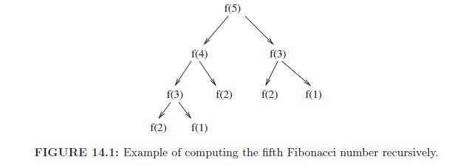
Exponential time. For example, the algorithm will take
forever for n = 100. Reason: Same calculations performed multiple
times!

Slide 6
Dynamic Programming
Instead of starting with a big problem and breaking it down into smaller problems, why not start with a small problem, save the result, and combine pieces until we can solve the big problem.
No recursion required!
For example, we will calculate f(1), f(2), f(3) and so on.

Slide 7
Dynamic Programming Solution
public static long f(int x) {
if (x == 1) {
return 1L;
}
if (x == 2) {
return 1L;
}
long a[] = new long[x + 1];
a[1] = 1L;
a[2] = 1L;
for (int i = 3; i <= x; i++) {
a[i] = a[i - 1] + a[i - 2];
}
return a[x];
}

Slide 8
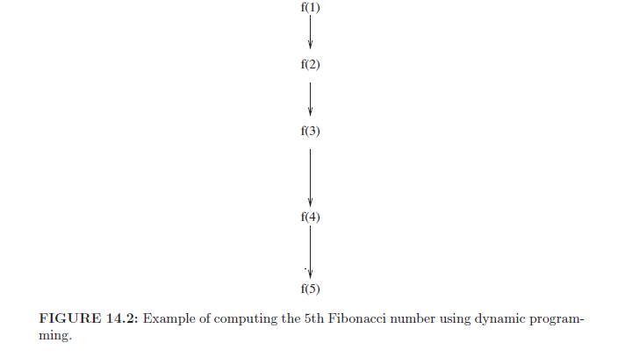

Slide 9
Recursion or Iteration?
Two ways to solve particular problem:
Iteration and
Recursion.
Iterative control structures use looping to repeat a set of statements.
Tradeoffs between two options.
Sometimes recursive solution is easier.
Recursive solution is often slower. Often, stack overflow.

Slide 10
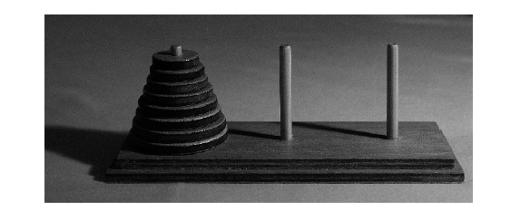
Tower of Hanoi Problem
We want to move the disks from the first to the third needle.
We are only allowed to place a disk on a bigger disk or empty
needle.
Recursively: move n-1 disks to the middle needle, the last disk to
the last needle and then n-1 disks to the last needle.

Slide 11
Recursive Solution
public class Test {
public static void main(String args[]) {
move(8, "needle 1","needle 3","needle 2");
}
public static void move(int count, String sourceNeedle,
String destinationNeedle, String intermediateNeedle){
if(count == 0) return;//base case
move(count-1, sourceNeedle, intermediateNeedle,
destinationNeedle);
System.out.println("Move a ring from: "+sourceNeedle+
" to "+destinationNeedle);
move(count-1, intermediateNeedle, destinationNeedle,
sourceNeedle);
}
}

Slide 12
Keys to a Recursive Solution
Start by creating the recursive formula. How can you solve the problem by braking it down into smaller problems?
Write the recursive method. Always start with the base cases!
Next, add the general cases.
Use a recursive solution for problems that cannot be easily solved iteratively.

Slide 13
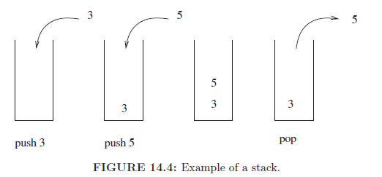
Stack
The push method places something on top of the stack.
The pop method removes the top of the stack and returns it.

Slide 14
Internal Details of a Recursive Call
Every time a method is called (recursively or not), the value of all local variables and the return address are stored in a frame and pushed on top of the stack.
When a method executes a return statement, the program pops the top frame of the stack. It transitions to the return address and it loads the value for all the local variables of the method from the frame.

Slide 15
Example Factorial Method
public static int f(int n){
if(n == 0){
return 1;
}
return f(n-1)*n;
}

Slide 16
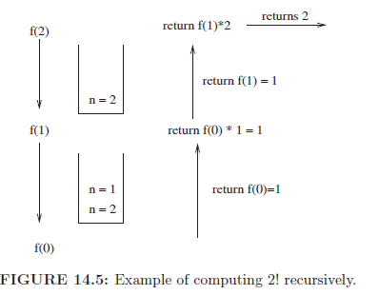

Slide 17
Tail Recursion
Some recursive methods can be easily rewritten not to use recursion.
These are the methods where there is a single recursive call at the end of every execution branch.
The rewrite uses an infinite while loop. The base case is presented first in the loop. When the base case is reached, a return statement is used to exit the loop. The general case is described next inside the loop. It is implemented by changing the values of the variables. A result variable that saves the result of the operation is introduced.
Next slide shows an iterative solution of the factorial method.

Slide 18
Non-recursive Version of Factorial
public static int f(int n){
int result = 1;
while(true){
if(n == 0){//base case
return result;
}
//general case
result = result * n;//new value of result is
calculated
n--;
}
}

Slide 19
Guessing Game
User thinks of a number between 1 and 1000.
Computer tries to guess it. First, we try 500.
The solution is recursive.
At every guess, we split the existing interval in two.
Base case is when the interval contains a single number. Then this must be the number.
Tail recursion is used. Second slide shows non-recursive solution.
public static void main(String[] args){
System.out.println("Please think of a number
between 1and 1000");
guess(1,1000, 500);
}

Slide 20
public static void guess(int low, int high, int guess){
if(low == high){
System.out.println("Your number must be: "+low);
System.exit(0);
}
System.out.print("Is your number higher(h), lower(l),
or equal(e) to: "+guess+": ");
Scanner keyboard = new Scanner(System.in);
String result = keyboard.next();
switch(result.charAt(0)){
case 'h':
guess(guess+1,high, (guess+high+1)/2); break;
case 'l':
guess(low, guess-1, (low+guess-1)/2); break;
case 'e':
System.out.println("I win again!");
System.exit(0);
}
}
}

Slide 21
public static void guess(int low, int high, int guess) {
while (true) {
if (low == high) {
System.out.println("Your number must be: " + low);
System.exit(0);
}
System.out.print("Is your number higher(h), lower(l),
or equal(e) to: " + guess + ": ");
Scanner keyboard = new Scanner(System.in);
String result = keyboard.next();
switch (result.charAt(0)) {
case 'h':
low=guess + 1;
guess = (guess + high + 1) / 2;break;
case 'l':
high = guess - 1;
guess = (low + guess - 1) / 2; break;
case 'e':
System.out.println("I win again!");
System.exit(0);
}
}}

Slide 22
Binary Search
We are given as input a sorted array of numbers.
We want to find if a number is in the array.
If it is, then we need to return the index of the number.
If the number is not in the array, then we will return -1.
We will solve the problem recursively. At every step, we will compare the number to the middle of the array. If the number is higher, then the number must be in the second half of the array.
The base case is when the array contains a single element.
The search method will take as input an array and the bounds of the array. The reason is that it is difficult to crate part of an array. However, it is much easier to change the start and end index of the current array.

Slide 23
class BinarySearch{
public static void main(String[] args) {
int[] a = {1,3,5,8,20,50,100};
System.out.println(binarySearch(0, a.length-1, 5, a));
}
public static int binarySearch(int start, int end,
int number, int [] a) {
int mid = (start + end) / 2;
if(a[mid]==number){
return mid;
}
if (start == end) {
return -1;//element not in array
}
if (a[mid] > number) {
return binarySearch(start, mid-1, number, a);
}
return binarySearch(mid + 1, end, number, a);
}
}

Slide 24
//Non-recursive version
public static int binarySearch(int start, int end,
int number, int[] a) {
while (true) {
int mid = (start + end) / 2;
if (a[mid] == number) {
return mid;
}
if (start == end) {
return -1;
}
if (a[mid] > number) {
end = mid-1;
} else {
start = mid + 1;
}
}
}

Slide 25
Bubble Sort
We go left to right and compare neighboring pair of numbers. If they are in the wrong order, we swap them.
10 5 20 2 (first compare 10 and 5, wrong order, swap them)
5 10 20 2 (compare 10 and 20, correct order)
5 10 20 2 (compare 20 and 2, wrong order, swap them)
5 10 2 20
After the first pass, the biggest number is at the end. Now we can recursively apply the algorithm on all the numbers except the last one.
Base case is when we have a single number.
Recursive and non-recursive solutions follow.

Slide 26
public class Test {
public static void main(String args[]) {
int[] a = {10,5,20,2};
bubbleSort(a,a.length-1);
for(int el: a){
System.out.print(el+" ");
}
}
//start of array is always 0!
public static void bubbleSort(int []a, int end){
if(end==0) return;//base case
for(int i = 0; i < end; i++){
if(a[i]>a[i+1]){
int temp = a[i];
a[i] = a[i+1];
a[i+1] = temp;
}
}
bubbleSort(a,end-1);
}
}

Slide 27
// Non-recursive solution
public static void bubbleSort(int[] a, int end) {
while (true) {
if (end == 0) {
return;
}
for (int i = 0; i < end; i++) {
if (a[i] > a[i + 1]) {
int temp = a[i];
a[i] = a[i + 1];
a[i + 1] = temp;
}
}
end--;
}
}

Slide 28
//Optimized version
//If we do a pass and no changes, then the array is sorted
public static void bubbleSort(int[] a, int end) {
while (true) {
if (end == 0) {
return;
}
boolean modified = false;
for (int i = 0; i < end; i++) {
if (a[i] > a[i + 1]) {
int temp = a[i];
a[i] = a[i + 1];
a[i + 1] = temp;
modified = true;
}
}
if(!modified) return; //array not modified
end--;
}
}

Slide 29
Selection Sort
The algorithm goes through the whole array and finds the smallest number.
It then swaps this element with the first element of the array. Now the smallest element is at the beginning. The algorithm is then recursively applied on all but the first element of the array.
Base case is when the array contains a single element.
10 5 20 2 (smallest number is 2).
2 5 20 10 (smallest number is swapped with first number).
Next, the array (5,20,10) is recursively sorted.
Recursive and non-recursive solutions are shown next.

Slide 30
public class SelectionSort {
public static void main(String args[]) {
int[] a = {10, 5, 20, 2};
selectionSort(0, a);
for (int el : a) {
System.out.print(el + " ");
}
}
public static int findMin(int a[], int start) {
int minIndex = start;
for (int i = start; i < a.length; i++) {
if (a[i] < a[minIndex]) {
minIndex = i;
}
}
return minIndex;
}

Slide 31
public static void swap(int a[], int i, int j) {
int temp = a[i];
a[i] = a[j];
a[j] = temp;
}
public static void selectionSort(int start, int[] a) {
if (start == a.length - 1) { //base case
return;
}
int j = findMin(a, start);
swap(a, start, j);
selectionSort(start + 1, a);
}
}

Slide 32
Non-recursive Solution
public static void selectionSort(int start, int[] a) {
while (true) {
if (start == a.length - 1) {
return;
}
int j = findMin(a, start);
swap(a, start, j);
start++;
}
}

Slide 33
Insertion Sort
There are two lists. Initially, the first list is empty.
We keep removing the first number from the second list and inserting it in the first list in the proper place.
Base case is when the second list becomes empty. At this point, the first list is sorted.
l1:{} l2={23,2,4,65,3}
after 1 iteration: l1: {23} l2={2,4,65,3}
after 2 iteration: l1={2,23}, l2={4,65,3}
after 3 iterations: l1={2,4,23}, l2={65,3}
after 4 iterations: l1={2,4,23,65}, l2={3}
after 5 iterations: l1={2,3,4,23,65}, l2={}

Slide 34
import java.util.*;
public class InsertionSort{
public static void main(String args[]) {
int[] a = {23,2,4,65,3};
ArrayList<Integer> l1 = new ArrayList<>();
ArrayList<Integer> l2 = new ArrayList<>();
for(int el:a) {
l2.add(el);
}
insertionSort(l1, l2);
System.out.println(l1);
}
We used ArrayLists because it is easier to inert a new element
and delete an existing element.

Slide 35
public static void insertionSort(ArrayList<Integer> l1,
ArrayList<Integer> l2){
if(l2.size()==0){
return;
}
int newElement = l2.get(0);
l2.remove(0);
for(int i=0;i < l1.size(); i++){
if(newElement< l1.get(i)){
l1.add(i,newElement);
insertionSort(l1,l2);
return;//We found the insertion spot and we are done
}
}
l1.add(newElement);//Insert element at the end
insertionSort(l1,l2);
}
}

Slide 36
//Non-recursive solution
public static void insertionSort(ArrayList<Integer> l1,
ArrayList<Integer> l2) {
while (true) {
if (l2.size() == 0) {
return;
}
int newElement = l2.get(0);
l2.remove(0);
int i;
for (i = 0; i < l1.size(); i++) {
if (newElement < l1.get(i)) {
l1.add(i, newElement);
break;
}
}
if(i == l1.size()){
l1.add(newElement);
}
}
}

Slide 37
Running Time of Sorting Algorithm
All algorithms so far are kind of slow. In the worst case, given n numbers, they will take roughly n*n time to sort them. For example, if we need to sort one million numbers, then all sorting programs so far will perform poorly.
We will consider two more sorting algorithms: quick and merge.
Quick sort is fast on average, but on some input it can be as bad as the three slow sorts.
Merge sort performs good in the worst-case. However, it is a recursive algorithm. The algorithm splits the input list into two lists, sorts them, and then it merges them.
Strategy used in Java sorting methods: Keep applying merge sort while size of list is bigger than 10. For a list smaller than 10 elements, apply a simple algorithm (e.g., selection sort).

Slide 38
Quick Sort
We choose the first element of the list as the pivot element.
Then we split the list into two parts: all the elements that are smaller than the pivot and all the elements that are bigger than the pivot. If those lists are of roughly equal size, the algorithm will be fast.
We recursively sort each of the sub-lists to produce the result.
Example: 20 3 30 5 8 40 7
Pivot: 20, Smaller: 3 5 8 7 Bigger: 30 40
Result: {3,5,7,8},20,{30,40}

Slide 39
import java.util.*;
public class QuickSort {
public static void main(String args[]) {
int[] a = {20, 3, 30, 5, 8, 40, 7};
ArrayList<Integer> list = new ArrayList<>();
for (int el : a) {
list.add(el);
}
list = quickSort(list);
System.out.println(list);
}
An ArrayList is used to make insertion easier.
Ironically, the algorithm is slowest when input is sorted. Then one of
the sublists will be empty, which gives us the same worst-case
running time as the previous algorithms.

Slide 40
public static ArrayList<Integer>
quickSort(ArrayList<Integer> a){
if(a.size()<=1) return a;
int pivot = a.get(0);
ArrayList<Integer> smaller = new ArrayList<>();
ArrayList<Integer> greater = new ArrayList<>();
for(int i=1; i < a.size(); i++){
if(a.get(i)<= pivot){
smaller.add(a.get(i));
} else {
greater.add(a.get(i));
}
}
ArrayList<Integer> result = quickSort(smaller);
result.add(pivot);
result.addAll(quickSort(greater));
return result;
}
}

Slide 41
Merge Sort
Worst-case running time is roughly n*log(n). This is much better than previous algorithms.
The input is split in two roughly equal parts. Each part is recursively sorted and then the parts are merged.
The merging process looks at the head of the two lists and keeps adding the smallest of the two elements to the result.
When one of the lists becomes empty, the other list is sent to the result.
Example: 20 3 6 11 45 2
List1 sorted: {3,6,20} List2 sorted: {2, 11, 45}
We first move 2 to the result, then 3, then 6 and so on.

Slide 42
import java.util.*;
public class MergeSort {
public static void main(String args[]) {
int[] a = {20, 3, 6, 11, 45, 2};
ArrayList<Integer> list = new ArrayList<>();
for (int el : a) {
list.add(el);
}
list = mergeSort(list);
System.out.println(list);
}
public static ArrayList<Integer> mergeSort(
ArrayList<Integer> a) {
if (a.size() <= 1) {
return a;
}
ArrayList<Integer> firstHalf = new ArrayList<>();
ArrayList<Integer> secondHalf = new ArrayList<>();
for (int i = 0; i < a.size() / 2; i++) {
firstHalf.add(a.get(i));
}

Slide 43
for (int i = a.size() / 2; i < a.size(); i++) {
secondHalf.add(a.get(i));
}
return merge(mergeSort(firstHalf),
mergeSort(secondHalf));
}
public static ArrayList<Integer> merge(
ArrayList<Integer> l1, ArrayList<Integer> l2) {
ArrayList<Integer> result = new ArrayList<>();
while (true) {
if (l1.size() == 0) {
result.addAll(l2);
return result;
}
if (l2.size() == 0) {
result.addAll(l1);
return result;
}
if (l1.get(0) > l2.get(0)) {
int nextElement = l2.get(0);
result.add(nextElement);

Slide 44
l2.remove(0);
} else {
int nextElement = l1.get(0);
result.add(nextElement);
l1.remove(0);
}
}
}
}

Slide 45
//Recursive version of merge method
public static ArrayList<Integer> merge(
ArrayList<Integer> l1, ArrayList<Integer> l2) {
if (l1.size() == 0) {
return l2;
}
if (l2.size() == 0) {
return l1;
}
ArrayList<Integer> result = new ArrayList<>();
int nextElement;
if (l1.get(0) > l2.get(0)) {
nextElement = l2.get(0);
l2.remove(0);
} else {
nextElement = l1.get(0);
l1.remove(0);
}
result.add(nextElement);
result.addAll(merge(l1,l2));
return result;
}

Slide 46
Summary
When using recursion, first create a recursive algorithm. That is, an algorithm that solves the problem by braking it down into smaller problems.
In the recursive solution, always start with the base case.
When possible, avoid recursion. Recursion has overhead, such as putting frames on the stack.
Rewrite recursive programs that use tail recursion into non-recursive programs that use an infinite loop.
When sorting, merge sort has best worst-case running time. However, it is a recursive algorithm and there is overhead. A possible solution is to apply a simple sort (e.g., selection sort) when the list becomes small. This will reduce the size of the stack.

