Slide 1
Java Applets
Chapter 15

Slide 2
Overview
A Java Applet allows us to run a Java program from a web browser.
Usually, just the .class file is sent to the client. In order for this to work, the client must also have a Java Virtual Machine (JVM) installed.
We will show how to write Java applets and HTML files that use them.
We will show an example of a Tic-Tac-Toe Java applet.

Slide 3
HTML
Stands for HyperText Markup Language.
It is the de facto standard for creating web pages.
It contains both the text to display and markup information that tells us how to format the text. Can be automatically generated by NetBeans.
<HTML>
<HEAD>
<TITLE>Applet HTML Page</TITLE>
</HEAD>
<BODY>
<H3>Applet HTML Page</H3>
<P>
<APPLET codebase="classes" code="TicTacToe.class" width=350 height=200></APPLET>
</P>
</BODY>
</HTML>

Slide 4
HTML (cont'd)
Starts with <HTML> and ends with </HTML>.
Every section starts with <...> and ends with </...>
It has a <HEAD> section and a <BODY> section.
The <HEAD> section can contain a <TITLE> section. This is the text that will be displayed at the top of the web browser window when the web page is opened.
<BODY> section can contain several <H> sections. H stands for header. H1 displays the biggest header and H6 - the smallest. Font point size cannot be directly specified.
<P> section can be used to describe a new paragraph.
<APPLET> section can be used to describe a JAVA applet to be inserted here. width and height variables can be specified in pixels. codebase is the name of the directory that contains the .class file.

Slide 5
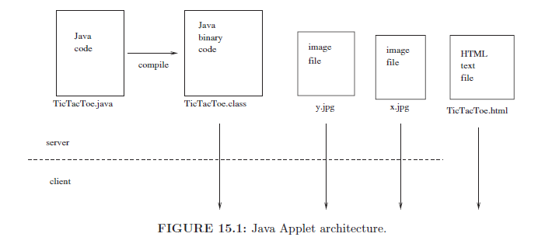

Slide 6
Writing a Java Applet
Remove the main method.
Create a class that extends JApplet. This will be the applet's window.
Add to this class the init method. This will be the first method to execute.
The setVisible method should not be called on the JApplet window because it is always visible.
The setTitle and setSize methods should not be called on the JApplet window because the title and the size of the applet are determined by the HTML file that opens the applet.
Remove any code that exits the program. An applet does not have a close button. Similarly, remove any reference to the setDefaultCloseOperation method for the applet window.
An applet can create additional JFrame objects (i.e., windows), but the applet window itself is not a JFrame object.

Slide 7
import java.awt.*;
import javax.swing.*;
public class MyApplet extends JApplet {
MyPanel p = new MyPanel();
public void init() {
p.setS("Initializing ...");
p.repaint();
add(p);
}
public void start() {
p.setS("Starting ...");
p.repaint();
}
public void stop() {
p.setS("Stopping ...");
p.repaint();
}

Slide 8
public void destroy() {
p.setS("Destroying ...");
p.repaint();
}
}
class MyPanel extends JPanel {
String s;
int i = 0;
public void setS(String s) {
this.s = s;
i++;
}
public void paintComponent(Graphics g) {
super.paintComponent(g);
g.drawString(s + " " + i, 10, 10);
}
}

Slide 9
JApplet Methods
init: called first at the beginning
start: called after init and every time the applet is started.
stop: called every time the applet is stopped and before the applet is killed.
destroy: called when the applet is destroyed.
The web browser decides when to start or stop an applet. For example, a heavy applet that displays moving graphics may be stopped by the web browser as we navigate to a new web page.

Slide 10
Creating Popup Windows
Sometimes, we want to create Java applets in their own windows. For example, we can create a button in the webpage. When this button is pressed, a new windows can open.
The next slide shows an example of a calculator app. When the button is pressed, a new window with a calculator is displayed.
When the button is pressed again, the window is hidden.

Slide 11
import java.awt.event.*;
import javax.swing.*;
public class MyApplet extends JApplet {
public void init(){
JButton calcButton = new JButton("Calculator");
final JFrame frame = new JFrame();
frame.setTitle("Calculator");
frame.setSize(200,200);
frame.add(new CalculatorPanel());
calcButton.addActionListener(new ActionListener(){
public void actionPerformed(ActionEvent e){
frame.setVisible(!frame.isVisible());
}});
add(calcButton);
}
}

Slide 12
The Tic-Tac-Toe Game
We will create a Java applet for the Tic-Tac-Toe game.
The game will be embedded inside a web browser and no new window will be opened.
The shapes to be displayed for X and O will be from images.
Our Artificial Intelligence (AI) will play good, but it will be possible to beat the game.
Our board will consist of nine squares. We will start by writing a Square class that will be responsible for displaying and changing a square.
In other words, our design will be bottom-up.

Slide 13
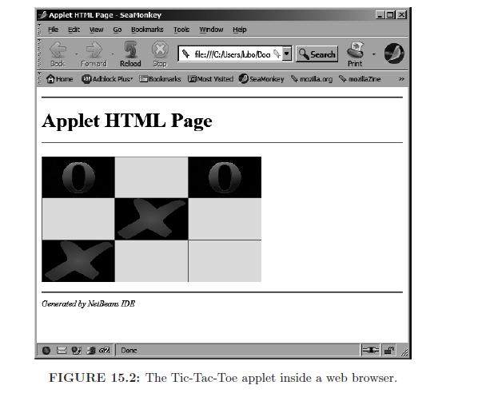

Slide 14
import java.awt.*;
import java.awt.geom.*;
class Square extends Rectangle2D.Double {
private boolean isX = false;
private boolean isO = false;
public boolean isCharacter(char c) {
if (c == 'x') {
return isX;
}
if (c == 'o') {
return isO;
}
return false;
}
public void placeCharacter(char c) {
if (c == 'x') {
isX = true;
isO = false;
}

Slide 15
if (c == 'o') {
isO = true;
isX = false;
}
}
public void clear() {
isX = false;
isO = false;
}
public boolean hasValue() {
return (isX || isO);
}
public Square(double x, double y, double dx, double dy) {
super(x, y, dx, dy);
}

Slide 16
public void draw(Graphics2D g2, Image xImage, Image oImage) {
g2.draw(super.getBounds2D());
if (isX) {
g2.drawImage(xImage, (int) getX()+1 ,(int) getY()+1, (int) getWidth()-2, (int) getHeight()-2, null);
}
if (isO) {
g2.drawImage(oImage, (int) getX()+1,(int) getY() +1, (int) getWidth()-2, (int) getHeight()-2, null);
}
}
}

Slide 17
Notes on the Square Class
isX and isO variables tells us if the square is an X or an O. Note that it is impossible that both of them are true. We cannot have a single Boolean variable because we have three possibilities: cell empty, cell X, cell O.
The class inherits from Rectangle2D.Double. This is the surrounding rectangle.
A square is drawn by drawing the surrounding rectangle and the image inside it. For the drawImage method, second and third arguments are top left corner. Fourth and fifth arguments are width and height of image! Last argument is null.

Slide 18
import java.awt.*;
import java.net.*;
import java.util.*;
import javax.imageio.*;
import javax.swing.*;
public class TicTacToe extends JApplet {
private ArrayList<Square> squares = new ArrayList<>();
private Image xImage, oImage;
public void initBoard() {
squares = new ArrayList<>();
Dimension d = getSize();
double dx = d.getWidth() / 3.0;
double dy = d.getHeight() / 3.0;
for (int x = 0; x < 3; x++) {
for (int y = 0; y < 3; y++) {
squares.add(new Square(x * dx, y * dy, dx, dy));
}
}
repaint();
}

Slide 19
public void init() {
try {
xImage = ImageIO.read(new URL(getCodeBase(),
"images/x.jpg"));
oImage = ImageIO.read(new URL(getCodeBase(),
"images/o.jpg"));
} catch (Exception exception) {
}
initBoard();
addMouseListener(new MyMouseListener());
}
...
}
The geSize method gives us the size of the applet. We divide it in
a 3x3 grid.
The ImageIO.read method reads the image. The images must be
stored in the image subdirectory of the codebase directory. The URL
class takes as input the name of the main directory and a relative file
name.
The getCodeBase method gets the value of the codeBase variable.

Slide 20
Painting Inside an Applet
We need to use the method paint instead of paintComponent. The reason is that we are inside a JApplet and not a JPanel.
In our case, we will just call the method draw on each square.
public void paint(Graphics g) {
super.paint(g);
Graphics2D g2 = (Graphics2D) g;
g2.setColor(Color.RED);
for (Square r : squares) {
r.draw(g2, xImage, oImage);
}
}

Slide 21
Responding to Mouse Clicks
When the user presses a mouse button, we will check which square the mouse is over. We will use the method contains of Rectangle2D to do so.
If the square has no value, we will place an X in it. If the game is not over, we will compute the computer move and also place it on the board.
If at any point the game is over, we will exit the method.

Slide 22
class MyMouseListener extends MouseAdapter {
public void mousePressed(MouseEvent e) {
for (Square r : squares) {
if (r.contains(e.getPoint())) {
if (!r.hasValue()) {
r.placeCharacter('x');
repaint();
if (isGameOver()) {
return;
}
computerMove();
repaint();
if (isGameOver()) {
return;
}
}
}
}
}
}

Slide 23
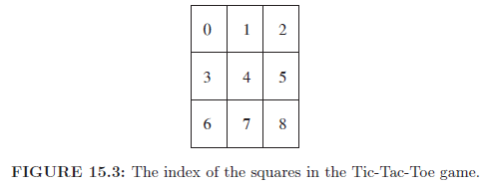
Checking for Win
Win is when there is vertical, horizontal, or diagonal line with
the character X or O.
We will create a method that check if the character c wins.
It will call a method isLine that checks if the specified line
is all filled with the same input character.

Slide 24
public boolean isLine(int i, int j, int k, char c) {
return (squares.get(i).isCharacter(c)
&& squares.get(j).isCharacter(c) &&
squares.get(k).isCharacter(c));
}
public boolean wins(char c) {
for (int i = 0; i < 3; i++) {
if (isLine(3 * i, 3 * i + 1, 3 * i + 2, c) ||// hr line
isLine(i, i + 3, i + 6, c))) { //vertical line
return true;
}
}
if (isLine(0, 4, 8, c) || isLine(2, 4, 6, c)){//diagonal
return true;
}
return false;
}

Slide 25
isBoardFull Method
Checks to see if the board is full.
If there is a square that does not have a value, then the method returns false.
If all squares have a value, then the method returns true.
isGameOver method is shown on next slide. It simply checks if X wins, if Y wins, or if the board is full.

Slide 26
public boolean isGameOver() {
if (wins('o')) {
JOptionPane.showMessageDialog(this, "I win!");
initBoard(); //restart game
return true;
}
if (wins('x')) {
JOptionPane.showMessageDialog(this, "You win!");
initBoard(); //restart game
return true;
}
if (isBoardFull()) {
JOptionPane.showMessageDialog(this, "It's a tie!");
initBoard(); //restart game
return true;
}
return false;
}
//JOPtionPane.showMessageDialog displays text in modal
//dialog, 1st parameter is parent window

Slide 27
computerMove method
If middle is empty, we always play there
Otherwise, we go through all the squares and check their score.
We place O at the square with the highest score.

Slide 28
public void computerMove() {
if (!squares.get(4).hasValue()) { // if middle is empty
squares.get(4).placeCharacter('o');
return;
}
Square bestRectangle = squares.get(0);
int best = computeScore(bestRectangle);
for (Square r : squares) {
if (computeScore(r) > best) {
best = computeScore(r);
bestRectangle = r;
}
}
bestRectangle.placeCharacter('o');
}

Slide 29
computeScore Method
If the square is not empty, score is 0. Placing a character on a full square is a terrible choice.
If we can win with our next move, then we should play it. This is our best option. Score = 4.
If we can prevent the human from winning with their next move, this is the second best option. Score = 3.
In all other cases, we will set Score = 2.

Slide 30
public int computeScore(Square r) {
if (r.hasValue()) {
return 0;
}
if (winsWithNextMove(r, 'o')) {
return 4;
}
if (winsWithNextMove(r, 'x')) {
return 3;
}
return 2;
}

Slide 31
winsWithNextMove method
We will place a character on the board (but don't display the board).
We will check if this is a winning move for the user with the input character. After we figure out if the moves wins or not, we will undo our board modification by removing the character from the square.
public boolean winsWithNextMove(Square r, char c) {
r.placeCharacter(c);
if (wins(c)) {
r.clear();
return true;
}
r.clear();
return false;
}

Slide 32
Summary
In order for a Java applet to work, we also need to create an HTML file.
The HTML file contains the size of the window, the title, and the name of the code base directory.
In order to write a Java applet, remove the main method. Create a class that inherits from the JApplet class and override the init method.

