Slide 1
Data Types and Conditional Statements
Chapter 2

Slide 2
Overview
Introduction to NetBeans
Simple Java program (including comments)
Introduction to variables
The assignment operator
Integer division
Casting
Printing to the screen and reading from the keyboard
if and if/else structures
Strings
The switch operation
The conditional operator

Slide 3
NetBeans (example of IDE)
Can be used to format the code. Go to Source-Format.
Execute the code by clicking the green arrow.
Red underlined means syntax error. Hoover over error for explanation.
Press Ctrl+Space for auto-complete.
JavaDoc (explanation of method) is shown during autocomplete.

Slide 4
Java Files Structure
All Java files have .java extension.
The compiled version has .class extension. This is the Java binary code.
In most IDE, one creates a project that contains multiple Java files.
Every Java file corresponds to a class. When a new file and therefore a new class is created, the IDE may ask for the package name. Several classes can belong to the same package. If no package name is defined, then the default package is used.

Slide 5
First Java Program
package helloworld;
public class Main {
public static void main(String args[]){
System.out.println("Hello World!");
}
}
First line is optional. It shows package name.
Put ; after every operation.
public class Main must be part of the Main.java file. Every Java file has exactly one public class that has the same name as the name of the file.
{} are used to show start and end of block. The body of classes and methods must be in a block.
The main method is where is the program starts executing.

Slide 6
Comments
Use // for single line comments.
Use /* … */ for multi-line comments.
Comments are not processed by the compiler.
They are written for the human reader, not for the computer.
package helloworld; //optional
public class Main { /* start of main
class */
public static void main(String args[]){
System.out.println("Hello World!");
}
}

Slide 7
Literals
A literal is a constant that needs to be understood literally by Java.
For example, 3 means the integer 3.
3.5 means the real number 3.5.
27L is the large integer 27.
"Hello World!" is the string Hello World.
'a' is the character a.
true is the Boolean value true.
false is the Boolean value false.
0x3F is the hexadecimal number 3F.

Slide 8
Printing
System.out.println("Hello World!"); Prints the string and new line.
System.out.print("Hello World!"); Prints just the string.
System.out.print("Hello World!\n"); Prints the string and new line. \n is the special character new line.
System.out.print("Hello World!"+'\n'); Prints the string and new line. The operator + is used to concatenate two strings (or a string and a character in this case).

Slide 9
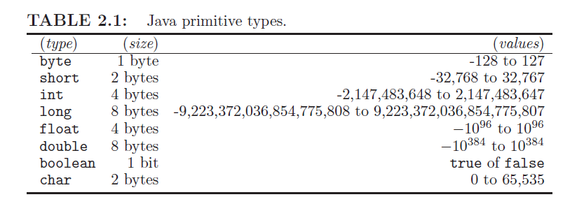
Variables
A variable can hold a piece of data. The size of the data depends on the type of the variable. Variables allow us to refer to main memory locations without specifying the address of the location. The name of a variable should start with lowercase letter. We will use short, long, and float only on rear occasions.

Slide 10
Declaring a Variable
Every variable must be declared before it can be used.
Declaring a variable allocates space in main memory.
int i; The variable i is of type integer.
double a; The variable a is of type real number.
char c; The variable c is of type character.

Slide 11
The Scope of a Variable
Every variable has a scope. This is where the variable can be used. The scope of a variable starts with the definition of the variable and ends at the closing of the inner most block.
{
.....{
int i;
...
}
}
start of inner most block
scope of variable i
end of inner most block

Slide 12
Variables (cont'd)
We can create and initialize a variable in the same line:
int i = 3;
byte b = 0x2B;
float f = 234.23F;
long l = 234234L;
double d = 2332432.22;
boolean b = true;
Several variables of the same type can be declared in one statement.
int i, j, k;
int i, j = 3, k;

Slide 13
The Assignment Operator
We will use = to assign a value to a variable. The left side must be a single variable. The right side can be an expression that involves variables and/or literals.
b = 3; // The value 3 is assigned to the variable b
c = 2+3; // The value 5 is assigned to the variable c
a = b+c; // The value of b+c is assigned to the variable a. If b = 3 and c=5, then the new value of the variable a will become equal to 8.
b+c = a; // Wrong! Will not compile!

Slide 14
The Assignment Operator (cont'd)
It is perfectly legal to write:
a = b = c = 3;
This is equivalent to
a=3;
b=3;
c=3;
Also equivalent to:
a = (b = (c=3));
In other words, the assignment operator performs two tasks:
it assigns a value to the variable on the left side and
it returns the new value of this variable.

Slide 15
Precedence of Operations
Multiplication and division are executed before addition and subtraction. Operations with the same precedence are executed left to right.
c = 3+2*5; // The new value of the variable c is 13 because multiplication is executed first.
d = 3/1*7; // The new value of the variable d is 21 because the expression is executed left to right.
Although legal, the above two expression are tricky. It is always better to use parenthesis. Parenthesis fix the order of execution of the operations.
c = 3+(2*5);
d = (3/1)*7;

Slide 16
Limit to Using Variables of Primitive Types
A variable is not all powerful.
Consider the definition:
long l = 23433L;
This works. However, we cannot assign an arbitrary integer to the variable l. The reason is that there are infinitely many integers and the memory of a computer is finite.
Consider the definition:
float f = 2342.23222233F
Only a finite number of real numbers can be represented using a float. If the specified literal cannot be represented, then the closest literal that can be represented is chosen.

Slide 17
Example Program
public class Test {
public static void main(String[] args) {
float x = 1 / 3F;
System.out.println(x);
}
}
It prints 0.33333334.
If we used double, we will get better precision.
However, there still can be precision problems.
Throughout the slides, we will mostly use double and int.

Slide 18
Reading Data From Keyboard
import java.util.*;// needed to read data
public class CalculatorPanel {
public static void main(String[] args) {
int i;
System.out.println("Enter an integer: ");
Scanner keyboard = new Scanner(System.in);
i = keyboard.nextInt();
System.out.println("You entered: "+i);
}
}
We need to create a Scanner object and then call a method on it. Next slide
shows possible methods that we can call.

Slide 19
Scanner Methods
nextInt() - gets the next integer
nextBoolean() - gets the next Boolean
nextDouble() - gets the next double
nextFloat() - gets the next float
nextShort() - gets the next short
next() - gets the next string (a line can have multiple strings separated by space)
nextLine() - gets the next line

Slide 20
Converting Celsius to Fahrenheit
Before writing any program, we need to create an algorithm. Here is an example:
1. Prompt the user to enter temperature in Celsius.
2. Read an integer form the keyboard and save it in memory location x.
3. Calculate the result of y=32+(9/5)*x, that is, the temperature in Fahrenheit, and save y in memory.
4. Print the value of y to the screen.

Slide 21
Example Implementation
import java.util.*;
public class Main {
public static void main(String args[]){
int x;
double y,c;
System.out.print("Enter temperature is Celsius: ");
Scanner keyboard = new Scanner(System.in);
x=keyboard.nextInt();
c = 9/5;
y = 32+c*x;
System.out.print("The temperature in Fahrenheit is: ");
System.out.println(y);
}
}

Slide 22
Notes
All variables must be declared before they can be used.
Variables are usually defined at the beginning of a block (the main method in our case).
We must always have the main method. This is where the program starts executing.
We could have also written:
y = 32+(9/5)*x;
Always display a prompt before reading user input.
The program will crash if the user does not enter an integer.

Slide 23
Program Debugging
If we run the program, then we will see that it produces incorrect output. To find the problem, we need to debug it. That is, execute the program line by line.
We first need to set a break point.
This is where the program stops.
We can then execute it line by line. In NetBeans:
F8: step over: goes to next line
F7: step in: will go inside a method
F4: runs to cursor
Hover over a variable to see its value.

Slide 24
Corrected Version
import java.util.*;
public class Main {
public static void main(String args[]){
int x;
double y,c;
System.out.print("Enter temperature is Celsius: ");
Scanner keyboard = new Scanner(System.in);
x=keyboard.nextInt();
c = 9/5.0;
y = 32+c*x;
System.out.print("The temperature in Fahrenheit is: ");
System.out.println(y);
}
}

Slide 25
Integer Division
Always be careful when you divide.
What can go wrong:
int i = 3/a; // What if a=0?
What if a=2. Then the result is 1!
The result of dividing two integers is always an integer!
The digits after the decimal dot are pruned out and no rounding occurs. Therefore, 999/1000 will be equal to 0.

Slide 26
Casting
Possible solutions:
(9/5.0) divides by the double 5.0
(9*1.0/5) When we multiply by 1.0 we convert 9 to a double.
(9/(double)5) converts the integer 5 to the double 5.0

Slide 27
Generating Random Numbers
double d = Math.random();
Returns a random number between 0 (inclusive) and 1(exclusive).
Must import java.math.*

Slide 28
Multiplication Game
Used to teach children to multiply numbers.
Asks the user to multiply two random digits and gives feedback.
Algorithm:
Create two random numbers: x and y.
Display the two random numbers and asks the user to enter the result of x*y.
Read the user input in z.
If z=x*y, then congratulate the user. Otherwise, suggest that they study harder.

Slide 29
Source Code for Multiplication Game
import java.util.*;
public class Arithmetic {
public static void main(String[] args) {
int x = (int) (Math.random() * 10);
int y = (int) (Math.random() * 10);
Scanner keyboard = new Scanner(System.in);
System.out.print(x + "*" + y + " = ");
int z = keyboard.nextInt();
if (z == x * y) {
System.out.println("Congratulations!");
} else {
System.out.println("You need more practice");
}
}
}

Slide 30
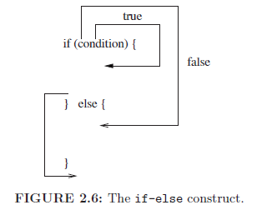
Notes
int x = (int) (Math.random() * 10); x is between 0 and 9
int x = (int) Math.random() * 10; x becomes 0
+ can be used to concatenate strings. It can be also used to concatenate a string and an integer (the result is a string).
2+"" will convert the number 2 to a string.
The if/else statement checks a condition
Always put code in blocks using {} after if and after else.
== checks for equality, = performs assignment
Always use == inside a condition.

Slide 31
Avoid Using if-else when Possible
import java.util.*;
public class Arithmetic {
public static void main(String[] args) {
int x = (int) (Math.random() * 10);
int y = (int) (Math.random() * 10);
Scanner keyboard = new Scanner(System.in);
System.out.print(x + "*" + y + " = ");
int z = keyboard.nextInt();
if (z == x * y) {
System.out.println("Congratulations!");
return; // exits the method
}
System.out.println("You need more practice");
}
}

Slide 32
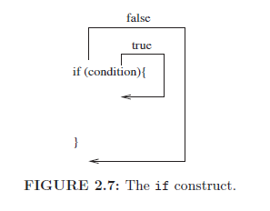
The if Statement
-Always create a block. If block does not exist, then the if applies to the first line only.
-Never put ; at the end of an if.

Slide 33
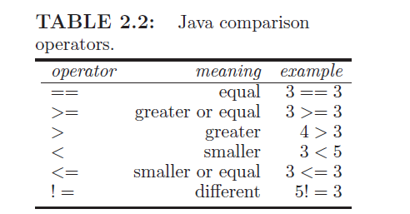
Condition Operators

Slide 34
Grade Computation Program
Ask the user to enter grade as a number.
Read number in variable x.
Declare a variable grade.
If x>=90 and x<=100, then set grade to be equal to A.
If x>=80 and x<90, then set grade to be equal to B.
If x>=70 and x<80, then set grade to be equal to C.
If x>=60 and x<70, then set grade to be equal to D.
If x<60, then set grade to be equal to F.

Slide 35
public class Grade {
public static void main(String[] args) {
int x;
char c='O';
System.out.println("Enter numeric grade: ");
Scanner keyboard = new Scanner(System.in);
x = keyboard.nextInt();
if(x<=100 && x >= 90){
c = 'A';
}
if(x<90 && x >= 80){
c = 'B';
}
if(x<80 && x >= 70){
c = 'C';
}
if(x<70 && x >= 60){
c = 'D';
}
if(x<60){
c = 'F';
}
System.out.println("Your letter grade is: "+c);
}
}

Slide 36
Combining Conditions
Examples:
(3==2 || 4<1)
(3==3 && 1 > 5)
(8>7 && 2>1)
!(4>3)

Slide 37
Reverse Grade Computation
Ask the user to enter the grade as string.
Save the result in the string s.
If s is equal to A, then tell the user that the grade is between 90 and 100.
If s is equal to B, then tell the user that the grade is between 80 and 90.
If s is equal to C, then tell the user that the grade is between 70 and 80.
If s is equal to D, then tell the user that the grade is between 60 and 70.
If s is equal to F, then tell the user that the grade is lower than 60.

Slide 38
import java.util.*;
public class Grade {
public static void main(String[] args) {
System.out.print("Enter letter grade: ");
Scanner keyboard = new Scanner(System.in);
String s = keyboard.next();//reads next string
if (s.equals("A")) {
System.out.println("Your grade is between 90 and 100");
}
if (s.equals("B")) {
System.out.println("Your grade is between 80 and 89");
}
if (s.equals("C")) {
System.out.println("Your grade is between 70 and 79");
}
if (s.equals("D")) {
System.out.println("Your grade is between 60 and 69");
}
if (s.equals("F")) {
System.out.println("Your grade is below 60");
}
}
}

Slide 39
Strings in Java
Strings are declared similar to primitive type. Use double quotes to surround string literals.
Use the method equals to compare strings for equality.
For lexicographical comparison (i.e., alphabetical), use the compareTo method.

Slide 40
The switch statement
Replaces a sequence of equality checks for a variable, that is a sequence of if conditions of the form:
if(a==...){ ... }
The switch statement cannot be used to replace if conditions of the form:
if(a>...){ ... }
Can be applied only to variables of type int, char, and String.

Slide 41
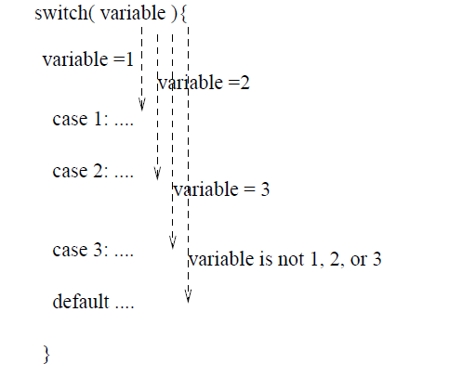
There is only a single jump. If variable=1, then all code
will be executed, unless we use a break!

Slide 42
import java.util.*;
public class Grade {
public static void main(String[] args) {
System.out.print("Enter letter grade: ");
Scanner keyboard = new Scanner(System.in);
String s = keyboard.next();
switch(s) {
case "A":
System.out.println("Your grade is between 90 and 100");
break;
case "B":
System.out.println("Your grade is between 80 and 89");
break;
case "C":
System.out.println("Your grade is between 70 and 79");
break;
case "D":
System.out.println("Your grade is between 60 and 69");
break;
case "F":
System.out.println("Your grade is below 60");
break;
default:
System.out.println("I have no idea what is your grade!");
}
}
}

Slide 43
The break Statement
Can be used to exit the inner-most switch or loop (more on that later).
Does not exit an if block (or any other kind of block).
Should be used together with the switch statement.

Slide 44
The Conditional Operator
It is also a shorthand for some if/else statements.
Instead of writing:
if(a==3){
b= 4;
} else {
b = 5;
}
We can write:
b = (a==3)? 4: 5;
General syntax: variable = (condition)? a1 : a2;
variable = a1 when condition true
variable = a2 when condition false

Slide 45
Example
import java.util.*;
public class Arithmetic {
public static void main(String[] args) {
int x = (int) (Math.random() * 10);
int y = (int) (Math.random() * 10);
Scanner keyboard = new Scanner(System.in);
System.out.print(x + "*" + y + " = ");
int z = keyboard.nextInt();
String output;
output = (z == x * y) ? "Congratulations!" :
"You need more practice";
System.out.println(output);
}
}

Slide 46
Conclusion
We showed how to write a basic Java program including:
how to define and initialize variables,
primitive data types: int, double, char, and boolean are the main ones,
reading from keyboard/writing to screen
the String class, and
changing the execution flow of control using the if, if/else, switch, and break statements.

