Slide 1
Loops
Chapter 3

Slide 2
Overview
Different kind of loops
while loops
do-while loops
for loops
The modulus operation (%)

Slide 3
Previous code
import java.util.*;
public class Arithmetic {
public static void main(String[] args) {
int x = (int) (Math.random() * 10);
int y = (int) (Math.random() * 10);
Scanner keyboard = new Scanner(System.in);
System.out.print(x + "*" + y + " = ");
int z = keyboard.nextInt();
if (z == x * y) {
System.out.println("Congratulations!");
} else {
System.out.println("You need more practice");
}
}
}

Slide 4
Continuous Loop
import java.util.*;
public class Arithmetic {
public static void main(String[] args) {
int x = (int) (Math.random() * 10);
int y = (int) (Math.random() * 10);
Scanner keyboard = new Scanner(System.in);
int z=x*y+1;
while(z!=x*y){
System.out.print(x + "*" + y + " = ");
z = keyboard.nextInt();
}
System.out.println("This is correct!");
}
}

Slide 5
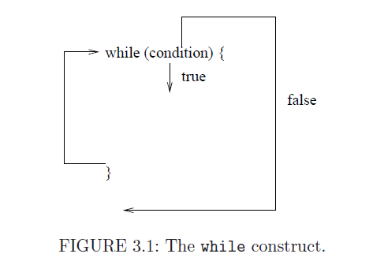
The while Loop

Slide 6
The while loops (cont'd)
Similar to an if statement. The program goes inside the block when the condition is true.
Unlike an if statement, the inside block can be executed multiple times.
It can be executed 0 times if the while condition is initially false.

Slide 7
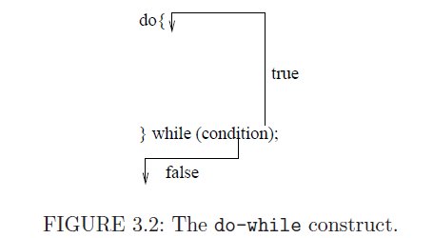
The do-while Loop

Slide 8
The do-while Loop (cont'd)
Similar to a while statement.
However, it is always executed at least once.
We need a ; at the end of the loop.
Useful when verifying input (need to read input at least once). If input is wrong, then we can reread it.

Slide 9
Multiplication Program (refactored)
import java.util.*;
public class Arithmetic {
public static void main(String[] args) {
int x = (int) (Math.random() * 10);
int y = (int) (Math.random() * 10);
Scanner keyboard = new Scanner(System.in);
int z;
do{
System.out.print(x + "*" + y + " = ");
z = keyboard.nextInt();
} while (z!=x*y);
System.out.println("This is correct!");
}
}

Slide 10
Important Points About Loops
They keep repeating while the condition is true
Always create a block for a loop using {}.
For example, the following loop applies only to the first line.
while(true) //Example how not to write code System.out.println("Hi"); System.out.println("What is your name? ");

Slide 11
Using break and continue
break exists the current loop (or switch) and goes to the line immediately after the body.
continue skips though the current iteration of the loop and starts a new iteration.

Slide 12
import java.util.*;
public class Arithmetic {
public static void main(String[] args) {
int x = (int) (Math.random() * 10);
int y = (int) (Math.random() * 10);
Scanner keyboard = new Scanner(System.in);
int z;
do{
System.out.print(x + "*" + y + " = ");
z = keyboard.nextInt();
if(z==x*y){
break; //successful guess
}
System.out.println("This is incorrect!");
} while (true);
System.out.println("This is correct!");
}
}

Slide 13
import java.util.*;
public class Arithmetic {
public static void main(String[] args) {
int x = (int) (Math.random() * 10);
int y = (int) (Math.random() * 10);
Scanner keyboard = new Scanner(System.in);
int z;
do{
System.out.print(x + "*" + y + " = ");
z = keyboard.nextInt();
if(z!=x*y){
continue;//goes to next iteration
}
break; //successful guess
} while (true);
System.out.println("This is correct!");
}
}

Slide 14
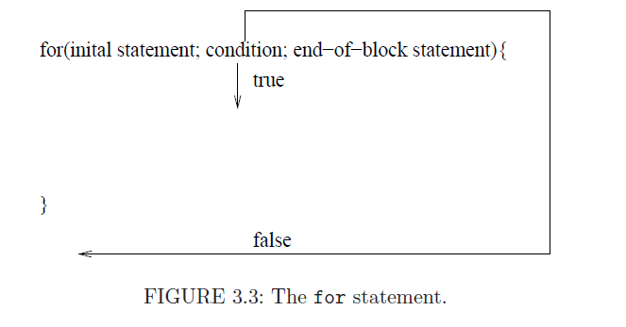
The for loop

Slide 15
Used for Counting
...
int numTries = 0;
while(numTries <= 9){
...
numTries = numTries+1;
}
...
is equivalent to
for(int numTries = 0; numTries <= 9; numTries = numTries+1){
...
}

Slide 16
Notes on for Loops
Never change the counter variable inside the body of the loop.
for(int i =, ....) allows you to use the variable i only inside the body of the for loop.
Conversely:
int i;
for(i = ...){
}
//variable i can be used here

Slide 17
Adding Numbers from 1 to 10
int sum = 0;
for(int i=1; i <= 10; i=i+1){
sum = sum + 10;
}
System.out.println(sum);
using for loop
int sum = 0;
int i = 1;
while (i <=10){
sum = sum + 10;
i=i+1;
}
System.out.println(sum);
using while loop

Slide 18
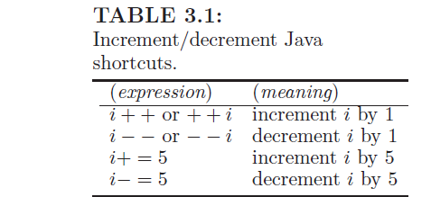
Arithmetic Shortcuts
i++; //increment by 1 performed later
++i; //increment by 1 performed first
example:
int i=5;
System.out.println(i++ + ++i);

Slide 19
Guessing Game
Computer guesses a number between 1 and 1000.
Player needs to guess it using 10 tries.
Player gets hints (higher or lower).

Slide 20
import java.util.*;
public class GuessGame {
public static void main(String[] args) {
int number = (int) (Math.random() * 1000)+1;
Scanner keyboard = new Scanner(System.in);
for (int numTries = 0; numTries < 10; numTries++) {
System.out.println("Enter your guess: ");
int guess = keyboard.nextInt();
if (guess == number) {
System.out.println("You got it!");
return; // exists the program
}
if(guess > number){
System.out.println("Go lower");
} else {
System.out.println("Go higher");
}
}
System.out.println("You ran out of guesses");
System.out.println("My number was: "+number);
}
}

Slide 21
import java.util.*;
public class GuessGame {
public static void main(String[] args) {
int number = (int) (Math.random() * 1000);
Scanner keyboard = new Scanner(System.in);
int numTries;
for (numTries = 0; numTries < 10; numTries++) {
System.out.println("Enter your guess: ");
int guess = keyboard.nextInt();
if (guess > number) {
System.out.println("Go lower");
continue; // go to next iteration
}
if (guess < number) {
System.out.println("Go higher");
continue; // go to next iteration
}
System.out.println("You got it!");
break; //exit for loop
}
if(numTries == 10){
System.out.println("You ran out of guesses");
System.out.println("My number was: " + number);
}
} }

Slide 22
Differences Between the Two Programs
The return statement exists the method (in this case the program).
What if we don't want to terminate the program after a correct guess?
The second program gives us this option.
continue goes to the next iteration
break exists the for loop, but not the program
Note that the variable numTries is defined before the for loop.
After the for loop, we need to check if it is equal to 10. If it is, then the user could not guess the number in 10 tries.

Slide 23
Printing a Diamond
*
* * *
* * * * *
* * *
*
We will use a nested for loop.
This a for loop within a for loop.
The first for loop will iterate over the lines. Then, for every line,
we will print several spaces and then several stars.
We will use the divide and conquer approach. We will separate
the program into two parts: for the top part and for the bottom part.
The reason is that the numbers of stars and the number of spaces
change differently in each part.

Slide 24
let n be the size of the diamond
nSpaces = n-1;
nStars = 1;
for every line in the first half {
print nSpaces spaces
print nStars stars
print new line
increment the number of stars by 2
decrement the number of spaces by 2
}
nSpaces = 2;
nStars = n-2;
for every line in the second half {
print nSpaces spaces
print nStars stars
print new line
decrement the number of stars by 2
increment the number of spaces by 2
}
*
* * *
* * * * *
* * *
*

Slide 25
import java.util.*;
public class Diamond {
public static void main(String[] args) {
Scanner keyboard = new Scanner(System.in);
System.out.print("Enter size of diamond: ");
int size = keyboard.nextInt();
int numStars = 1;
int numSpaces = size - 1;
for (int line = 0; line < size / 2 + 1; line++) {
for (int i = 0; i < numSpaces; i++) {
System.out.print(" ");
}
for (int i = 0; i < numStars; i++) {
System.out.print("* ");
}
System.out.println();
numSpaces -= 2;
numStars += 2;
}
*
* * *
* * * * *
* * *
*

Slide 26
numStars=size-2;
numSpaces = 2;
for (int line = 0; line < size / 2; line++) {
for (int i = 0; i < numSpaces; i++) {
System.out.print(" ");
}
for (int i = 0; i < numStars; i++) {
System.out.print("* ");
}
System.out.println();
numSpaces += 2;
numStars -= 2;
}
}
}
*
* * *
* * * * *
* * *
*

Slide 27
Second Solution
public class Diamond {
public static void main(String[] args) {
Scanner keyboard = new Scanner(System.in);
System.out.print("Enter size of diamond: ");
int size = keyboard.nextInt();
for (int numStars =1, numSpaces = size-1; numSpaces >=0;
numSpaces-=2, numStars+=2) {
for (int i = 0; i < numSpaces; i++) {
System.out.print(" ");
}
for (int i = 0; i < numStars; i++) {
System.out.print("* ");
}
System.out.println();
}

Slide 28
Second Solution (cont'd)
for (int numStars=size-2, numSpaces = 2; numStars >0;
numSpaces+=2, numStars-=2 ) {
for (int i = 0; i < numSpaces; i++) {
System.out.print(" ");
}
for (int i = 0; i < numStars; i++) {
System.out.print("* ");
}
System.out.println();
}
}
}

Slide 29
More on for loops
In the first part of a for loop, we can define multiple variables (separate them by comma). The first part can also be empty.
The second part of the for loop must contain a single condition. If the condition is missing, true is default value.
The third part of the for loop can contain multiple statements that are separated by comma. The third part of the for loop can also be empty.

Slide 30
The Modulus Operation: %
Can be applied only on integers.
Returns the remainder when dividing two integers.
For example:
24%2 = 0
33%5 = 3
In other words, a%b is equal to the difference of a and the closest number less than or equal to a that is divisible by b.
a % b = a-(a/b)*b

Slide 31
import java.util.*;
public class Test {
public static void main(String[] args){
System.out.println("Please enter a decimal number: ");
Scanner keyboard = new Scanner(System.in);
int number = keyboard.nextInt();
String result = "";
while(number > 0){
int remainder = number % 16;
if(remainder <= 9){
result = result + remainder;
} else {
result = result+ (char)('A'+remainder-10);
}
number/=16;
}
System.out.print("The number in hexadecimal is: ");
for(int i=0; i < result.length(); i++){
System.out.print(result.charAt(result.length()-i-1));
}
System.out.println();
}
}

Slide 32
Notes
s.charAt(3): returns the character at position 3.
s+23: concatenates the string s and the number 23.
(char)('A'+1): returns the letter 'B'
(char)('A'+5): returns the sixth letter of the alphabet.
s.length(): returns the length of the string (i.e., number of characters)
Method keeps dividing by 16 and stores reminder. The result is the remainders in reverse order.
We can also store the digits in the correct order, as shown on the next slide.

Slide 33
import java.util.*;
public class Test {
public static void main(String[] args){
System.out.println("Please enter a decimal number: ");
Scanner keyboard = new Scanner(System.in);
int number = keyboard.nextInt();
String result = "";
while(number > 0){
int remainder = number % 16;
if(remainder <= 9){
//adds the digit at the beginning of the string
result = remainder+result;
} else {
result = (char)('A'+remainder-10)+result;
}
number/=16;
}
System.out.println("The number in hexadecimal is: "+result);
}
}

Slide 34
Conclusion
We covered different kind of loops.
Use while loop when we want to keep executing the same piece of code until some condition changes.
Use do-while loop when we want the loop to be executed at least once (regardless of any conditions).
Use for loop when we want to count. Remember to never change the counter variable inside the loop.
The modulus operation (%) gives us the remainder of dividing two integers. It cannot be used on doubles.

