Slide 1
Classes Revisited
Chapter 8

Slide 2
Overview
Class Inheritance vs. Class Composition
Method overriding
Polymorphism and Dynamic Binding
Casting
Abstract classes and methods
Interfaces (including Comparable)
The Object class
The equals method
The clone method

Slide 3
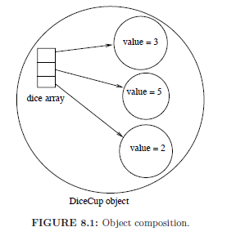
Class Containment
class DiceCup{
Die[] dice = new Dice[3];
dice[0] = new Die(3);
dice[1] = new Die(5);
dice[2] = new Die(2);
...
}

Slide 4
Class Inheritance
public class Superhero {
private String name;
private int goodPower;
private int respect;
public void setName(String name){
this.name = name;
}
public String getName(){
return name;
}
...
}
public class Villain {
private String name;
private int evilPower;
private int narcissism;
public void setName(String name){
this.name = name;
}
public String getName(){
return name;
}
...
}

Slide 5
Comparing the Classes
Both classes have the name attribute.
Both classes have getter/setter method for the attribute.
Principle of software engineering: do not write the same code multiple times (easy to make mistakes).
Can we avoid writing this code multiple times?
Yes, if we create a superclass that has the name attribute and the getter/setter methods. The two classes will inherit from the new class.
When we inherit from a class, we inherit all its public methods.

Slide 6
public class FictionalCharacter {
private String name;
public void setName(String name){
this.name = name;
}
public String getName(){
return name;
}
}
public class Villain extends FictionalCharacter{
private int evilPower;
private int narcissism;
...
}
public class Superhero extends FictionalCharacter {
private int goodPower;
private int respect;
...
}

Slide 7
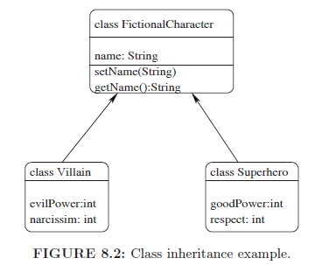
Example Unified Modeling Language (UML) Diagram

Slide 8
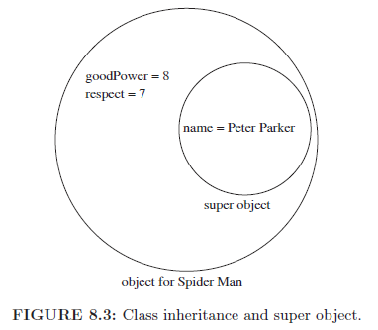
Super Object
When we inherit from a class, we
must create an object of the
superclass. This object always exists (different from composition).

Slide 9
Composition vs. Inheritance
In class composition, there are 0 or more inner objects. In class inheritance, there is exactly one inner object.
Different syntax: Inheritance uses the extends keyword. Composition, on the other hand, involves creating an object inside a class.
As we will see later, polymorphism and dynamic binding does not apply to class composition.

Slide 10
Accessing The Super Object
Suppose we are inside the Superhero class.
We cannot directly access the variable name because it is a private variable of a different class (the superclass).
However, we can write super.getName() to retrieve the name.
Similarly, we can write super.setName("Bob") to change the name of the super object.
The super keyword refers to the super object (similar to the this keyword). When there is no ambiguity (e.g., there is only a getName method in the superclass), the super keyword can be omitted.

Slide 11
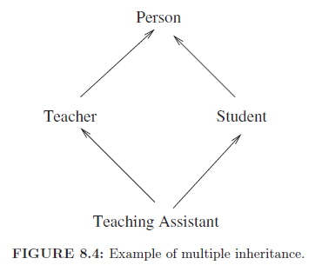
Multiple Inheritance
Not supported in Java.
The reason is that if it supported, then the super reference
will be ambiguous.
It will violate the rule that every object can have a single
super object.

Slide 12
Implementing Multiple Inheritance Through Composition
class Person{
...
}
class Teacher extends Person{
...
}
class Student extends Person{
...
}
class TeachingAssistant extends Teacher{
Student studentSuperObject;
}

Slide 13
The FictionalCharacter Class
public class FictionalCharacter {
private String name;
public FictionalCharacter(){
}
public FictionalCharacter(String name){
this.name = name;
}
public String getName(){
return name;
}
public void setName(String name){
this.name = name;
}
}

Slide 14
The Superhero Class (poor design)
public class Superhero extends FictionalCharacter {
private int goodPower;
private int respect;
public Superhero(String name, int goodPower,
int respect){
this.goodPower = goodPower;
this.respect = respect;
super.setName(name); // super not required
}
}
There is no call to create the super object.
Therefore, a super object is automatically created using the empty
constructor.
The super object is created as the first task in all constructors.

Slide 15
The Superhero Class (better design)
public class Superhero extends FictionalCharacter {
private int goodPower;
private int respect;
public Superhero(String name, int goodPower,
int respect){
super(name);
this.goodPower = goodPower;
this.respect = respect;
}
}
The super object is created by explicitly calling the constructor:
super(name);
The constructor of the FictionalCharacter class that takes as input a
String is called.
The line: super(...) must be the first line in all constructors of
the Superhero class. If missing, then the empty constructor of FictionalChracter is called to create the super object.

Slide 16
Abstract Classes and Methods
An abstract class is a class that is defined using the abstract keyword.
It is similar to a regular class. However, we cannot directly created objects from it using the new keyword.
However, we can inherit from it. In the subclass, we must use the super constructor to create the super object that belongs to it.
An abstract method is a method that is defined using the abstract keyword. It has no body.
Abstract methods must be overridden (i.e., defined with body) in the non-abstract subclasses.
Classes that contain abstract method must be abstract. The reason is that they do not have bodies for the abstract methods.

Slide 17
Example Abstract Class
public abstract class FictionalCharacter {
private String name;
public FictionalCharacter(){
}
public FictionalCharacter(String name){
this.name = name;
}
public String getName(){
return name;
}
public void setName(String name){
this.name = name;
}
}

Slide 18
Example Abstract Method
public abstract class FictionalCharacter {
private String name;
public FictionalCharacter(){
}
public FictionalCharacter(String name){
this.name = name;
}
public String getName(){
return name;
}
public void setName(String name){
this.name = name;
}
public abstract double computeStrength();
}

Slide 19
Overriding Abstract Methods
public class Superhero extends FictionalCharacter {
private int goodPower;
private int respect;
public Superhero(String name, int goodPower, int respect){
super(name);
this.goodPower = goodPower;
this.respect = respect;
}
public double computeStrength(){
return goodPower*respect*Math.random();
}
public String toString(){
return super.getName()+
" is a superhero that has good power = "+goodPower+
" and respect = "+respect;
}
}

Slide 20
public class Villain extends FictionalCharacter {
private int evilPower;
private int narcissism;
public Villain(String name, int evilPower,int narcissism){
super(name);
this.evilPower = evilPower;
this.narcissism = narcissism;
}
public double computeStrength(){
return evilPower*narcissism*Math.random()*0.9;
}
public String toString(){
return super.getName()+
" is a villain that has evil power = "+evilPower+
" and narcissism = "+narcissism;
}
}

Slide 21
The Main Class
import java.util.*;
public class FaceOff {
public static void main(String[] args){
ArrayList<FictionalCharacter> characters =
new ArrayList<>();
populateCharacters(characters);
for(FictionalCharacter character: characters){
System.out.println(character.toString());
}
}
...
}

Slide 22
Auto-casting
Note that we can insert an object of type Superhero or Villain in the ArrayList of FictionalCharacter. The reason is that every Superhero and every Villain is-a FictionalCharacter.
A different example:
Superhero superCat = new Superhero("Bob",10,10);
FictionalCharacter fictionalCat = superCat;
We can treat a superhero as a fictional character. There is no need for a cast (i.e., this is auto-casting). The reason is that every superhero contains inside it (as a super object) a fictional character.

Slide 23
Explicit Casting
Suppose the class FictionalChracter was not abstract and we can directly create objects from it.
First try:
Superhero s = new FictionalCharacter();
We will get an error when we compile the code. The reason is that not every fictional character is a superhero. In other words, auto-casting doesn't work the other way.
Second try:
Superhero s = (Superhero) new FictionalCharacter();
This will compile. However, we will get an exception when we run the program. The reason is that the right hand side is not a superhero. However, if it were, then this will work.

Slide 24
Polymorphism
Examine the variable character.
Its compile-time type is FictionalCharacter. This is what it is defined as in Java.
Its runtime type can be either Superhero or Villain. This is the type of the object the variable references.
Polymorphism states: when we have the syntax o.m(), then only the runtime type of the object o is considered. If the class that is the runtime type of the object o does not contain the method m, then we look in the super classes until we find the first class that contains the method m. This is the method that is executed. Since the compile-time type of the object o is either the runtime type of the object or a super class, we are guaranteed to find a class that contains the method m.

Slide 25
Dynamic Binding
When Java sees the syntax: o.m(), it doesn't immediately know what method to execute.
When the program is compiled, the runtime type of o is not clear.
Therefore, dynamic binding is used.
This means that a table is created during the execution of the program. This table stores the runtime type of every object.
Every time Java sees the syntax: o.m(), it checks this table to determine the runtime type of the object. It then searches for the method m in this class and its super classes until it finds it.

Slide 26
public static void populateCharacters(
ArrayList<FictionalCharacter> characters){
while(true){
printMenu();
int choice = getIntValue("Enter your choice: ");
switch(choice){
case 1:
characters.add(new Superhero(
getStringValue("Name: "), getIntValue("Good Power[1-10]: "),
getIntValue("Respect:[1-10]: ")));
break;
case 2:
characters.add(new Villain(
getStringValue("Name: "), getIntValue("Evil Power[1-10]: "),
getIntValue("Narcissism[1-10]: ")));
break;
case 3: return;
}
}
}

Slide 27
public static void printMenu(){
System.out.println("1. Enter Superhero");
System.out.println("2. Enter Villain");
System.out.println("3. Finish Entering");
}
public static int getIntValue(String prompt){
int choice;
Scanner keyboard = new Scanner(System.in);
System.out.print(prompt);
choice = keyboard.nextInt();
return choice;
}
public static String getStringValue(String prompt){
String choice;
Scanner keyboard = new Scanner(System.in);
System.out.print(prompt);
choice = keyboard.next();
return choice;
}
}

Slide 28
1. Enter Superhero
2. Enter Villain
3. Finish Entering
Enter your choice: 1
Name: Superman
Good Power[1-10]: 8
Respect:[1-10]: 8
1. Enter Superhero
2. Enter Villain
3. Finish Entering
Enter your choice: 2
Name: Joker
Evil Power[1-10]: 7
Narcissism[1-10]: 10
1. Enter Superhero
2. Enter Villain
3. Finish Entering
Enter your choice: 3
Superman is a superhero that has good power = 8 and respect = 8
Joker is a villain that has evil power = 7 and narcissism = 10

Slide 29
The Object Class
Yes, Object is the name of a class!
All classes inherit from it.
It contains a default implementation of the toString method. It simply prints the type of object and some identifier.
We need to override the toString method if we want printing an object to produce a meaningful output.
For example, the toString method is defined for the ArrayList class, so we can just print an ArrayList directly without using a for loop.
The class also contains the equals method that simply compares the addresses of the two objects. Again, we need to override it if we want the method to compare the content of the objects.

Slide 30
Interfaces
Similar to a class, but we use the interface keyword.
It has no constructors.
It has no instance variable, only constants (i.e., static final variables).
All method are always abstract and public. Therefore, methods are defined with no modifiers.
Objects cannot be instantiated from interfaces. Moreover, we cannot use the super keyword when we inherit from an interface. The reason is that an interface has no constructors.
Since an interface has no state associated with it (no instance variables), Java allows us to inherit from multiple interfaces.
We use the implements keyword when inheriting from an interface (instead of the extends keyword).

Slide 31
The compareTo Method
This method is defined in the Comparable interface (part of
java.util.*).
When we implement the Comparable interface, we need to
override this method. That is, we need to define an ordering of the elements.
It is a generic interface. This means we need to provide in <..> what kind of objects the method compareTo takes as input.

Slide 32
public abstract class FictionalCharacter implements
Comparable<FictionalCharacter>{
private String name;
public FictionalCharacter(){
}
public FictionalCharacter(String name){
this.name = name;
}
public String getName(){
return name;
}
public void setName(String name){
this.name = name;
}
public abstract double computeStrength();

Slide 33
public int compareTo(FictionalCharacter other){
if(computeStrength() > other.computeStrength()){
return 1;
}
if(computeStrength() < other.computeStrength()){
return -1;
}
return 0;
}
}
New design makes fictional characters comparable.
Note that the computeStrength method is abstract. However,
we can call it in the compareTo method. The reason is that the
compareTo method must be called on two objects, that is, the
computeStrength method will be defined on these objects (the first
object will be the hidden parameter).

Slide 34
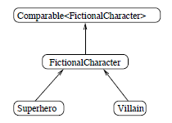
Inheritance Hierarchy

Slide 35
Alternative for the compareTo Method
public int compareTo(FictionalCharacter other){
return (int)(computeStrength()-other.computeStrength());
}
This doesn't work!
It will work if the computeStrengh method returned an integer.
However, suppose that we have two superheroes: cat1 and cat2.
If the strengths are 3.3 and 3.7, then the method will return 0. This
means that the two superheroes have the same strength, which is not
true.

Slide 36
New Version of FaceOff Class
import java.util.*;
public class FaceOff {
public static void main(String[] args){
ArrayList<FictionalCharacter> characters =
new ArrayList<>();
populateArray(characters);
Collections.sort(characters);
System.out.println(
characters.get(characters.size()-1));
}
...
} //method will print the strongest fictional character

Slide 37
Java Methods for Sorting
Collections.sort( ...) Takes as input an ArrayList.
The elements of the ArrayList must implement the Comparable Interface.
This allows the sort method to call the compareTo method to compare two elements.
There is also a method for sorting an array: Arrays.sort(...)
The elements of the array must again implement the Comparable interface.
Note that both methods take as input a reference to an array (or an ArrayList). The reference does not change, but the content of the array (or the ArrayList) becomes sorted.

Slide 38
Public Classes (review)
Every Java file must contain exactly one public class. If the name of the file is Foo.java, then the name of the class must be Foo.
Everyone can create an instance of a public class.
A class can also be declared without a modifier.
A file can contain 0 or more classes without a modifier.
A class without a modifier can be accessed only within the package.

Slide 39
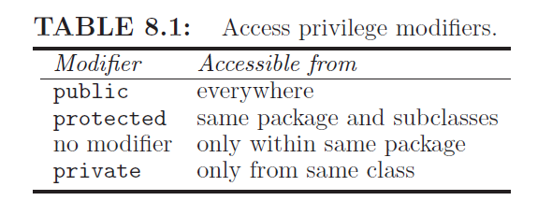
Access Modifiers for Methods/Variables

Slide 40
Overriding a Method
When overriding a method, we cannot assign weaker access privileges.
For example, a private method cannot be overridden.
A no-modifier method can be overridden as a no-modifier method, protected or a public method.
A protected method can be overridden as a protected or public.
A public method can only be overridden as a public method.

Slide 41
Assigning Access Privileges
Declare variables private.
For methods, assign the weakest access privilege possible. For example, the computeStrengh method should not be public. We want to keep it a secret how we compute the strength of a fictional character. For example, we do not want the rest of the world to know that superheroes are given a slight advantage over villains.
The method cannot be private because we override it.
The weakest access privilege we can assign is no modifier.

Slide 42
public abstract class FictionalCharacter implements
Comparable<FictionalCharacter>{
...
abstract double computeStrength();
...
}
public class Superhero extends FictionalCharacter {
...
double computeStrength(){
return goodPower*respect*Math.random();
}
...
}
public class Villain extends FictionalCharacter {
...
double computeStrength(){
return evilPower*narcissism*Math.random()*0.9;
}
...
}

Slide 43
The final Keyword
If we define a class as final, then we cannot inherit from it.
If a method is defined as final, then the method cannot be overridden.
Now nobody can override the method and change its behavior.
public class Superhero extends FictionalCharacter {
...
final double computeStrength(){
return goodPower*respect*Math.random();
}
...
}

Slide 44
Static Methods and Polymorphism
Polymorphism does not apply to static methods.
The reason is that static methods are called on the class and not on an instance of the class.
Next slide shows an example static method that keeps track of the number of fictional characters.
For example, Superhero.memberCount() will give us the number of superheroes. Similarly, FictionalCharacter.memberCount() will give us the number of fictional characters.
However, if we remove the method for the Superhero class, then the call Superhero.memberCount() will result in error. The reason is that polymorphism does not apply to static methods.

Slide 45
public abstract class FictionalCharacter implements
Comparable<FictionalCharacter>{
private String name;
private static int memberCount = 0;
...
public FictionalCharacter(){
memberCount++;
}
public FictionalCharacter(String name){
this.name = name;
memberCount++;
}
public static int memberCount(){
return memberCount;
}
}

Slide 46
public class Superhero extends FictionalCharacter {
private int goodPower;
private int respect;
private static int memberCount = 0;
public Superhero{
memberCount++;
}
public Superhero(String name, int goodPower,
int respect){
super(name);
this.goodPower = goodPower;
this.respect = respect;
memberCount++;
}
public static int memberCount(){
return memberCount;
}
}

Slide 47
Explicit Type Checking
ArrayList<FictionalCharacter> characters =
new ArrayList<>();
for(FictionalCharacter el: characters){
if(el instanceof Superhero){ //counts the superheroes
count++;
}
}
The instanceof keyword check the runtime type of the object. In the
example, if the runtime type of the object el is Superhero or a subclass
(direct or transitive), then true is returned. Otherwise, false is returned.

Slide 48
The getClass Method
There is a class that is called Class!
An object of this class is created for every class. For example, Foo.class will return the object for the Foo class.
The getClass() method returns an object of type Class. This is the runtime type of the object. The method is defined in the class Object. Therefore, it can be called on any object. Here is an example.
for(FictionalCharacter el: characters){
if(el.getClass()==Superhero.class){
count++; //counts the number of superheroes
}
}

Slide 49
Cloning Objects
Example:
Superhero batman = new Superhero(...);
Superhero batman1 = batman.clone();
Makes a copy of an object.
It is defined in the class Object as protected!
(1) Therefore it needs to be overridden as public before it can be used.
(2) We also need to implement the Clonable interface (the interface is empty and contains no methods).
(3) We also need to handle a possible exception. It is raised if we do not implement the Clonable interface.

Slide 50
public class FictionalCharacter implements Cloneable{
private String name;
private Address address;
public FictionalCharacter(){
}
public FictionalCharacter(String name, Address address){
this.name = name;
this.address = address;
}
public String toString(){
return name +" lives at "+address;
}
public Object clone() throws
CloneNotSupportedException{
return super.clone();
}
}
// Note that the clone method returns an object
of type Object

Slide 51
public class Address{
private String streetName;
private int number;
public Address(){}
public Address(String streetName, int number){
this.streetName = streetName;
this.number = number;
}
public String toString(){
return number+" "+streetName;
}
public void changeAddress(String streetName,
int number){
this.streetName = streetName;
this.number = number;
}
}

Slide 52
public class CloneTest{
public static void main(String[] args) throws Exception{
Address address = new Address("Main",123);
FictionalCharacter c1 =
new FictionalCharacter("Superwoman", address);
FictionalCharacter c2 = (FictionalCharacter)c1.clone();
address.changeAddress("Main", 235);
System.out.println(c2);
}
} //address will be changed for both fictional characters!

Slide 53
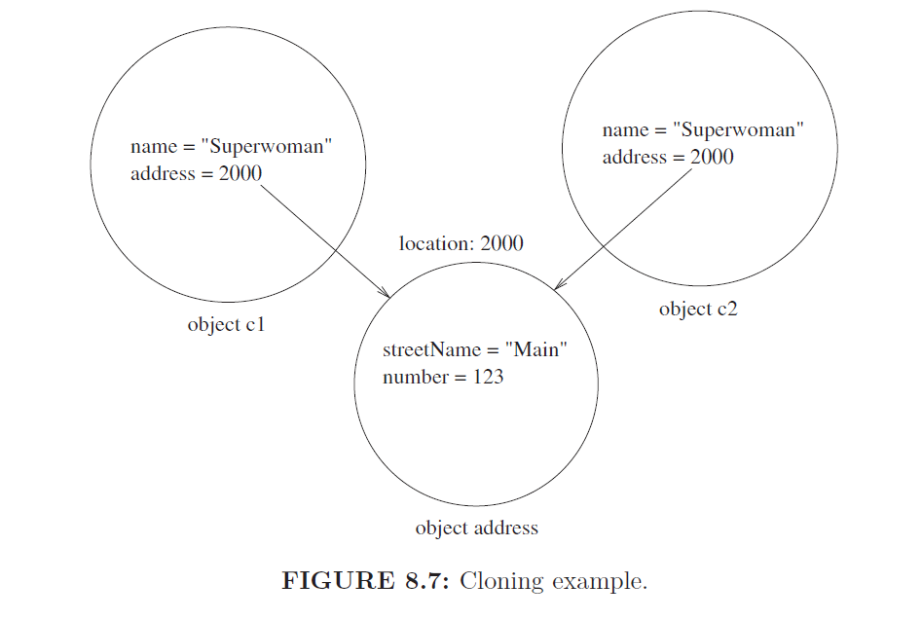

Slide 54
Using the clone Method
Java asks us to jump through three hoops when using the clone method: override the method as public, implement the Clonable interface, and handle an exception.
By doing these tasks, we tell Java that we understand the dangers of cloning.
In particular, the default clone method does not copy inner object, it just copies their addresses.
Therefore, when we clone an object with inner objects, we need to pay attention to the inner objects and clone them explicitly.

Slide 55
Correct Implementation
public class FictionalCharacter implements Cloneable{
private String name;
private Address address;
...
public Object clone() throws
CloneNotSupportedException{
FictionalCharacter result =
(FictionalCharacter) super.clone();
result.address = (Address) address.clone();
return result;
}
}

Slide 56
class Address implements Cloneable {
private String streetName;
private int number;
public Address() {
}
public Address(String streetName, int number) {
this.streetName = streetName;
this.number = number;
}
public String toString() {
return number + " " + streetName;
}
public void changeAddress(String streetName, int number){
this.streetName = streetName;
this.number = number;
}
public Object clone() throws CloneNotSupportedException{
Address result = (Address) super.clone();
result.streetName = new String(streetName);
return result;
}
}

Slide 57
Deep vs Shallow Copy
Deep copy means to copy the object and the inner objects. This is the correct way to copy an object.
Shallow copy means to copy the object and only the addresses of the inner objects.
Problem with shallow copy is that a change of the state of an inner object will affect multiple outer objects.

Slide 58
Deep vs Shallow Comparison
Shallow comparison is when we compare the addresses of two objects (i.e., are the objects the same). We can use == to perform shallow comparison.
Deep comparison is when we compare the content of two objects. We need to override the equals method from the class Object. The original method does only shallow comparison (i.e., it compares the addresses of the objects).
The equals method takes as input an object of type Object.

Slide 59
Superhero s1 = new Superhero("Superman",5,5);
Superhero s2 = new Superhero("Superman",5,5);
if(s1.equals(s2)){
...
}
public class FictionalCharacter{
private String name;
...
public boolean equals(Object other){
if(other.getClass()!= getClass()){
return false;
}
return name.equals(((FictionalCharacter)other).name);
}
}

Slide 60
public class Superhero extends FictionalCharacter {
private int goodPower;
private int respect;
...
public boolean equals(Object other){
if(! super.equals(other)){
return false;
}
return (goodPower == ((Superhero)other).goodPower
&& respect == ((Superhero)other).respect);
}
}
Both the clone and equals method are defined in the class
Object.
We showed how to override them.
However, we need to override the original methods, that is, we
need methods that work with objects of type Object.

Slide 61
Conclusion
Inheritance and Composition are similar. However, different syntax is used. Inheritance supports exactly one super class. The third difference is that class composition does not support dynamic binding.
Dynamic binding means that the runtime type of an object is considered when an instance method is called. If the method cannot be found in this class, Java searches for it in the superclasses until it finds it.
Use deep and not shallow copy and comparison.
The Object class has the methods clone and equals. They need to be overridden before they can be used.

