Slide 1
Fun with Swing
Chapter 9

Slide 2
Overview
Swing vs. AWT
Creating windows and panels.
Displaying formatted text in panels.
Drawing graphics (lines, circles, etc.) in panels.
Displaying images (e.g., gif files) in panels.
Using colors

Slide 3
AWT
AWT = abstract window toolkit - handles basic GUIs by calling the Operating System (OS) (e.g. Windows, Solaris, Macintosh) primitives (also called APIs - application programming interfaces).
Problem: Menus, scrollbars, and text fields behave differently under different OS.
X11/Motif does hot have as rich a collection of components as Windows and Macintosh.
We also needed to test an application on each platform, different bugs under different platforms.

Slide 4
Swing
Swing: All components are painted on black windows. For example, under Windows, Windows APIs for components are not used.
Result: Java Applications look the same under all OS.
Drawback: Swing is a little slower.
Drawback: Maybe we don't want application to look the same under all OSs.
In swing, we can specify look and feel of controls.

Slide 5
What about graphical layout tools?
In Java, we can do more sophisticated things.
For example, when a window is resized, so are the components inside it.
Java GUI code generations tools are available (e.g., the one included in NetBeans), but we are not covering them.
We will focus on creating and displaying GUIs using Swing.

Slide 6
Windows
Can be created using a JFrame object.
The class JFrame provides various methods to control the attributes of a window.
A JFrame if invisible by default. We need to add all the components to the JFrame and then call setVisible(true).
Height and width is measured in pixels.
Attributes associated with windows:
title
width
height
Q: Why JFrame, why not Frame?!?!
A: JFrame is from swing, Frame is from AWT (all Swing components start with a J).

Slide 7
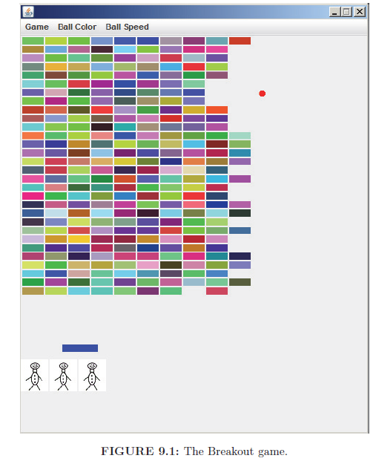
Breakout Game

Slide 8
The Main Class
public class Breakout {
public static void main(String[] args){
BreakoutFrame frame = new BreakoutFrame();
frame.setVisible(true);
}
}
We first create the window. Then we display it by making it visible.
The BreakoutFrame class inherits from the JFrame class.
In other words, we create our own window class. Then we
instantiate it.
Note that the ending the main method does not terminate the
application. It will keep running until there are windows open. In
case of emergency, we can always terminate the program using:
System.exit(0).

Slide 9
Better Version (we will not use it)
public class Breakout {
public static void main(String[] args){
EventQueue.invokeLater(new Runnable(){
public void run(){
BreakoutFrame frame = new BreakoutFrame();
frame.setVisible(true);
}
});
}
}
Java recommends creating new windows in the dispatch thread,
as shown above.
A thread is a mini-process. Creating windows in a separate thread
means that the program will not slow down if a window is slow to
be displayed.
However, we will not create complex windows and will use the simple version.
Transforming the code to use the dispatch tread is straight forward.

Slide 10
BreakoutFrame Class
class BreakoutFrame extends JFrame {
//super();
public static final int HEIGHT = 600;
public static final int WIDTH = 488;
public static final int LOCATION_X = 50;
public static final int LOCATION_Y = 100;
public BreakoutFrame() {
setDefaultCloseOperation(JFrame.EXIT_ON_CLOSE);
setLocation(LOCATION_X, LOCATION_Y);
setSize(WIDTH, HEIGHT);
setResizable(false);
}
}

Slide 11
setDefaultCloseOperation Method
Tells Java what to do when the window is closed using the X in the top right corner.
JFrame.EXIT_ON_CLOSE the program exits.
JFrame.DISPOSE_ON_CLOSE the window is disposed, but the program continues to execute.
JFrame.HIDE_ON_CLOSE the window is made invisible. The program continues to execute, and the window can be made visible by calling setVisible(true).
JFrame.DO_NOTHING_ON_CLOSE The window is not closed and the program does not terminate.

Slide 12
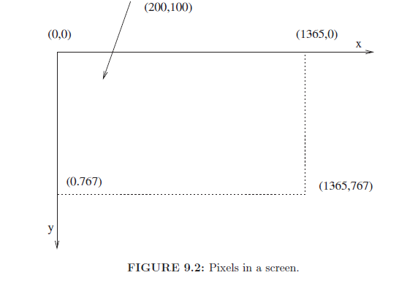
Screen Architecture

Slide 13
Windows Methods
setLocation(x,y): specifies the top left corner of the window in pixels.
setSize(width, height): the size of the window in pixels
setResizable(false): makes the window non resizable.
How to determine current screen resolution? (typical resolution: 1366 x768)
Dimension scrnsize = Toolkit.getDefaultToolkit().
getScreenSize();
System.out.println("The height in pixels is: "+
scrnsize.height);
System.out.println("The width in pixels is: "+
scrnsize.width);

Slide 14
What if I want to draw in the window?
Define an object from a class that inherits JPanel.
Add the object in the window (e.g. in the JFrame)
JPanel has a method:
void paintComponent(Graphics g) - executed whenever the content of the JPanel needs to be repainted.
A JPanel object has the following nice properties:
you can draw on it and
it is a container: i.e., you can insert in it: buttons, labels, scrollbars, other panels, etc.

Slide 15
More on the paintComponent Method
Defined in the JPanel class, can be overriden.
When overriding it, start by calling super.paintComponent(g). This creates a blank window you can draw on.
The method is called whenever the window needs to be redisplayed.
The method can be explicitly called by calling the repaint() method on the JPanel object.
NEVER call the paintComponet() method directly.

Slide 16
Common Misuse of paintComponent
Novice programs often generate data (for example, creating random data) in the paintComponent method.
This is the wrong approach.
The result is that the content of the window will change every time it is resized (i.e., paintComponent method is called).
Correct approach is to use the paintComponent method only to display the data. The actual data is created and modified somewhere else, usually in the other methods of the panel class.

Slide 17
Changing the BreakoutFrame Class
class BreakoutFrame extends JFrame{
BreakoutFrame(){
...
BreakoutPanel panel = new BreakoutPanel();
add(panel);
}
}
The add method adds the panel to the window.
For now, we will add a single panel to a window (read about
multiple panels in Chapter 12).
If we try to add multiple panels, then only the last panel will be
displayed.

Slide 18
class BreakoutPanel extends JPanel {
public static final int NUM_BRICK_ROWS = 10;
public static final int NUM_BRICK_COLUMNS = 30;
private Ball ball = new Ball(Color.red);
private ArrayList<Brick> bricks = new ArrayList<>();
private Paddle paddle = new Paddle(Color.BLUE);
private Player player = new Player();
public BreakoutPanel() {
for (int row = 0; row < NUM_BRICK_ROWS; row++) {
for (int col = 0; col < NUM_BRICK_COLUMNS; col++) {
bricks.add(new Brick(row, col, getRandomColor()));
}
}
}
public Color getRandomColor() {
Color color = new Color((int) (Math.random() * 256),
(int) (Math.random() * 256), (int) (Math.random()*256));
if (getBackground().equals(color)) {
return Color.RED;
}
return color;
}

Slide 19
public void showMessage(String s, Graphics2D g2) {
Font myFont = new Font("SansSerif",
Font.BOLD+Font.ITALIC,40);
g2.setFont(myFont);
g2.setColor(Color.RED);
Rectangle2D textBox = myFont.getStringBounds(s,
g2.getFontRenderContext());
g2.drawString(s, (int)(getWidth()/2 -
textBox.getWidth() / 2),
(int) (getHeight() / 2 - textBox.getHeight()));
}

Slide 20
public void paintComponent(Graphics g) {
super.paintComponent(g);
Graphics2D g2 = (Graphics2D) g;
if (bricks.size() == 0) {
showMessage("YOU WIN!", g2);
} else if (!player.isAlive()) {
showMessage("GAME OVER!", g2);
} else {
ball.draw(g2);
paddle.draw(g2);
for (Brick brick : bricks) {
brick.draw(g2);
}
}
player.draw(g2);
}
}

Slide 21
The paintComponent Method
Calls super.paintComponent(g). This clears the painting area.
Graphics2D g2 = (Graphics2D) g; Created a 2D brush. We will use a 2D brush for drawing.
If there are no bricks, then we display the message YOU WIN.
If the player is dead, that is, they have exhausted all their lives, then we print the message GAME OVER.
Otherwise, we draw the ball, bricks, paddle, and icons for lives.
Note that the draw methods need a 2D brush as input.

Slide 22
Fonts
We can create a Font object and use it for drawing text.
Font myFont = new Font("SansSerif", Font.BOLD + Font.ITALIC,40); Specifies font name, mask, and point size.
Default fonts (always available):
SansSerif
Serif
Monospaced
Dialog
DialogInput
To get all font names that are installed with the Operating System:
String[] fontNames =GraphicsEnvironment.
getLocalGraphicsEnvironment().
getAvailableFontFamilyNames();

Slide 23
Font (cont'd)
Font.PLAIN = 0000 (in binary numbers)
Font.BOLD = 0001
Font.ITALIC = 0010
By adding font masks, we can change text mask, e.g. font and italic.
Of course, we should always use constant (e.g. FONT.BOLD) and never use the number 1. The reason is that the value of the constant may change in future Java implementations.
g2.setFont(font) changes the font of the brush.

Slide 24
Colors
g2.setColor(new Color(20,30,40)); sets red, green and blue on scale: 0 to 255.
We can think of every pixel having three guns: red, green and blue and we can set the intensity of each gun.
Alternatively, g2.setColor(Color.RED) changes color to red.
The setColor method changes the drawing color of the brush.
The getBackground method returns the current background.
The setBackground method changes the current background color.
If we pick a random color for the brick and this is color is the same as the background color, then we make the brick red. This prevents creating invisible bricks.

Slide 25
Drawing a Rectangle
Rectangle2D r = new Rectangle2D.Double(10.23,10.4,11.56,23.34);
g2.draw(r); //draw the rectangle with no fill
g2.fill(r); //fills the rectangle with the current color of brush
Rectangle2D.Double (constructor takes doubles) and Rectangle2D.Float (constructor takes floats) inherit from Rectangle2D.
Of course, drawings with non-integers coordinates cannot be displayed. Java creates an optical illusion by setting neighboring pixels to appropriate colors.
The parameters are: top left corner x coordinate, top left corner y coordinate, width, and height.

Slide 26
Last Two Lines of showMessage Method
Rectangle2D textBox = myFont.getStringBounds(s, g2.getFontRenderContext());
Gets the surrounding rectangle of displaying the s string using the g2 brush.
g2.drawString(s, (int)(getWidth()/2 -
textBox.getWidth() / 2),
(int) (getHeight() / 2 - textBox.getHeight()));
getWidth() will get the width of the panel.
textBox.getWidth() will get the width of the surrounding box of the string.
The drawString method draws the string. The first parameter is the string, while the next two are the coordinates of the bottom left corner of the string as integers.

Slide 27
class Ball {
public static final int SIZE = 10;
public static final int START_X = 200;
public static final int START_Y = 400;
private Color color;
private int x, y;
public Ball(Color color) {
this.color = color;
x = START_X;
y = START_Y;
}
public void draw(Graphics2D g2) {
g2.setPaint(color);
Ellipse2D e = new Ellipse2D.Double(x, y, SIZE, SIZE);
g2.fill(e);
}
}

Slide 28
The Ball Class
The Ball class is responsible for drawing the ball.
Ellipse2D.Double and Ellipse2D.Float inherit from Ellipse2D.
Parameters are the surrounding rectangle (top left corner x, top left corner y, width, and height).
g2.draw(e); draw the ellipse
g2.fill(e); fills the ellipse
Circle is just an ellipse with surrounding rectangle that is a square (equal width and height).

Slide 29
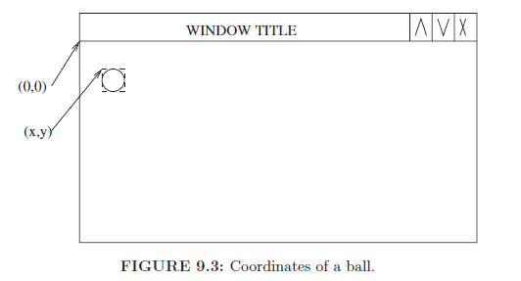
Drawing a Ball
Note that coordinates are relative to the top left corner of the panel
because the drawing happens inside the panel class.

Slide 30
class Paddle {
public static final int WIDTH = 50;
public static final int HEIGHT = 10;
public static final int START_X = 200;
public static final int START_Y = 430;
private Color color;
private int x, y;
public Paddle(Color color) {
this.color = color;
x = START_X;
y = START_Y;
}
public void draw(Graphics2D g2) {
g2.setPaint(color);
Rectangle2D r = new Rectangle2D.Double(x, y, WIDTH,
HEIGHT);
g2.fill(r);
}
}

Slide 31
class Brick{
public static final int HEIGHT = 10;
public static final int WIDTH = 30;
//sets gap between bricks
public static final int BRICK_H_GAP = 2;
public static final int BRICK_V_GAP = 2;
private int x, y;
private Color color;
public Brick(int row, int col, Color color) {
this.color = color;
x = BRICK_H_GAP + row * (BRICK_H_GAP + Brick.WIDTH);
y = BRICK_V_GAP + col * (BRICK_V_GAP + Brick.HEIGHT);
}
public void draw(Graphics2D g2) {
g2.setPaint(color);
Rectangle2D r = new Rectangle2D.Double(x, y, WIDTH,
HEIGHT);
g2.fill(r);
}
}

Slide 32
Other Drawings
Drawing a point:
Point2D p = new Point2D.Double(10,20);
g2.draw(p);
Drawing a line:
Line2D l1 = new Line2D.Double(startPoint,endPoint);
Line2D l2 =new Line2D.Double(10,10,20,20);
g2.draw(l1);
Note that when we draw a rectangle or ellipse, we specify top left corner, width and height. However, when drawing a line, we specify starting point and ending point.

Slide 33
Player Class
class Player {
public static int INITIAL_NUM_LIVES = 3;
public static int IMAGE_DISTANCE = 40;
public static int IMAGE_Y = 450;
private int numLives;
public Player() {
this.numLives = INITIAL_NUM_LIVES;
}
public void killPlayer() {
numLives--;
}
public boolean isAlive() {
return (numLives > 0);
}

Slide 34
Player Class (cont'd)
public void draw(Graphics2D g2) {
try {
Image image = ImageIO.read(new File("player.gif"));
for (int x = 0; x < numLives; x++) {
g2.drawImage(image, x * IMAGE_DISTANCE, IMAGE_Y,
null);
}
} catch (Exception myException) {}
}
}
First red line: reads the image from a file and loads it in the image
variable.
drawImage method: draws the image. The last parameter is an
image observer that is notified as more of the image becomes available.
(we can just write null). The 2nd and 3rd parameter are the top left
corner.

Slide 35
Files and Exceptions (preview)
Topic covered in Chapter 13.
We can specify the name of a file as C:/pictures/picture.gif or
C:\\pictures\\picture.gif (remember that \ means special character).
If we do not specify a directory, then the main project directory is used.
If the file is not found, then an exception is raised.
We cannot ignore the exception by using paintComponent(...) throws Exception. The reason is that the paintComponent method overrides a method that does not throw an exception.
The try/catch syntax handles the exception. The catch block is empty: that is, we do not do anything when an exception occurs.

Slide 36
Summary
We only showed how to display the ball and paddle.
We will show how to move them in the next chapters.
To draw, we need to create a window and a panel inside the window.
We will show how to create multiple panels in the same window in next chapters.
Rectangle2D, Ellipse2D, Line2D, Point2D, and Image are classes that can be instantiated to create objects to be displayed.
We can use the drawString method to draw strings.
All drawing happens in the paintComponent method.
We only show how to draw using a 2D brush (i.e., a Graphics2D object).

